Slide 1

Natural Language Processing,
Self-supervised learning and Transformers
Binxu Wang
Mar. 7th, 2023
Neuro140, Tutorial 4
Notes:
In this tutorial I’d like to cover some topic that has been left out from the lectures or previous tutorials.
It involves natural language processing, self-supervised learning and transformer.
These are all big topics that I can talk about for days or courses.
So this tutorial will function more like a pointer, for you to feel like
“Ah these things are cool, maybe I can use it, or explore these ideas in my project. ”

Slide 2

Part I
Beyond Supervised Learning
How to learn without labelling

Slide 3
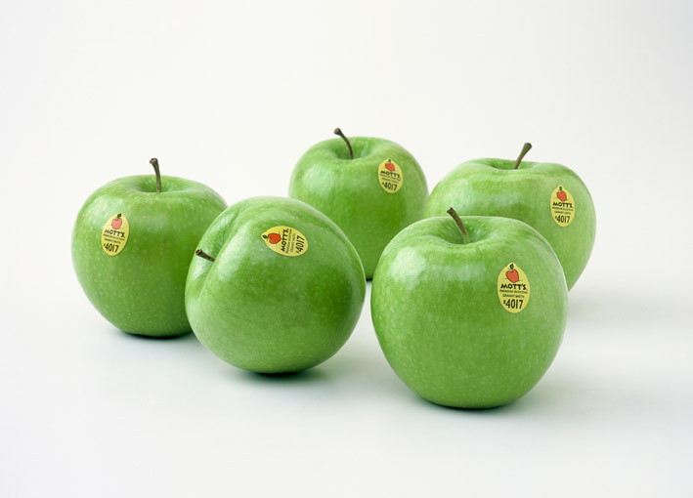
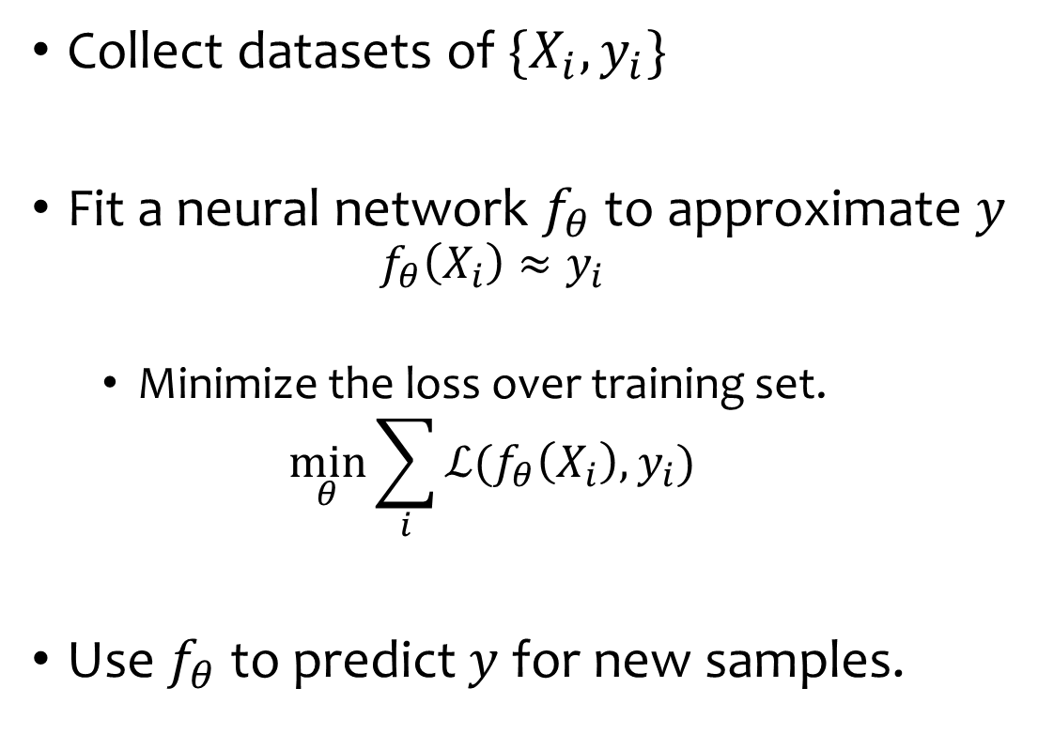

Paradigm of (supervised) machine learning
Collect datasets of $\{X_{i},y_{i}\}$
Fit a neural network $f_{θ}$ to approximate $y$
  $$f_{θ}\left(X_{i}\right)≈y_{i}$$
  Minimize the loss over training set.
  $$\min_{θ}{\sum_{i}{ℒ(f_{θ}\left(X_{i}\right),y_{i})}}$$
Use $f_{θ}$ to predict $y$ for new samples.
Apple, id=5
$$f_{θ}:X→y$$

Slide 4
Where does the supervision (labels) come from ?
Supervision is distilled and denoised human perception.
Labelling takes tremendous amount of human effort.
For some tasks, human don’t have good labels.
  Depth estimation.
14 Million images annotated
10 annotations per images by Mturk workers

Slide 5
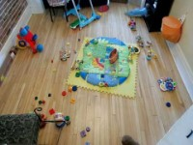
Infants learn without much external supervision…
Infants’ learning of language and vision doesn’t require millions of labels.
They learn from the statistics of the data itself.

Slide 6

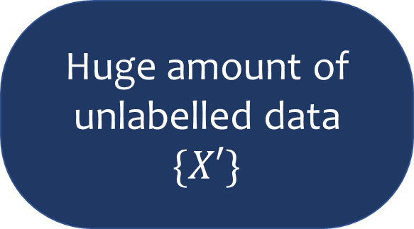
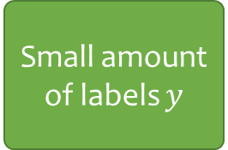

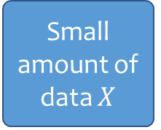
Self-supervised learning paradigm
Self-supervised pre-training
Supervised fine-tuning
Huge amount of unlabelled data $\{X′\}$
Small amount of data $X$
Small amount of labels $y$
$$f_{θ}$$
$$f_{θ}$$
e.g. Raw sensory experience
e.g. Semantic labelling
Biased car
Objective of pretraining
  Learn good representation , s.t.
    downstream tasks can be easily solved on these representations. (e.g. linear decodable)
    with fewer labeled samples

Slide 7

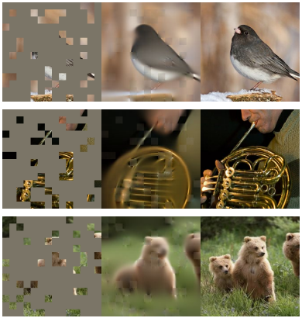
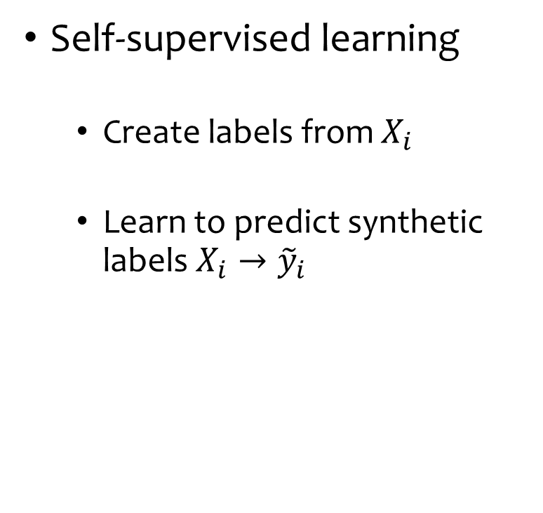
No supervision?
Create supervised tasks and solve them.
Self-supervised learning
  Create labels from $X_{i}$
  Learn to predict synthetic labels $X_{i}→{\tilde{y}}_{i}$
Self-prediction
(Masked Autoencoder)
Contrastive learning
(SimCLR)

Slide 8

Part II
Natural Language Processing 101
Where self-supervised learning triumphed

Slide 9
How to let machine understand language?

Slide 10
Two Pillars of NLP
Representation
Modelling
How to represent language to machines?
How to model language?
Simultaneously solved by ML models, e.g. transformers
Inspired by MIT 6.8610
Notes:
They are some how related and in the end

Slide 11
Representation: Word as Vectors
Unlike pixel, meaning of word are not explicitly in the characters.
Word can be represented as index in dictionary
  But index is also meaningless.
Represent words in a vector space
  Vector geometry ⇒ semantic relation.
  Vector clustering ⇒ semantic similarity
Words in a sentence
I love cats and dogs .
Token Index
328, 793, 3989, 537, 3255, 269
Word Vectors
Notes:
pipe.tokenizer("I love cats and dogs.")

Slide 12
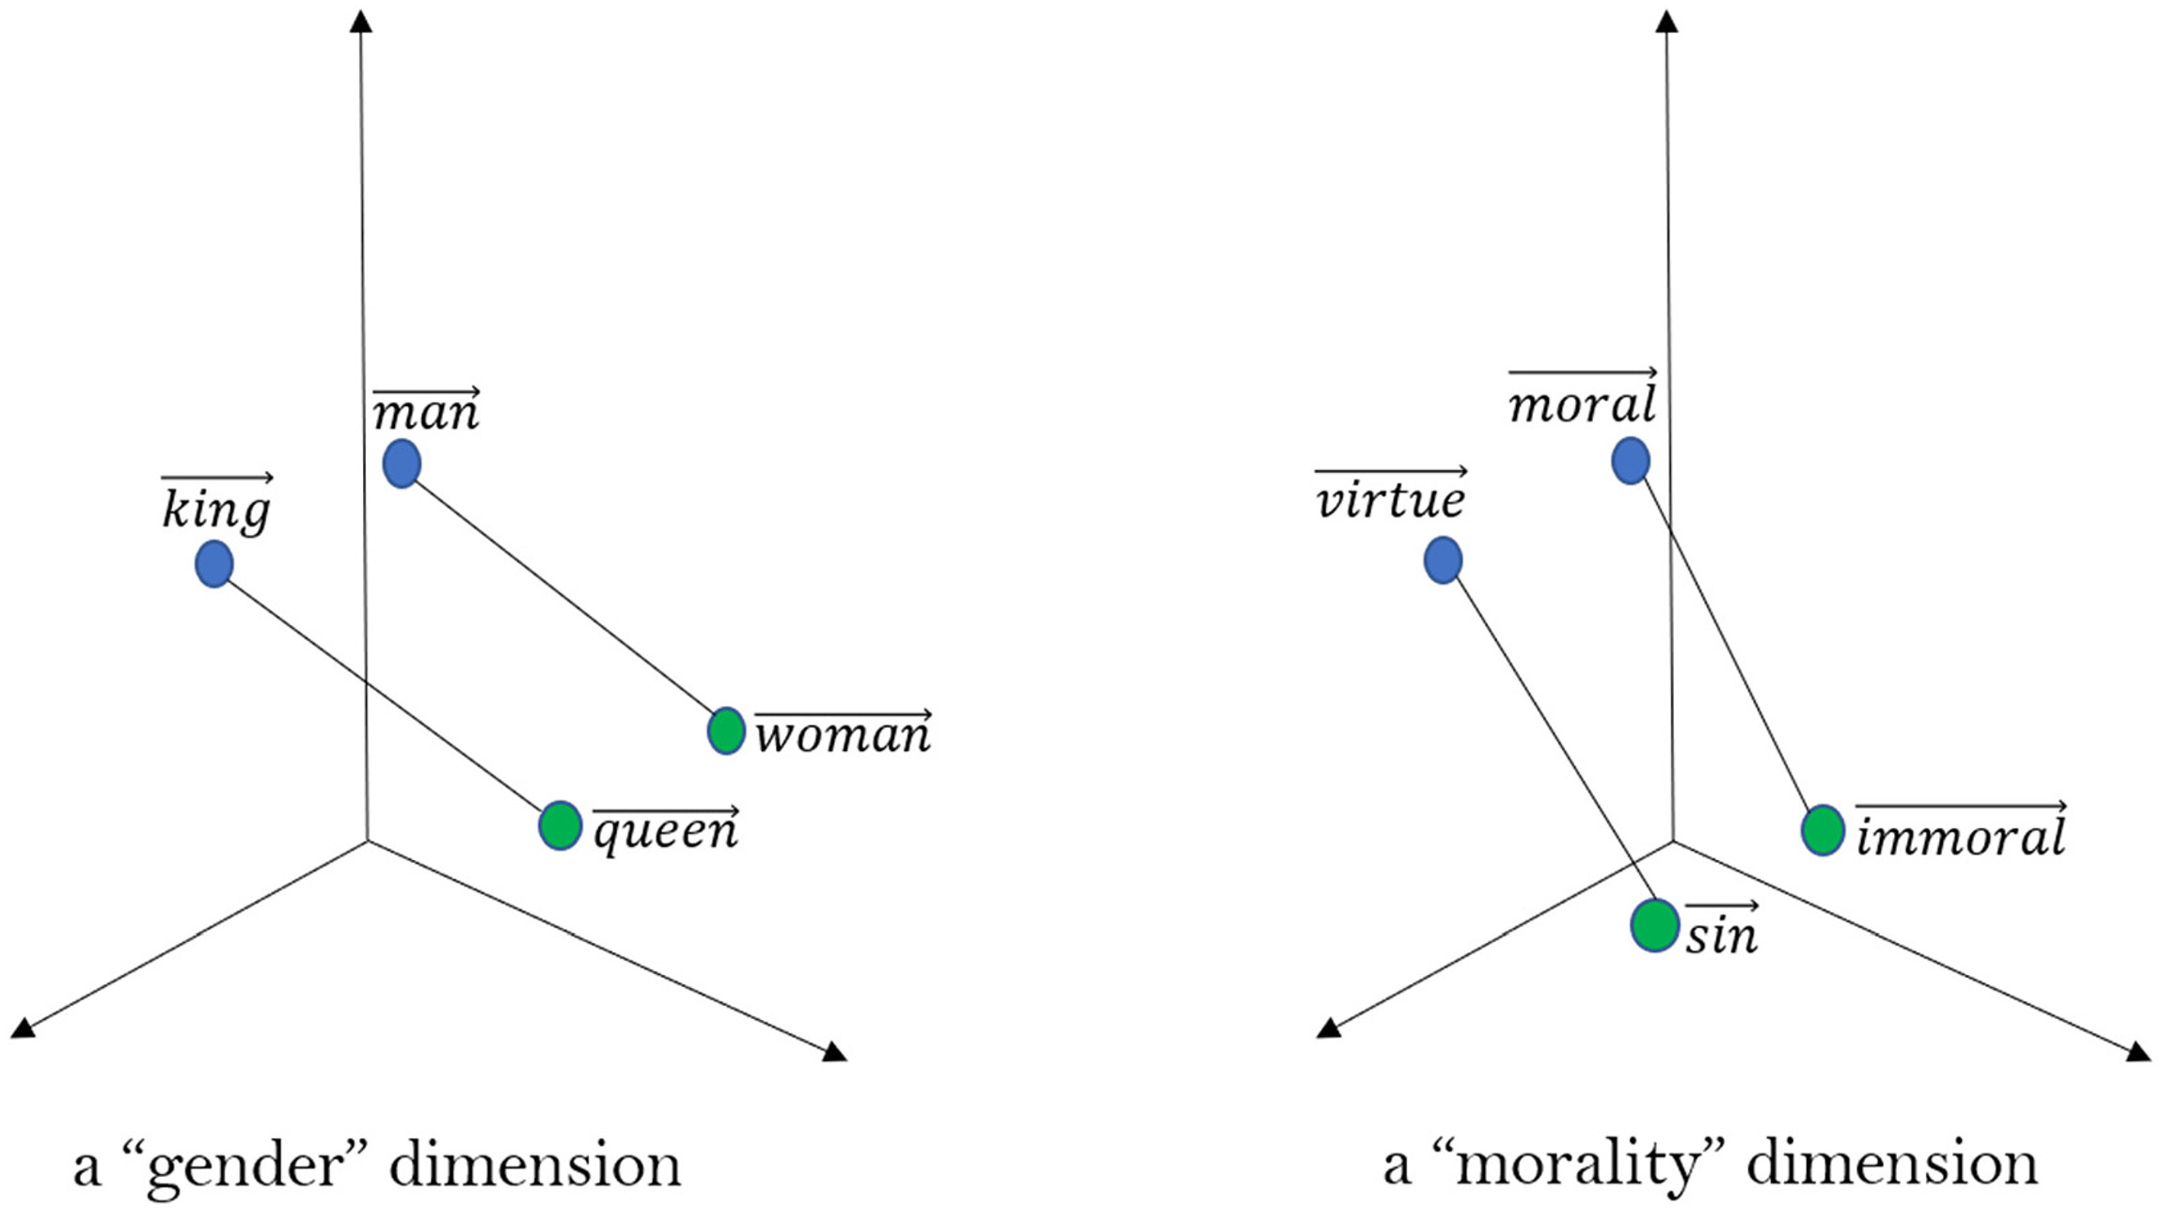
Word as Vectors:
Vector space geometry captures semantic relationship
Arseniev-Koehler, Alina. "Theoretical foundations and limits of word embeddings: what types of meaning can they capture?." Sociological Methods & Research (2021)

Slide 13
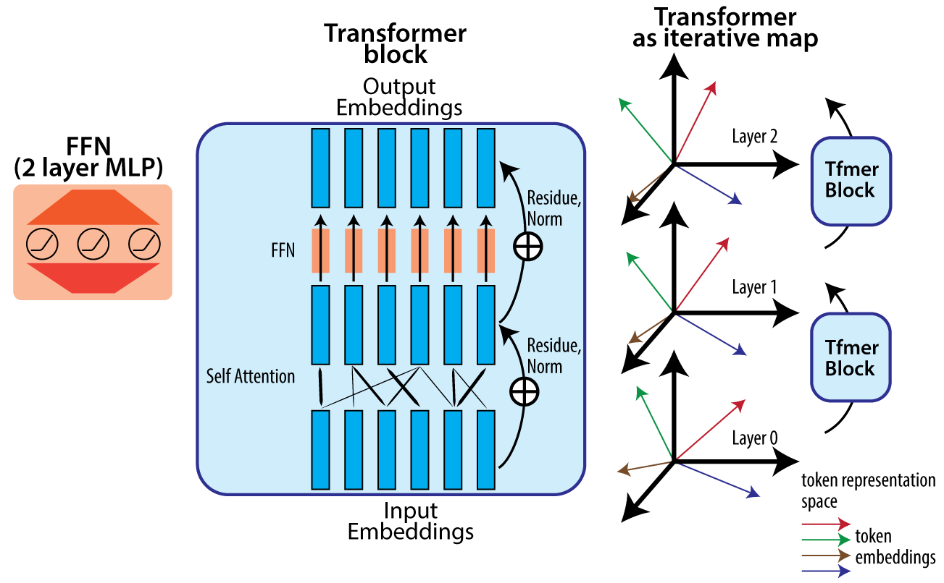
Word Vector in Context:
RNN / Transformers
Meaning of word depends on context.
  “I can buy a can of fish.”
Word vectors should depend on context.
Transformers / RNN let each word “absorb” influence from other words to be contextualized
Transformer
Block
Transformer
Block
More on attention later…
I love cats and dogs .

Slide 14
What type of training leads to good word representation?
Let’s think about some exercises we did when learning a new language.

Slide 15
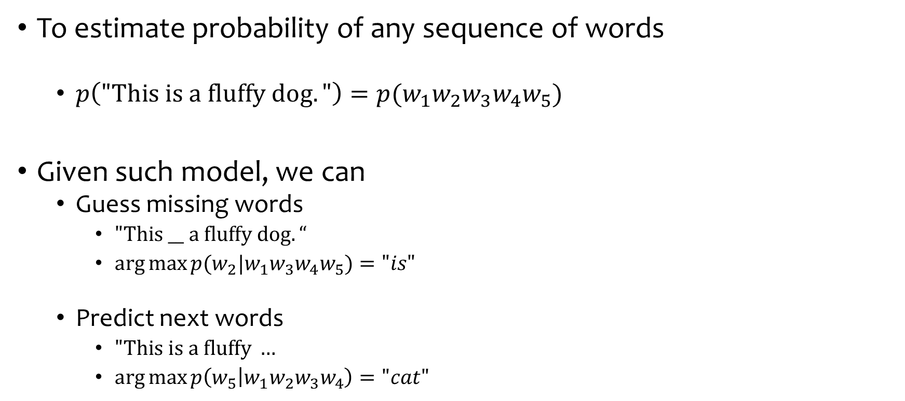
Language modelling
To estimate probability of any sequence of words
  $p\left("This is a fluffy dog."\right)=p(w_{1}w_{2}w_{3}w_{4}w_{5})$
Given such model, we can
  Guess missing words
    $"This __ a fluffy dog.“$
    $\arg{\max{p(w_{2}|w_{1}w_{3}w_{4}w_{5})}}="is"$
  Predict next words
    $"This is a fluffy …$
    $\arg{\max{p\left(w_{5} | w_{1}w_{2}w_{3}w_{4}\right)}}="cat"$
Notes:
To introduce how to train these models, first we’d like to introduce the second pillar
assess conditional prob

Slide 16
Language model can help …
Text generation
  Code completion
  Text summary
  Chat bot
  Translation
  Grammar correction
Text Classification
  Detect spam
  Authorship attribution
Inspired by MIT 6.8610

Slide 17
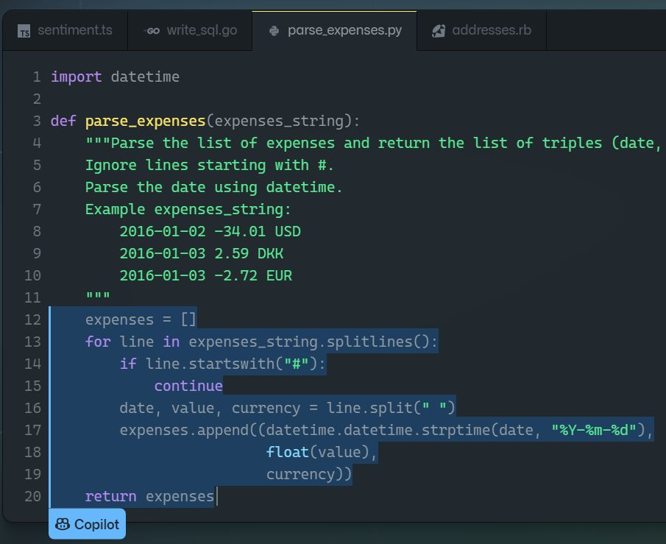
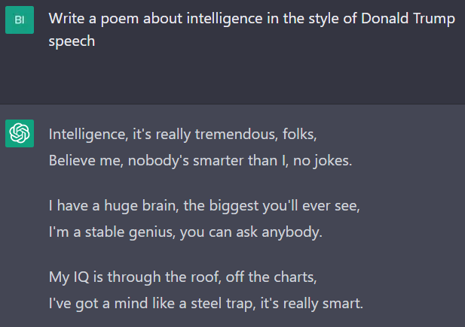
E.g. Github Copilot, ChatGPT

Slide 18
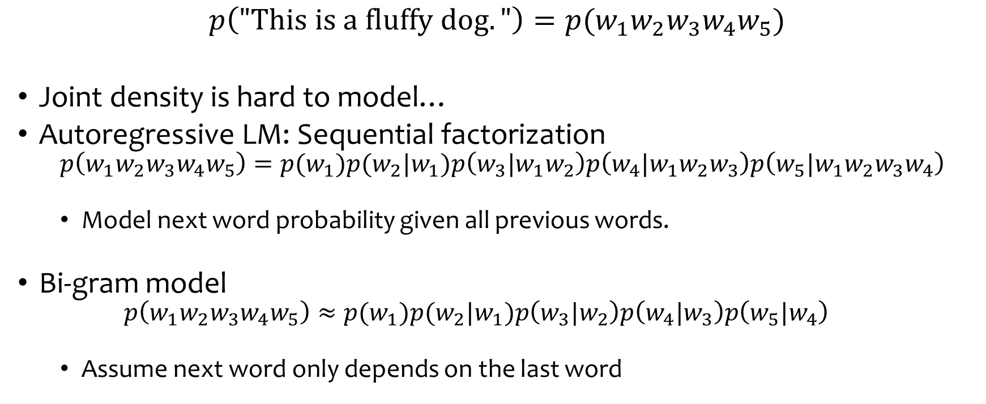
How to learn language model?
$$p\left("This is a fluffy dog."\right)=p(w_{1}w_{2}w_{3}w_{4}w_{5})$$
Joint density is hard to model…
Autoregressive LM: Sequential factorization
  $$p\left(w_{1}w_{2}w_{3}w_{4}w_{5}\right)=p(w_{1})p(w_{2}|w_{1})p\left(w_{3}|w_{1}w_{2}\right)p\left(w_{4}|w_{1}w_{2}w_{3}\right)p\left(w_{5}|w_{1}w_{2}w_{3}w_{4}\right)$$
  Model next word probability given all previous words.
Bi-gram model
  $$p\left(w_{1}w_{2}w_{3}w_{4}w_{5}\right)≈p(w_{1})p(w_{2}|w_{1})p\left(w_{3}|w_{2}\right)p\left(w_{4}|w_{3}\right)p\left(w_{5}|w_{4}\right)$$
  Assume next word only depends on the last word

Slide 19
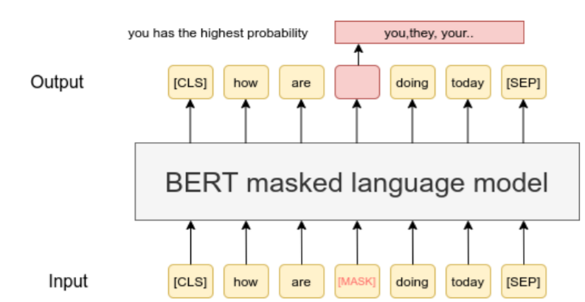
Learning Word Vectors per Language Modelling
BERT, GPT & CLIP
Downstream Classifier can decode:
Part of speech, Sentiment, …
Self-supervised learning of word representation
  Language modelling: predict next word (GPT)
  Masked language modelling: predict missing words (BERT)
  Contrastive Learning: matching image and text. (CLIP)
MLM — Sentence-Transformers documentation (sbert.net)

Slide 20
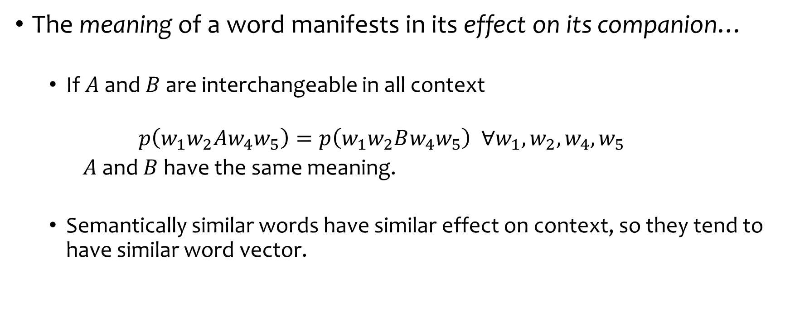
Why language modelling learns good word representation?
The meaning of a word manifests in its effect on its companion…
  If $A$ and $B$ are interchangeable in all context
  $$p\left(w_{1}w_{2}Aw_{4}w_{5}\right)=p\left(w_{1}w_{2}Bw_{4}w_{5}\right) ∀w_{1},w_{2},w_{4},w_{5}$$
  $A$ and $B$ have the same meaning.
  Semantically similar words have similar effect on context, so they tend to have similar word vector.

Slide 21
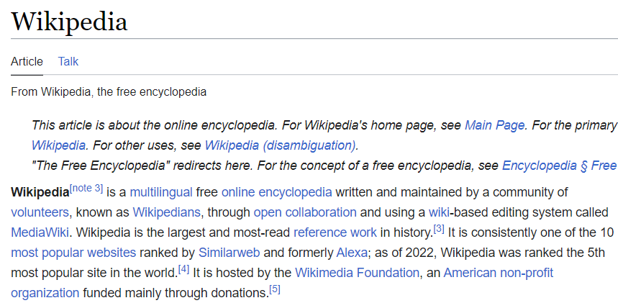
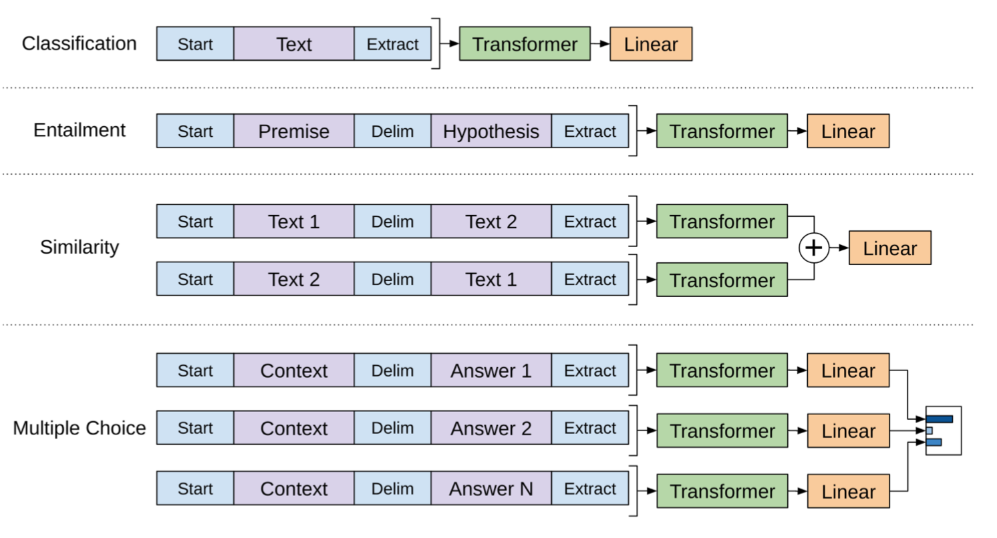
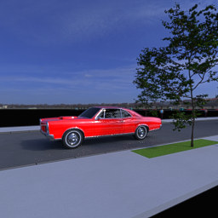
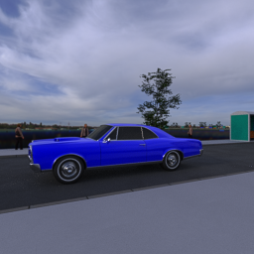
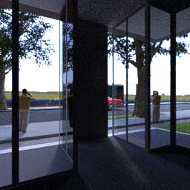
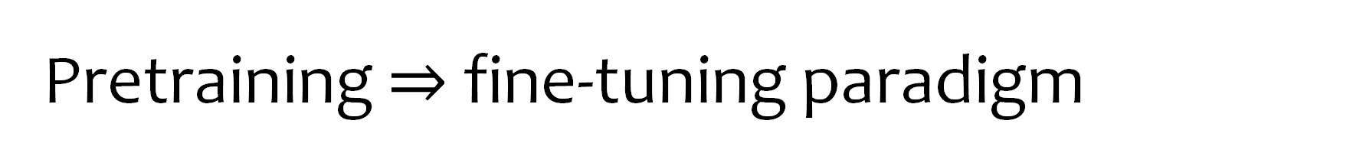
Pretraining $⇒$ fine-tuning paradigm
Vision Model Pretraining:
ImageNet classification
Language Model Pretraining:
Wikipedia-text, Papers, Books…
Downstream usage
Downstream usage
Classification, segmentation etc.

Slide 22
Interim Summary:
Final goal :
  A language model
  A good representation of words, sentence, paragraph.
Model architecture
  RNN (LSTM, GRU), Transformer, etc.
Learning method:
  Self-supervised learning (SSL)
    Language modelling: Predict missing words / next words
  Multi-modal supervision.

Slide 23

Part III
Attention & Transformer

Slide 24









Origin of Attention:
Machine Translation (Seq2Seq)
Original sentence
French Translation
I love cats and dogs .
J'adore
les
chats
et les chiens.
Encoder hidden state
(Word Vectors)
$$e_{1}$$
$$e_{2}$$
$$e_{3}$$
$$e_{4}$$
$$e_{5}$$
$$e_{6}$$
Decoder hidden state
(Word Vectors)
$$h_{1}$$
$$h_{2}$$
$$h_{3}$$
Use Attention to retrieve relevant info from a batch of vectors.
J'adore les chats et les chiens.
我爱猫咪和狗狗。

Slide 25
How to retrieve relevant information?
From dictionary to feature based attention.

Slide 26

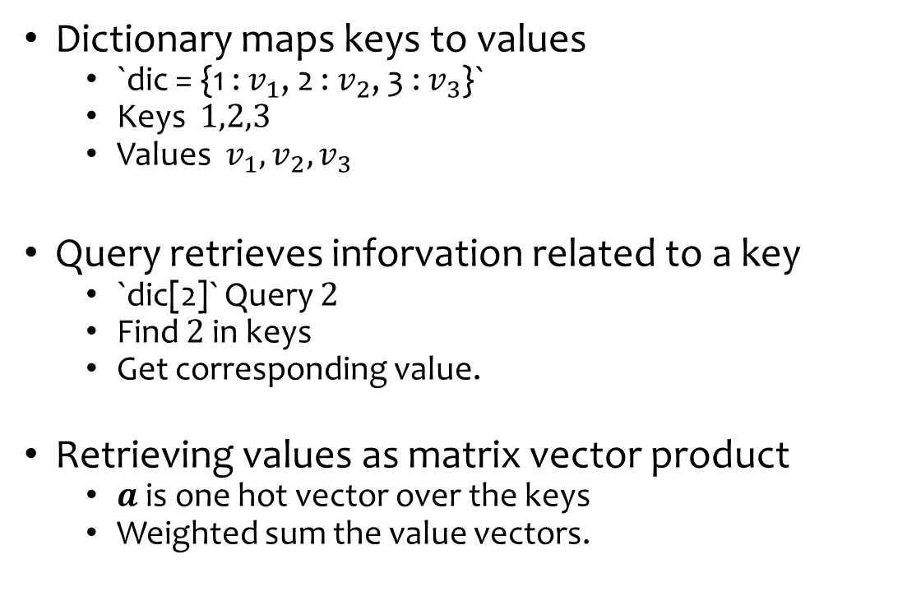








From Dictionary to Attention
Dictionary: Hard-indexing
Dictionary maps keys to values
  `dic = {1 : $v_{1}$, 2 : $v_{2}$, 3 : $v_{3}$}`
  Keys $1,2,3$
  Values $v_{1},v_{2},v_{3}$
Query retrieves inforvation related to a key
  `dic[2]` Query $2$
  Find $2$ in keys
  Get corresponding value.
Retrieving values as matrix vector product
  $a$ is one hot vector over the keys
  Weighted sum the value vectors.
$$1$$
$$2$$
$$3$$
$$v_{1}$$
$$v_{2}$$
$$v_{3}$$
0
$$v_{2}$$
$$×$$
1
$$=$$
0
Notes:
So how to retrieve information from these vectors ?
Let’s first think about one classic datastructure in programming

Slide 27



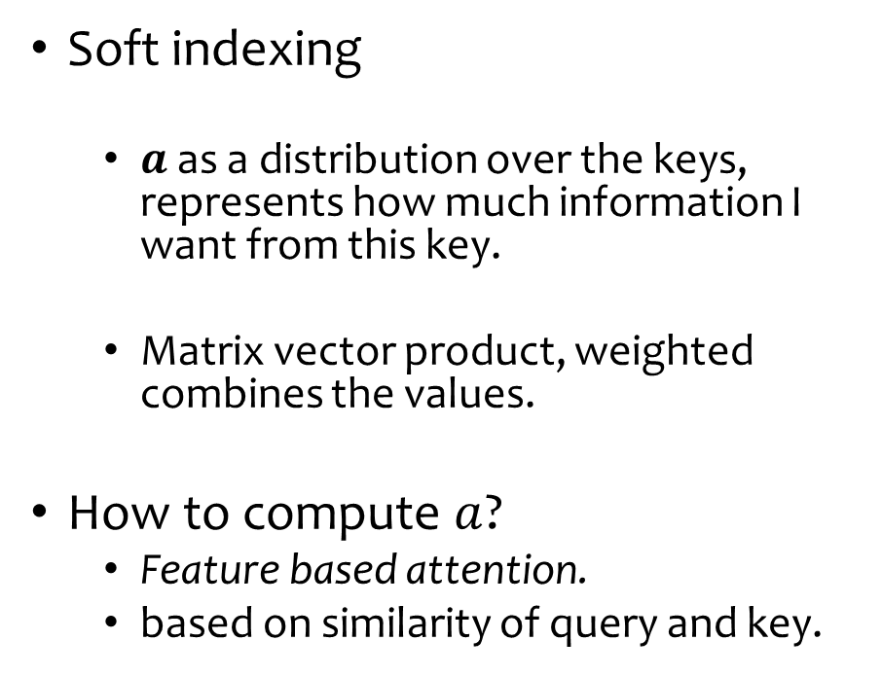













From Dictionary to Attention
Attention: Soft-indexing
Soft indexing
  $a$ as a distribution over the keys, represents how much information I want from this key.
  Matrix vector product, weighted combines the values.
How to compute $a$?
  Feature based attention.
  based on similarity of query and key.
$$1$$
$$2$$
$$3$$
$$v_{1}$$
$$v_{2}$$
$$v_{3}$$
$$0.1$$
$$v_{2}$$
$$v_{1}$$
$$v_{3}$$
$$×$$
$$0.8$$
$$=$$
$$0.1$$
$$0.8$$
$$+0.1$$
$$+0.1$$
Notes:
So how to retrieve information from these vectors

Slide 28
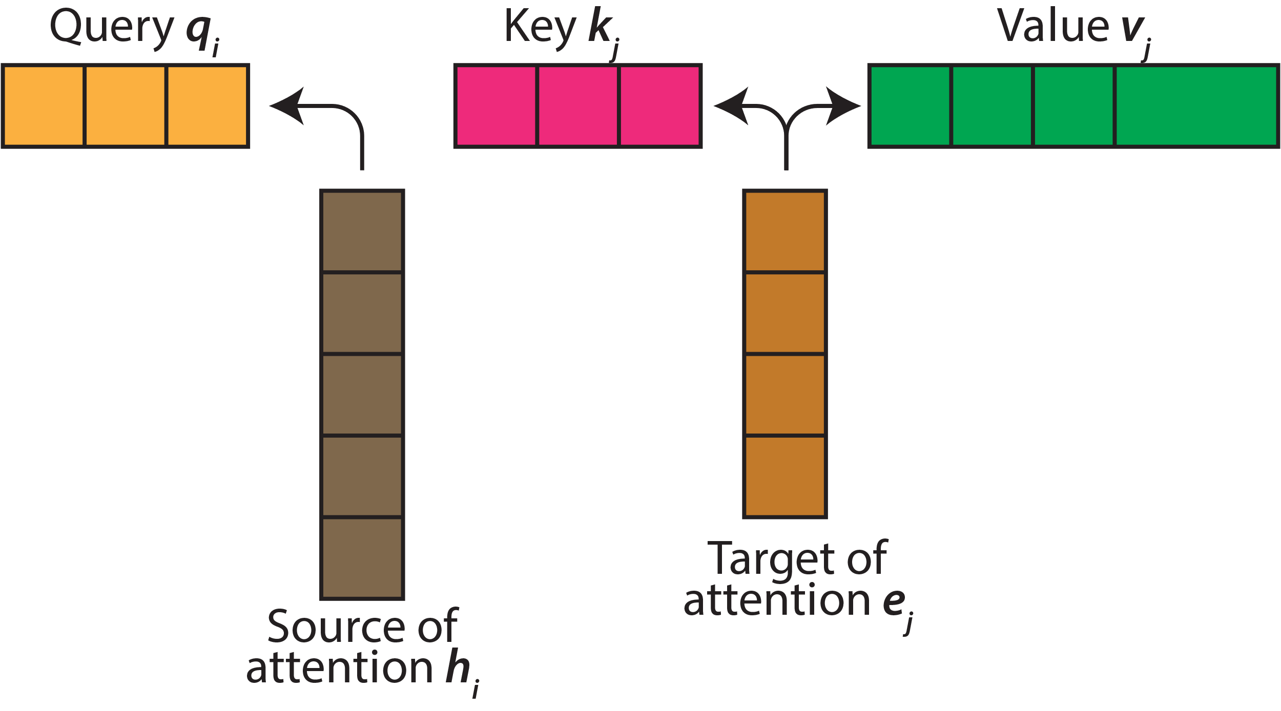
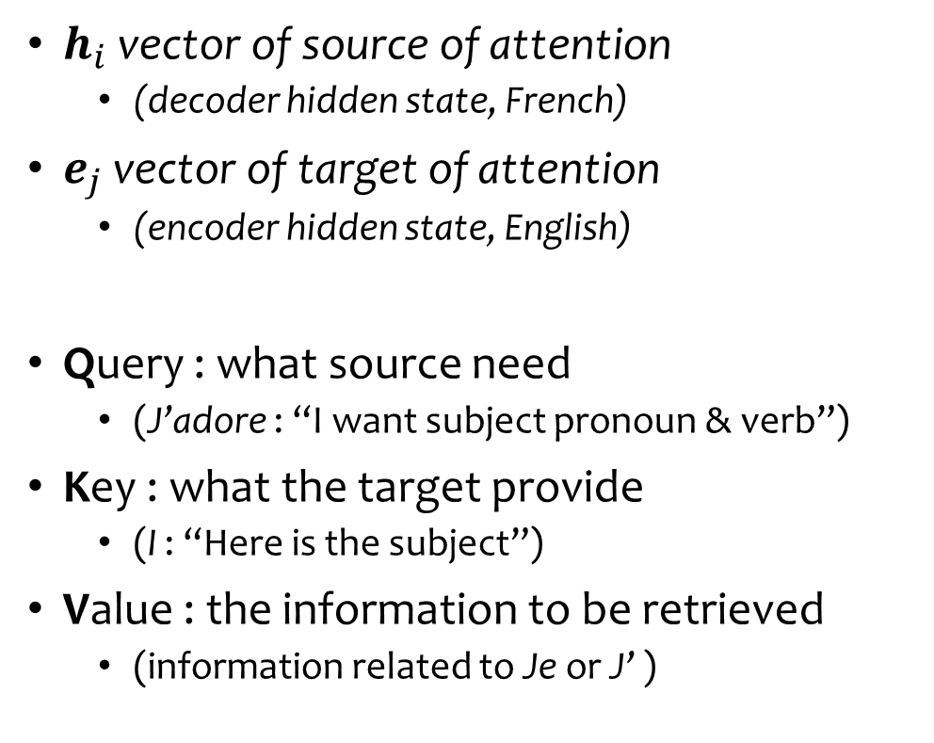
QKV attention
$h_{i}$ vector of source of attention
  (decoder hidden state, French)
$e_{j}$ vector of target of attention
  (encoder hidden state, English)
Query : what source need
  (J’adore : “I want subject pronoun & verb”)
Key : what the target provide
  (I : “Here is the subject”)
Value : the information to be retrieved
  (information related to Je or J’ )

Slide 29
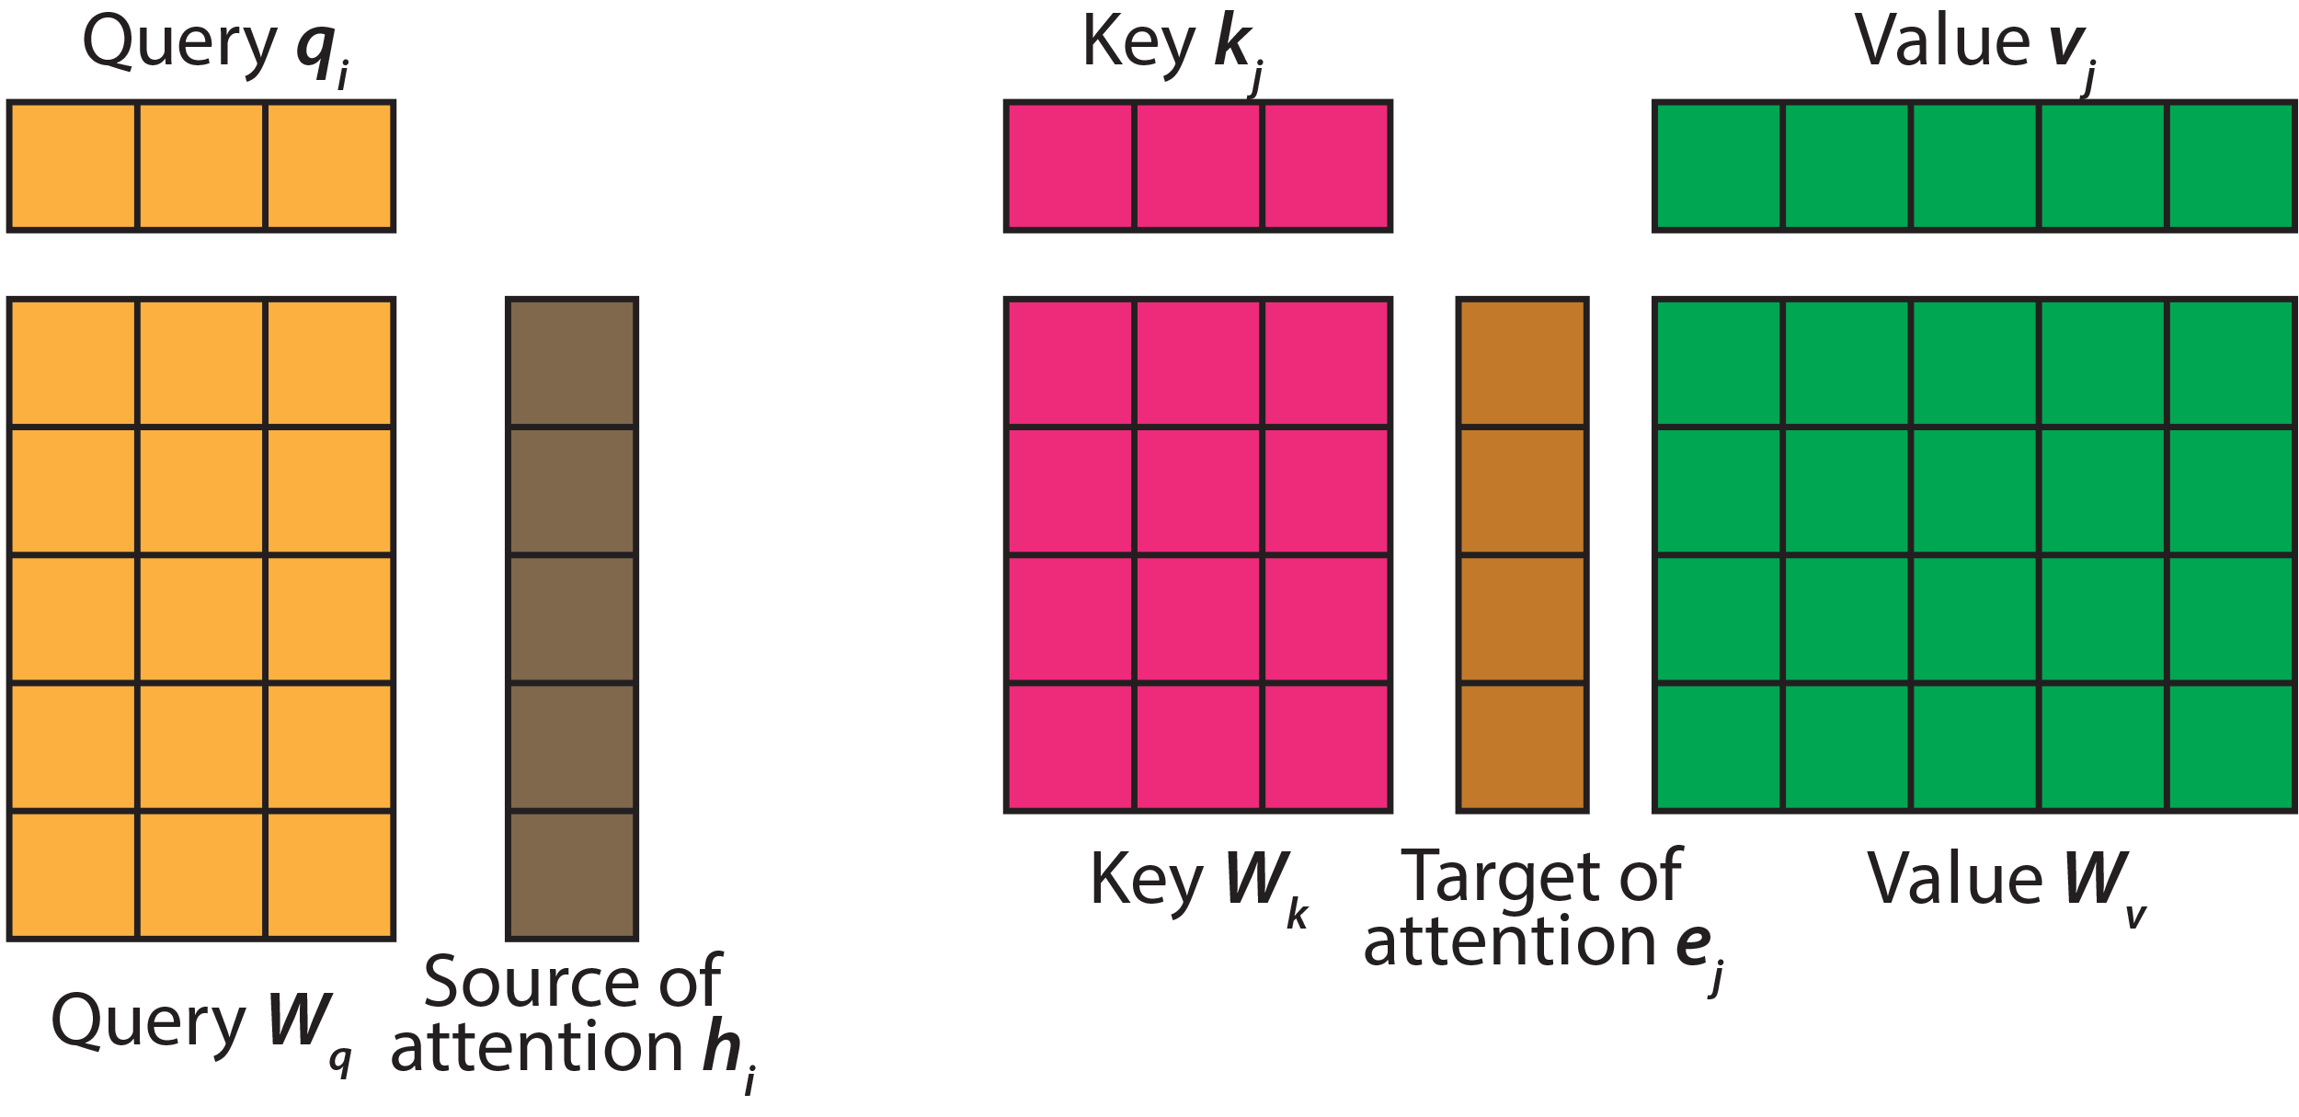
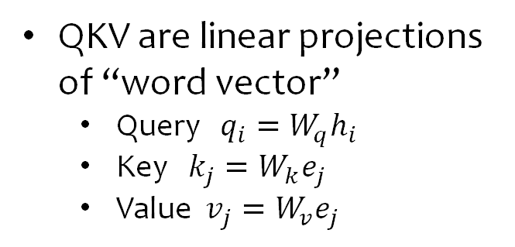
QKV attention
QKV are linear projections of “word vector”
  Query $q_{i}=W_{q}h_{i}$
  Key $k_{j}=W_{k}e_{j}$
  Value $v_{j}=W_{v}e_{j}$

Slide 30
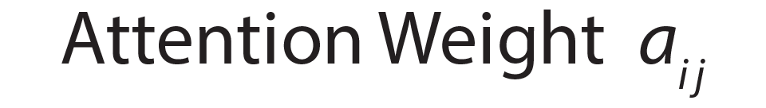

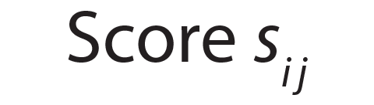

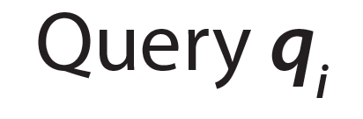
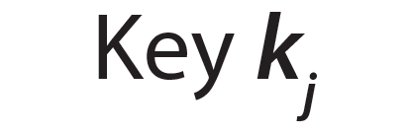


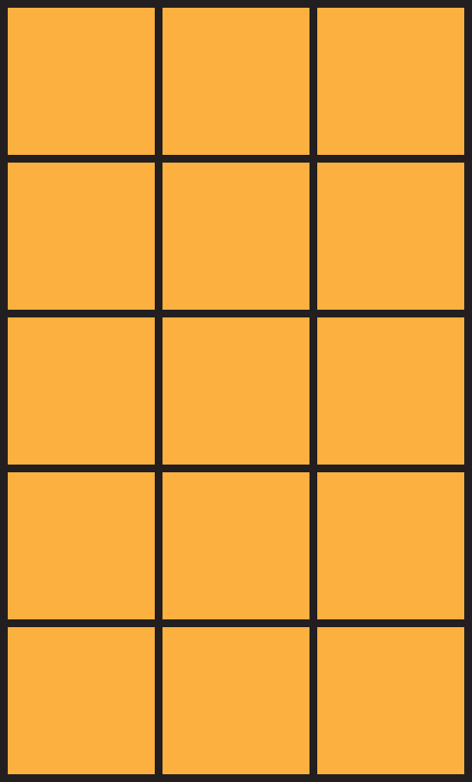



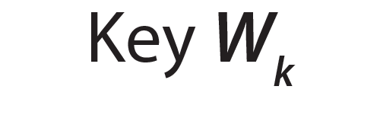
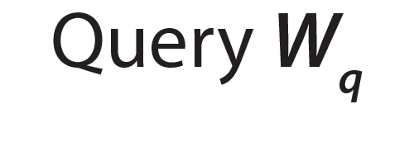
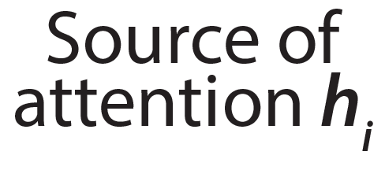
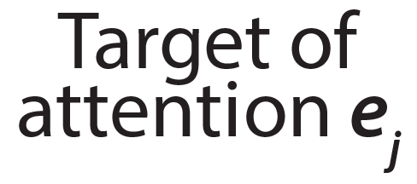

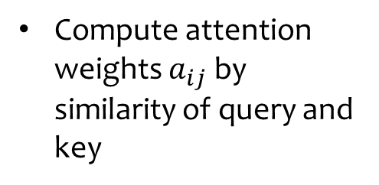
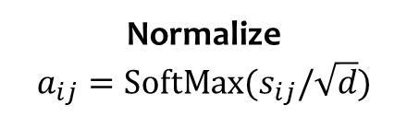
QKV attention
Normalize
$$a_{ij}=SoftMax(s_{ij}/\sqrt{d})$$
Compute attention weights $a_{ij}$ by similarity of query and key
Dot product $q_{i}^{T}k_{j}$

Slide 31

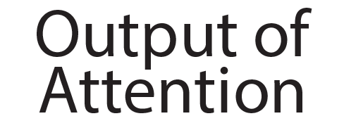

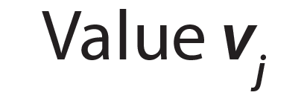
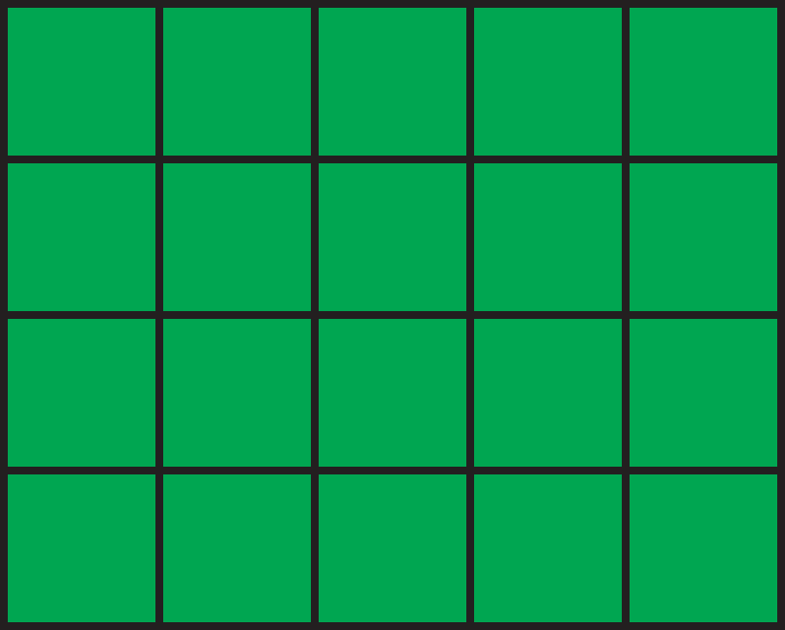
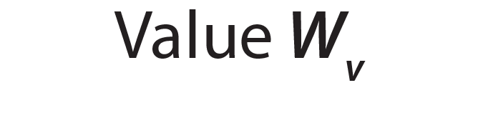
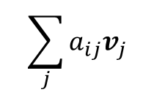
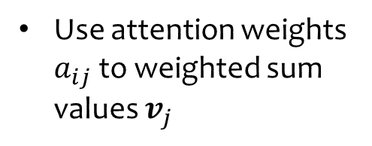
QKV attention
$$\sum_{j}{a_{ij}v_{j}}$$
Use attention weights $a_{ij}$ to weighted sum values $v_{j}$

Slide 32
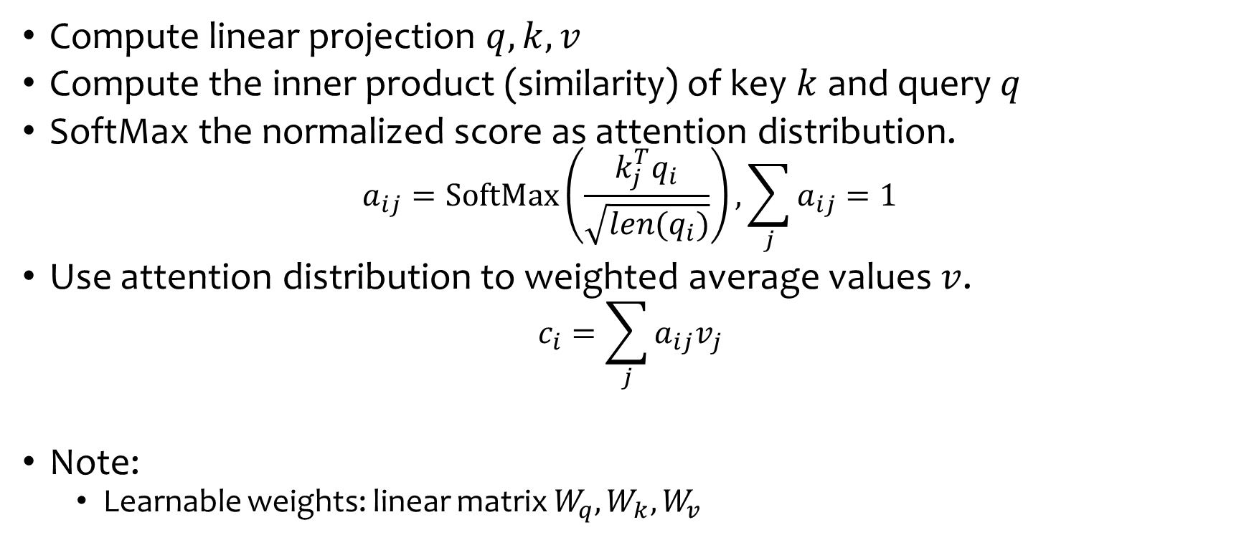
Summary: Attention mechanism
Compute linear projection $q,k,v$
Compute the inner product (similarity) of key $k$ and query $q$
SoftMax the normalized score as attention distribution.
$$a_{ij}=SoftMax\left(\frac{k_{j}^{T}q_{i}}{\sqrt{len(q_{i})}}\right),\sum_{j}{a_{ij}}=1$$
Use attention distribution to weighted average values $v$.
$$c_{i}=\sum_{j}{a_{ij}v_{j}}$$
Note:
  Learnable weights: linear matrix $W_{q},W_{k},W_{v}$

Slide 33
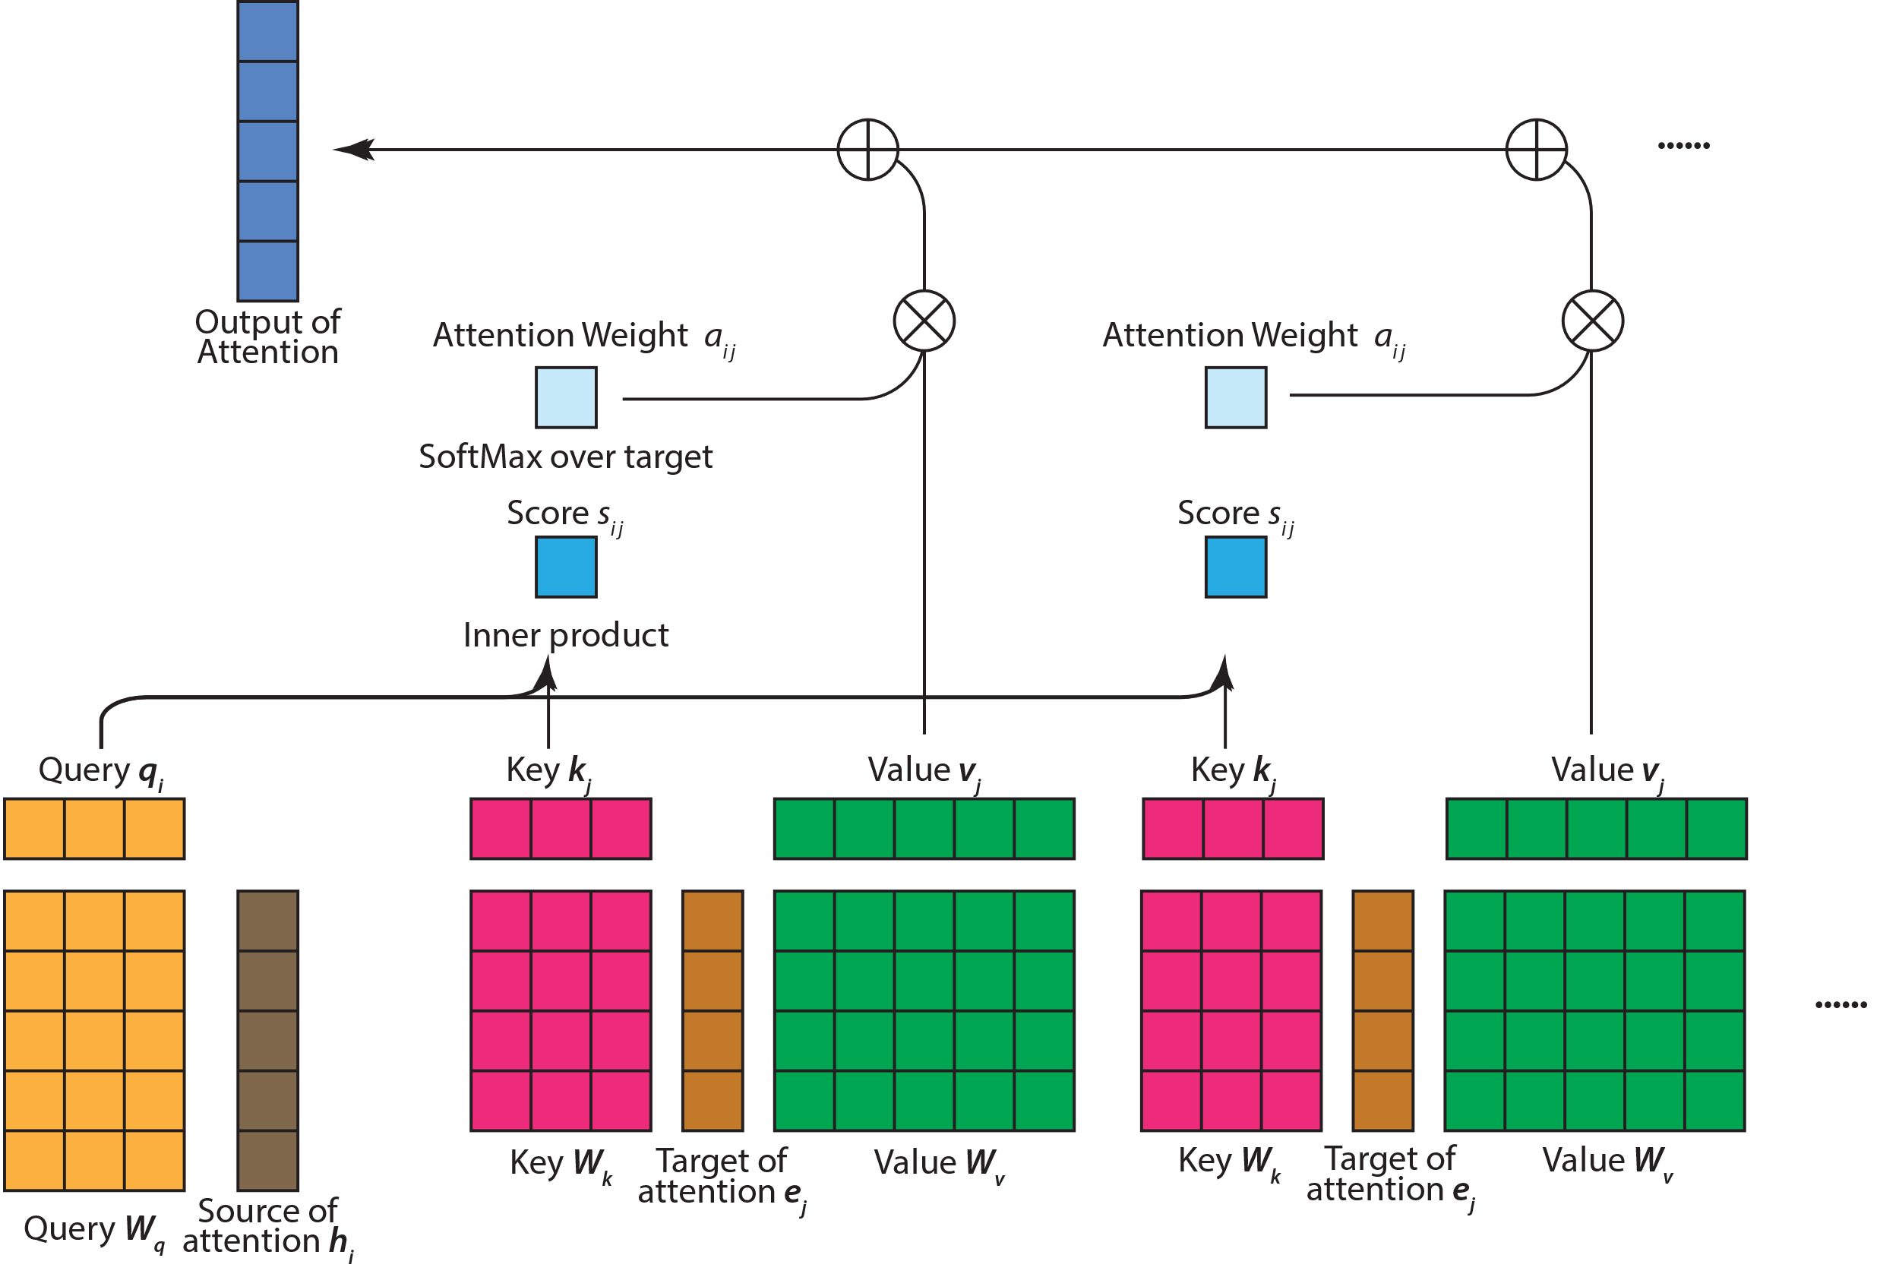
QKV attention

Slide 34
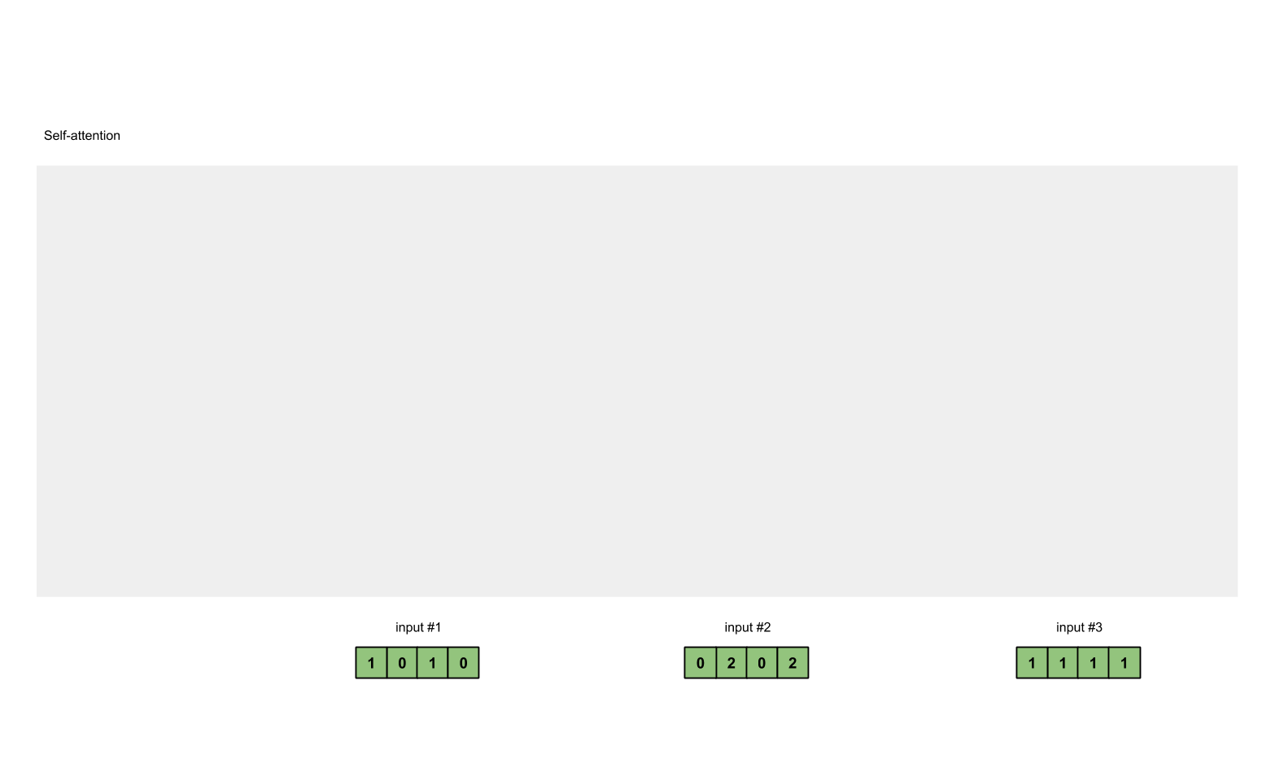

Slide 35
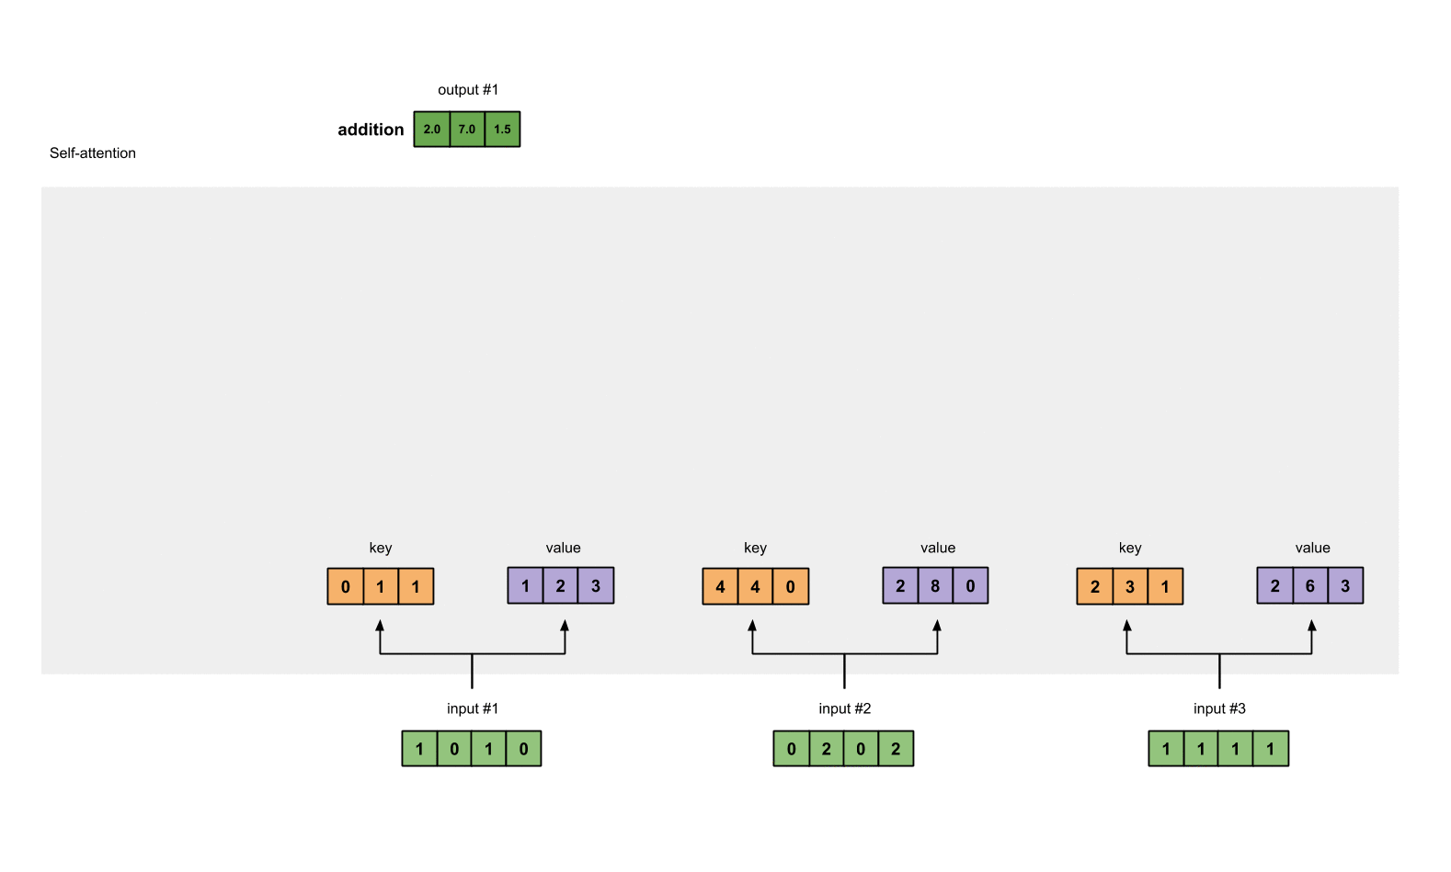

Slide 36

“A robot must obey the order given it.”
https://jalammar.github.io/illustrated-gpt2/

Slide 37

“A robot must obey the order given it.”
https://jalammar.github.io/illustrated-gpt2/

Slide 38

https://jalammar.github.io/illustrated-gpt2/

Slide 39

Illustrated self attention with matrix shape
https://jalammar.github.io/illustrated-transformer/

Slide 40


Illustrated self attention with matrix shape
https://jalammar.github.io/illustrated-transformer/

Slide 41


Visualizing attention matrix $a_{ij}$ after training
Learning to pay Attention
French 2 English
  “la zone economique europeenne” →
  “the European Economic Area”
  “a ete signe” →
  “was signed”
  Attention + RNN
https://jalammar.github.io/visualizing-neural-machine-translation-mechanics-of-seq2seq-models-with-attention/
Notes:
Attent matrix visualized
After training

Slide 42




Cross & Self Attention
Cross Attention
  Source and target are different bunch of vectors (can have different length, number)
  E.g. words in one language pay attention to words in another.
Self Attention ($e_{i}=h_{i}$)
  Source and target are the same bunch of vectors, with same length, number.
French Translation
J'adore
les
chats
Decoder hidden state
(Word Vectors)
$$h_{1}$$
$$h_{2}$$
$$h_{3}$$

Slide 43
From Attention to Transformer
A transformer block has
  Self Attention
  Feed forward network
    E.g. a multi-layer perceptron with 1 hidden layer
  Normalization (Layer normalization)
A transformer model contains N x transformer block

Slide 44
Interim Summary: Attention
Attention allows dynamic routing of information.
  Self attention : Mixing information in one domain
  Cross attention : Fetching information from one domain to the other
Composition of Attention, MLP and Normalization forms Transformers

Slide 45

Part IV
Training language models
Given these models, how to train them?

Slide 46
What type of training leads to good word representation?
Let’s think about some exercises we did when learning a new language.

Slide 47

Masked word prediction / Cloze task:
BERT
Mask out 15% tokens
Predict the mask token from context on both sides.

Slide 48

Next word prediction:
GPT
Each word predict the next word considering all previous words
  Enforcing causal attention.
  Enabling text generation
Autoregressive model, suitable for text generation.
The Illustrated GPT-2

Slide 49

Multimodal representation learning:
CLIP
Learn a joint encoding space for text caption and image
Contrastive learning
  Maximize representation similarity between paired image and caption.
  Minimize representation similarity of other pairs
Transformer
Vision Transformer
CLIP paper 2021

Slide 50

Part V
Transformer Beyond Language
Notes:
The tremendous success of transformer in language domain, diffused into all other domains of AI.
It’s just a super flexible neural architecture that can be embed in any place.

Slide 51
Transformer is a powerful sequence processing tool…

Slide 52






Everything can be formatted as sequence…
Music notes
Audio Signal
Image (as sequence of patches)
Video sequence
Protein sequence
Action sequence in games
https://towardsdatascience.com/transformers-an-exciting-revolution-from-text-to-videos-dc70a15e617b
Notes:
https://torchprotein.ai/tutorial_1
https://towardsdatascience.com/transformers-an-exciting-revolution-from-text-to-videos-dc70a15e617b

Slide 53

Audio transformer
OpenAI, Whisper, 2022
https://openai.com/research/whisper

Slide 54


Music transformer
Huang, Cheng-Zhi Anna, et al. "Music transformer." (2018).
https://magenta.tensorflow.org/music-transformer

Slide 55
Protein sequence

Slide 56

Vision transformers
Patches as tokens / words
Self attention between patch tokens.
Extra [CLASS] token used for classification.
https://towardsdatascience.com/transformers-an-exciting-revolution-from-text-to-videos-dc70a15e617b

Slide 57

Transformers for image generation
Encoded patches discretized as tokens
Transformer model the sequence of tokens
Images decoded from the tokens.
Esser, Patrick, Robin Rombach, and Bjorn Ommer. "Taming transformers for high-resolution image synthesis." CVPR. 2021.

Slide 58


Transformers for Control / Game
Game playing / control as sequence completion
  Interleaved sequence of action, observation $\{s_{0},a_{1},s_{1},a_{2},s_{3},a_{3}\}$ as a sequence of tokens.
  Predict next action from past observation and actions.
Gato, DeepMind, 2022

Slide 59
Attention provides a flexible mechanism to fuse between modalities.
Domain A
Domain B
Modality A & B can be
Image, audio, video, text, action sequence, protein sequence, neural activity time series, …

Slide 60


Perceiver / Perceiver IO:
Transformer for general data perception
General data processing as long as data can be mapped into sequence of vectors
  Use cross attention to fetch information from input
  Self attention to process input.
  Use cross attention to fetch relevant information and send to output.
Jaegle, Andrew, et al. "Perceiver: General perception with iterative attention." ICML, 2021.
Jaegle, Andrew, et al. "Perceiver io: A general architecture for structured inputs & outputs." ICLR, 2021

Slide 61


Slide 62

Transformers are powerful, but …
Think about
  How to represent your signal as a sequence of tokens (image -> sequence)
  Use discrete tokens or continuous token vectors
  $O(N^{2})$ memory cost for long sequence
  Special header / prompt for the sequence
  Training objective.

Slide 63
Recap
Goal of NLP, good representation.
Attention mechanism & Transformers
Self-supervised training objectives (e.g. BERT, GPT, CLIP)
Pre-training and finetuning paradigm.
Application of transformer beyond language. (e.g. Audio, Music, Vision, Game, Control etc.)

Slide 64

Thanks for your listening!

Slide 65
Choice of text encoding
Encoder in Stable Diffusion: pre-trained CLIP ViT-L/14 text encoder
Word vector can be randomly initialized and learned online.
Representing other conditional signals
  Object categories (e.g. Shark, Trout, etc.):
    1 vector per class
  Face attributes (e.g. {female, blonde hair, with glasses, …}, {male, short hair, dark skin}):
    set of vectors, 1 vector per attributes
Time to be creative!!

Slide 66

Conditional Diffusion Models
Instead of sampling from $p\left(x\right)$, sampling from $p\left(x | y\right)$
If $x$ is an image, examples:
  $y$ is an object category $→$ generating images of that object (cf. BigGAN)
  $y$ is text prompt $→$ generating images corresponding to a prompt
  $y$ is an image $→$ generating similar images with variation.
  $y$ is a semantic map $→$ generating images with spatially different semantic content
  $y$ is part of an image $→$ generating inpainting or outpainting given the context.

