Slide 1
Brief Conceptual Review for HW1
Intro to Computational Neuroscience
Section 4
Binxu Wang
Oct. 4th, 2021

Slide 2
Our Question
In a neural system, we want to know what the neurons "care about" in the environment.
  Problem 1, Auditory cortex neuron ~ auditory input.
  Problem 2, Medial Entorhinal Cortex neurons ~ location, speed, body configuration.
Notes:
It’s generally helpful to think about what to do first and then dive into the code.
Though this is a iterative process. Knowing what tools are available to solve the problem will also help you think and devise your way.

Slide 3
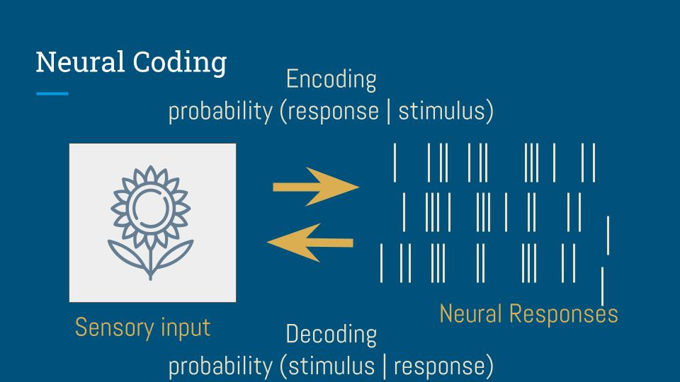
Big Picture
Ella’s jupyter book

Slide 4
What’s in our pocket?
Spike triggered average
  Tools: Align the environment to spikes, and average it.
Encoding: Linear Nonlinear model
  Tools: generalized linear model, likelihood, MLE, optimization
Decoding: Linear decoding
  Tools: regression, cost function, least square

Slide 5
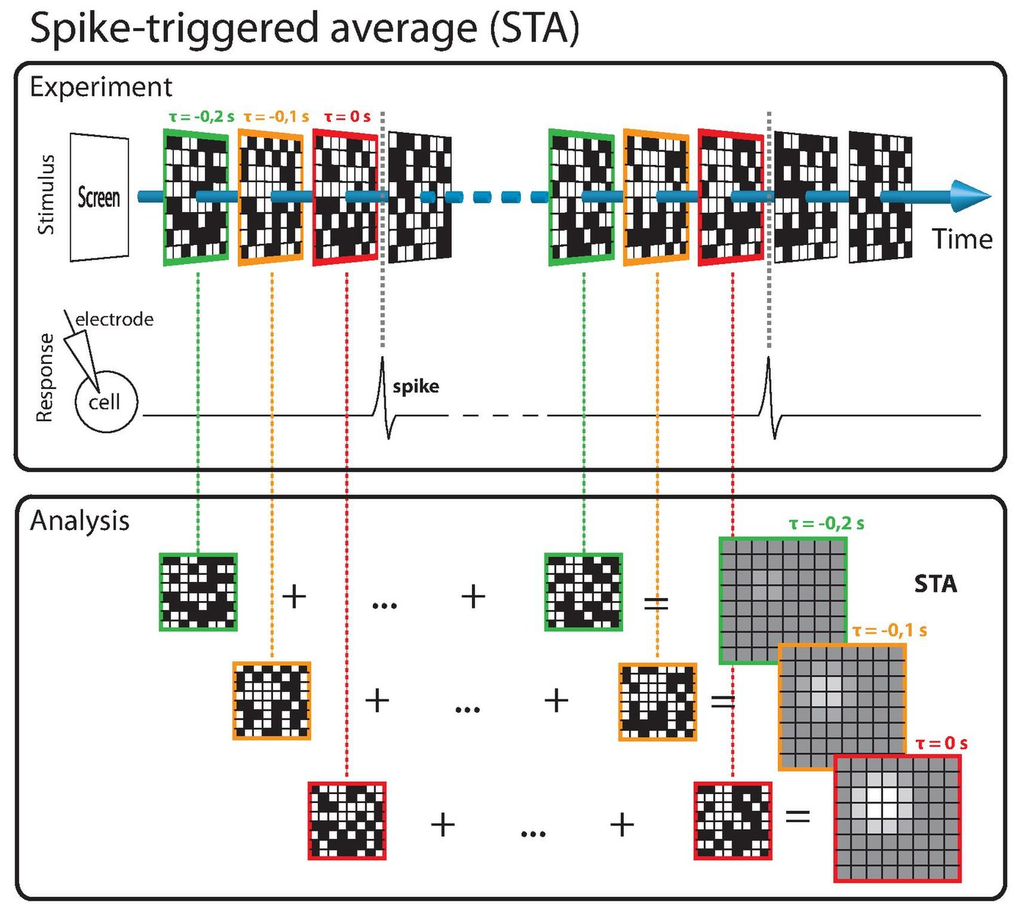
STA
(Problem 1, f, g)
Average the (stimulus) context of a spike
  Movie frames, sound waves, spectrogram, location ……
What’s the requirement for stimulus to use STA?
  Independent and identially distributed (i.i.d. )
  White noise

Slide 6
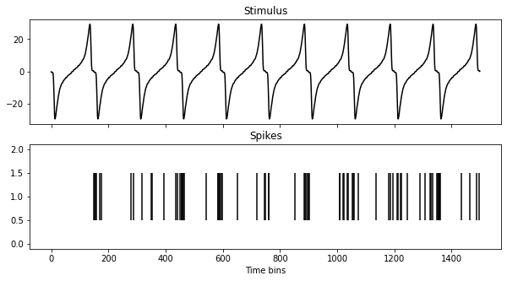
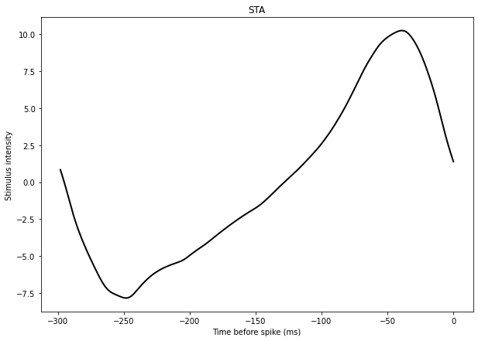
A Counter Example
Natural stimuli are highly correlated, hard for STA to work! (think about face and eyes)
Ella’s jupyter book

Slide 7
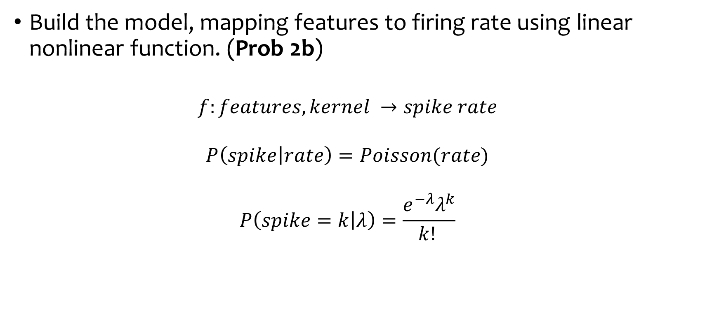
Encoding model: LNP
Build the model, mapping features to firing rate using linear nonlinear function. (Prob 2b)
  $$f:features,kernel →spike rate$$
  $$P\left(spike | rate\right)=Poisson(rate)$$
  $$P\left(spike=k | λ\right)=\frac{e^{−λ}λ^{k}}{k! }$$

Slide 8

Encoding model: LNP
Calculate the negative log likelihood, use the model above, (Prob 2c)
  $$ℒ\left(kernel;features,spike\right)=−log P\left(spikes | rate\right)$$
  $$=−\log{P(spikes|f(featuers,kernel))}$$

Slide 9
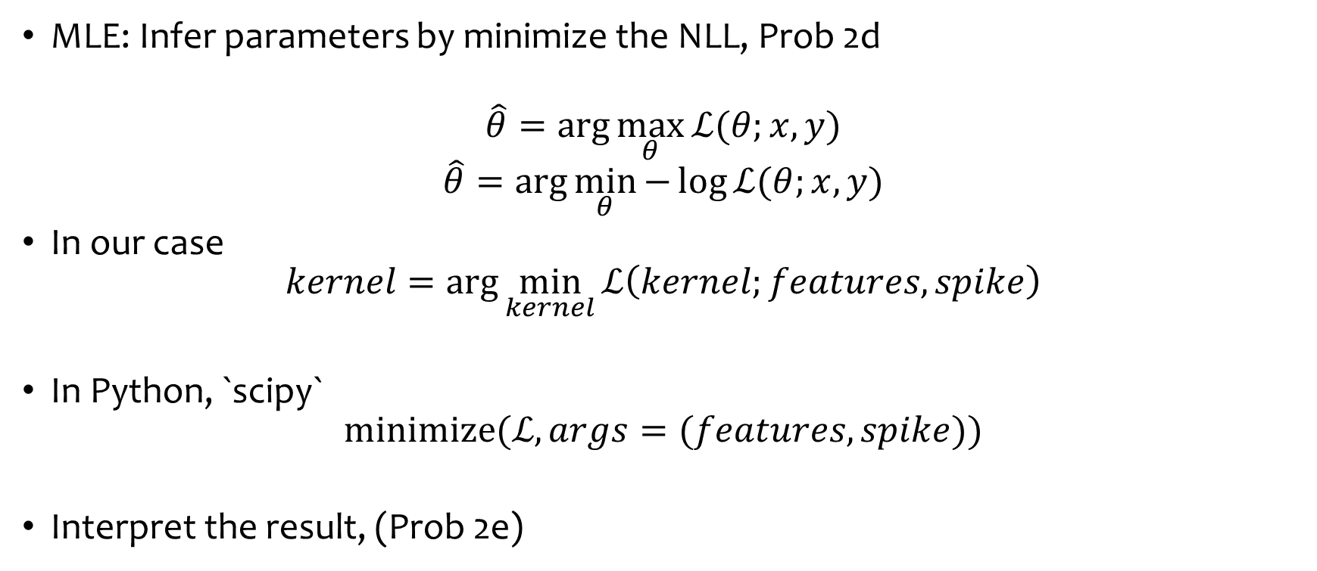
Encoding model: LNP
MLE: Infer parameters by minimize the NLL, Prob 2d
$$\hat{θ}=\arg{\max_{θ}{ℒ(θ;x,y)}}$$
$$\hat{θ}=\arg{\min_{θ}{−\log{ℒ(θ;x,y)}}}$$
In our case
$$kernel=\arg{\min_{kernel}{ℒ\left(kernel;features,spike\right)}}$$
In Python, `scipy`
$$minimize(ℒ, args=(features,spike))$$
Interpret the result, (Prob 2e)

