Slide 1
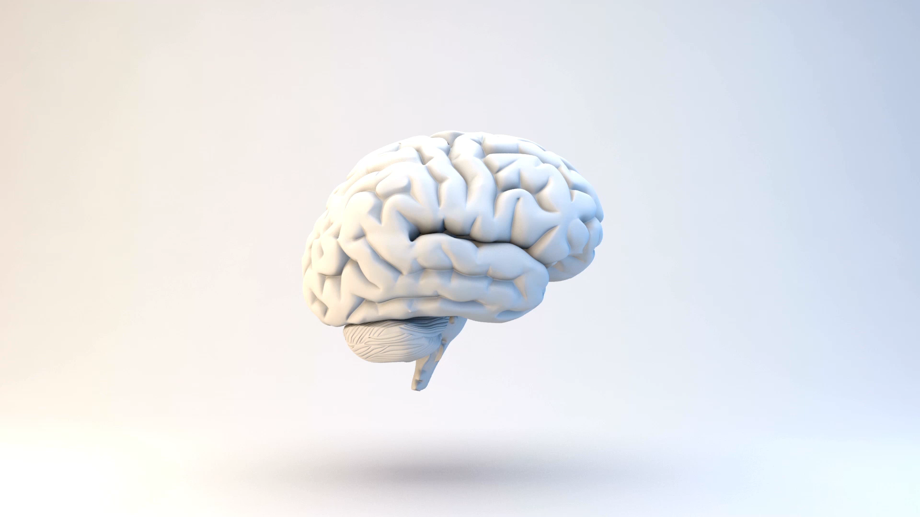
PCA, Decoding, and Early Vision
Neuro120 Review Section 5
Binxu Wang
Oct.18th
Notes:
Similarly, I’ll review relevant concepts to HW2

Slide 2
Outline
Neural Decoding (P2)
  Math: Linear regression
Dimensionality reduction (P1)
  Math: PCA
Model of early vision (P3)
  Math: DoG kernel, Convolution, Padding etc.

Slide 3







Linear Regression (P2)
Our model
Given data and target => weight
Given data and weight => “predicted” response
$$y=Xw+ε$$
$⇒$
$$y$$
$$X$$
$$w$$
Fitting, Learning, Training …
$$=$$
Weights / parameter
$⇒$
Prediction, Inference, Forward …
Response / Target
Predictor data / Regressor
Notes:
In our case,

Slide 4
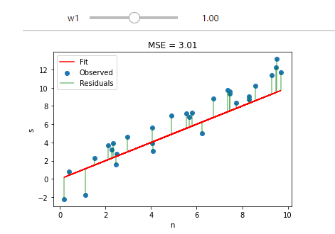

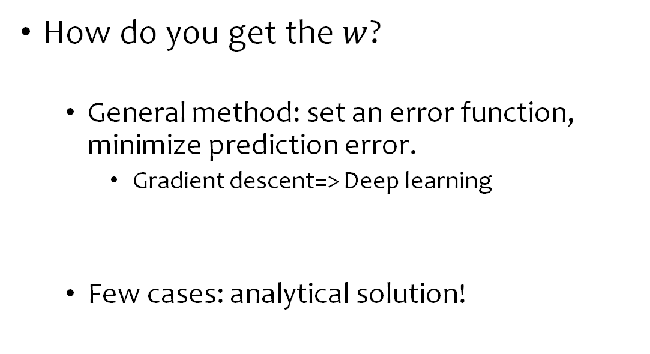
Linear Regression (P2)
How do you get the $w$?
  General method: set an error function, minimize prediction error.
    Gradient descent=> Deep learning
  Few cases: analytical solution!
$$\arg{\min_{w}{{ \left\|Xw−y\right\|}_{2}^{2} }}$$

Slide 5

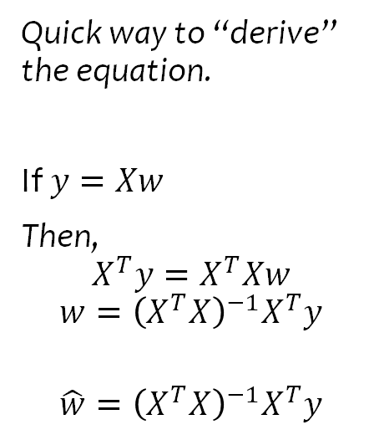



Solution to Ordinary Least Square
$$\hat{w}={\left(X^{T}X\right)}^{−1}X^{T}y$$
Quick way to “derive” the equation.
If $y=Xw$
Then,
$$X^{T}y=X^{T}Xw$$
$$w={\left(X^{T}X\right)}^{−1}X^{T}y$$
$$\hat{w}={\left(X^{T}X\right)}^{−1}X^{T}y$$
$$−1$$
$$\hat{w}$$
$$=$$
Notes:
Actually this solution is the same as that of maximum likelihood estimation.

Slide 6
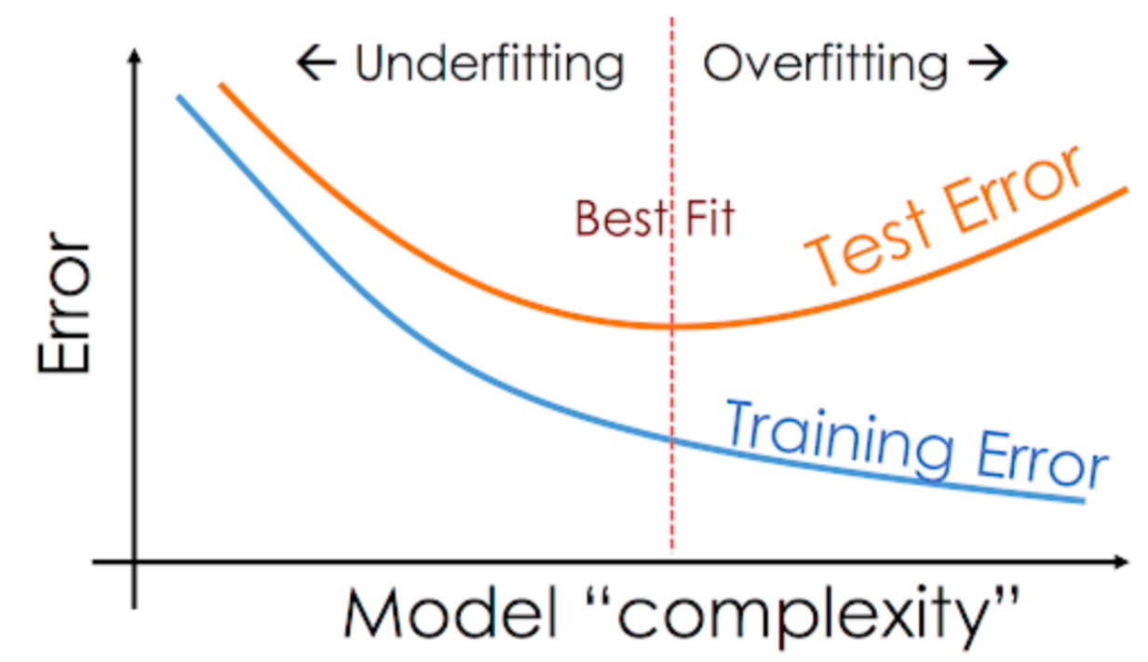
Importance of Train-Test Split
Why do we separate the test set?
  Test error do not always follow training error.
  Key for model / parameter selection (not showed)
  What about PCA ?
Notes:
Model do not always perform the same in training set, test set !
It’s like you do not always have the same performance for homework vs exams; work vs school.
* You study too hard and find a trick that works for homework but not for exams

Slide 7
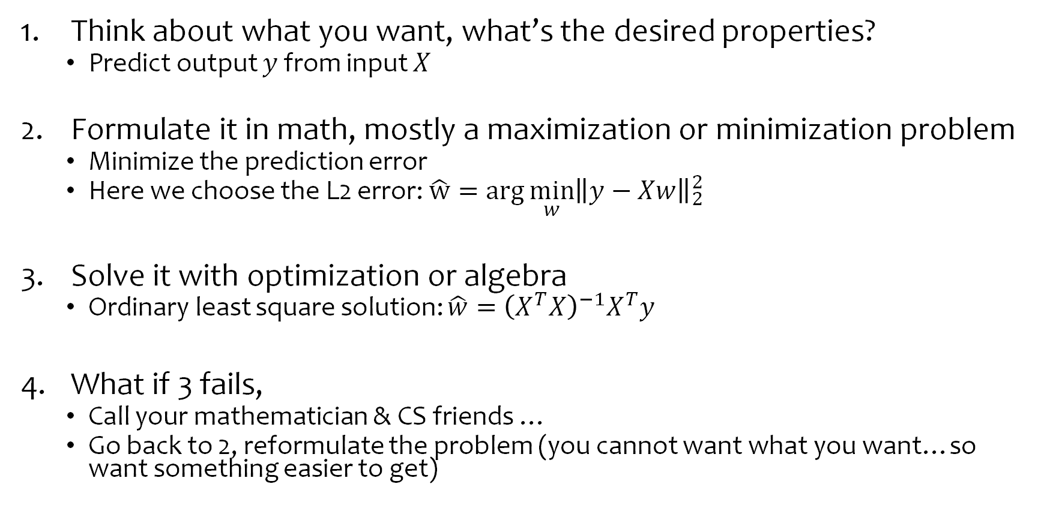
Meta-note on devising analysis methods
LNP, Regression, PCA, deep learning …
Think about what you want, what’s the desired properties?
  Predict output $y$ from input $X$
Formulate it in math, mostly a maximization or minimization problem
  Minimize the prediction error
  Here we choose the L2 error: $\hat{w}={\arg{\min_{w}\left\|y−Xw\right\|}}_{2}^{2}$
Solve it with optimization or algebra
  Ordinary least square solution: $\hat{w}={\left(X^{T}X\right)}^{−1}X^{T}y$
What if 3 fails,
  Call your mathematician & CS friends …
  Go back to 2, reformulate the problem (you cannot want what you want…so want something easier to get)

Slide 8
Forms of Neural Code
Rate vs Temporal Coding
Neural Doctrine vs Population Doctrine
  Functional unit
Notes:
Population code, you can decode information from multiple neurons not single ones.
Emergent properties of population code but not single.
Individual neurons may not be nicely interpretable.

Slide 9
Mixed Selectivity and Interpretability

Slide 10
Why Dimension Reduction? (P1)
Why: Find lower dimension representation that
  Preserve information for analysis, visualization
  Compress data
  Assist downstream analysis tasks.
It’s possible because
  Correlation

Slide 11
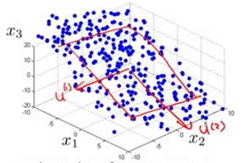
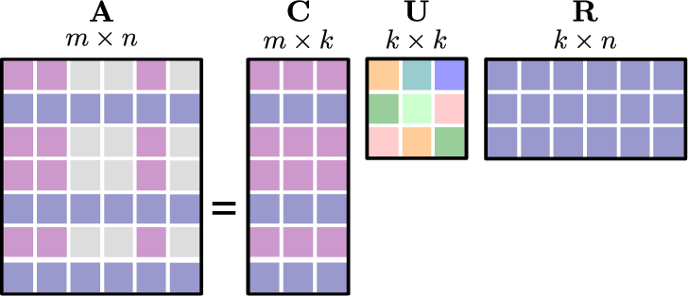
Principal Component Analysis (PCA)
P1
Multiple views of the same method
  Optimal embedding of data points (Geometric)
  Matrix decomposition / Low rank approximation / Data compression (Algebraic)
Advanced methods generalize from these two views
Geometry: Manifold learning (LLE, Isomap, UMAP, tSNE)
Algebra: Decomposition (NMF)
Notes:
Low dimensional views of high dimensional data.
Projection
Scree plot
Correlation
In your homework

Slide 12
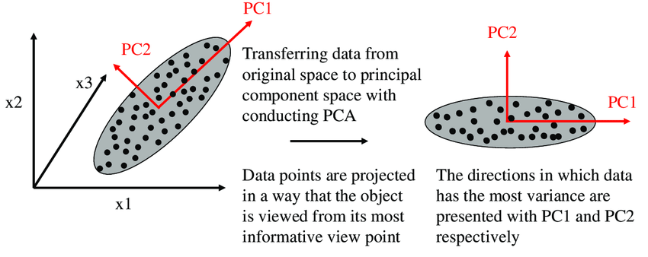

Geometric Embedding View
Problem setup:
  Find a sequence of directions $v_{i}$ that preserve the most variance of the data after projection.
  $$\arg{\max_{v}{Var(Xv_{1})}}$$
  $$\arg{\max_{v_{2}}{Var(Xv_{2})}}, given v_{2}^{T}v_{1}=0$$

Slide 13

Matrix Decomposition / Approximation / Compression View
Problem setup:
  Find basis that make the reconstruction on this basis closest to original data.
  $$\arg{{\min_{K,V}\left\|X−KV^{T}\right\|}_{F}^{2} }, V^{T}V=I$$

Slide 14
Matrix Decomposition / Approximation
Rank of reconstructed data = number of components

Slide 15
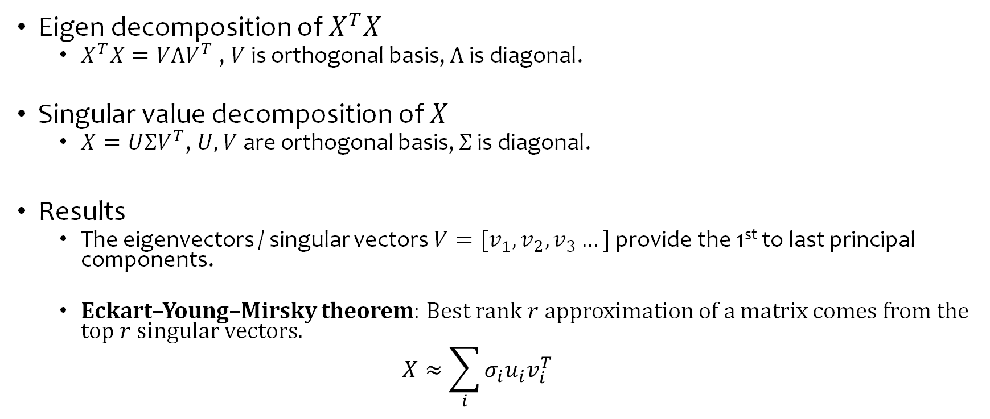
Solution to PCA
Eigen decomposition of $X^{T}X$
  $X^{T}X=VΛV^{T}$ , $V$ is orthogonal basis, $Λ$ is diagonal.
Singular value decomposition of $X$
  $X=UΣV^{T}$, $U,V$ are orthogonal basis, $Σ$ is diagonal.
Results
  The eigenvectors / singular vectors $V=[v_{1},v_{2},v_{3}…]$ provide the 1st to last principal components.
  Eckart–Young–Mirsky theorem: Best rank $r$ approximation of a matrix comes from the top $r$ singular vectors.
  $$X≈\sum_{i}{σ_{i}u_{i}v_{i}^{T}}$$

Slide 16
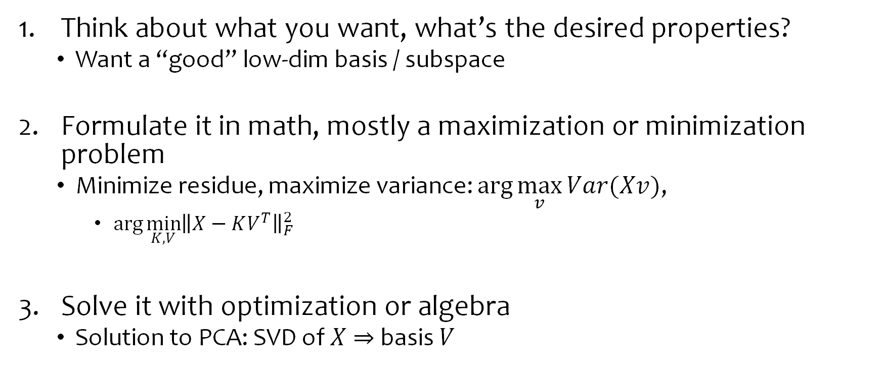
Meta-note on devising analysis methods
Regression, PCA, LNP, deep learning …
Think about what you want, what’s the desired properties?
  Want a “good” low-dim basis / subspace
Formulate it in math, mostly a maximization or minimization problem
  Minimize residue, maximize variance: $\arg{\max_{v}{Var(Xv)}}$,
    $\arg{{\min_{K,V}\left\|X−KV^{T}\right\|}_{F}^{2} }$
Solve it with optimization or algebra
  Solution to PCA: SVD of $X$ $⇒$ basis $V$

Slide 17
Connection between Linear Regression and PCA?

Slide 18
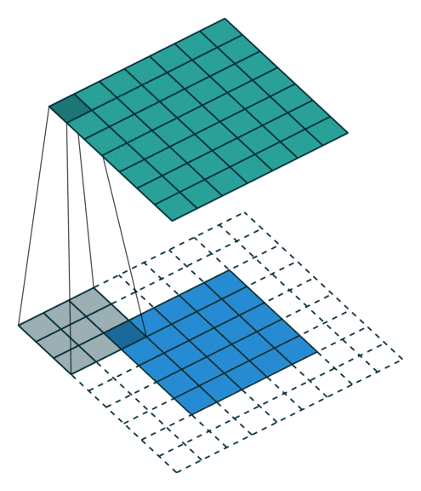
Convolution (P3 b-e)
Which form of multiplication it is, between kernel and patch?
  Dot (vector dot). Or element wise product and sum
How to deal with borders?
  Padding with “pseudo values”.
  (“valid” parameter in `convolve2d`)

Slide 19
Convolution vs Linear Nonlinear Model
(P3 c vs e)
Linear Nonlinear Model:
  Image Patch → Scalar output
  One neuron linearly combine / weight the patch in the RF
Convolution:
  Image Patch → “feature map” / image output
  Population of neurons with same property processing / responding to the whole image

Slide 20
Vision

Slide 21
Vision is important
It affords so many functions (visual question answering):
  Object recognition
  Face identification
  Physical inference
  Social inference
  Reconstruct events from static images
Notes:
Specialized in process one form of input, visual optical input
Same data in different format will not work.
Attention, Eye movement, Recognize person and status, physical interaction, social interaction => humor
Story or events from a single image

Slide 22
Vision is complex
Active sampling aspect of vision
Influence from internal models / prior / belief / cognitive state.
  More than mapping stimuli → response.
It’s an “Illusion”.
Notes:
Same visual input, different prior can affect our perceptions
What you see is not the raw data.
Illumination assumptions account for individual differences in the perceptual interpretation of a profoundly ambiguous stimulus in the color domain: “The dress”
https://jov.arvojournals.org/article.aspx?articleid=2617976
Night owl see more in dark blue and black early bird see more in white and gold.
> Exposed day light vs artificial light may explain.

Slide 23
Early Vision
Retina -> LGN -> V1
Notes:
One general comment or statement is as computational neuroscientist,
We should embrace or look at the complexity of biological system, but not be despair.
Know the complex and simplify the complex into understandable terms.

Slide 24
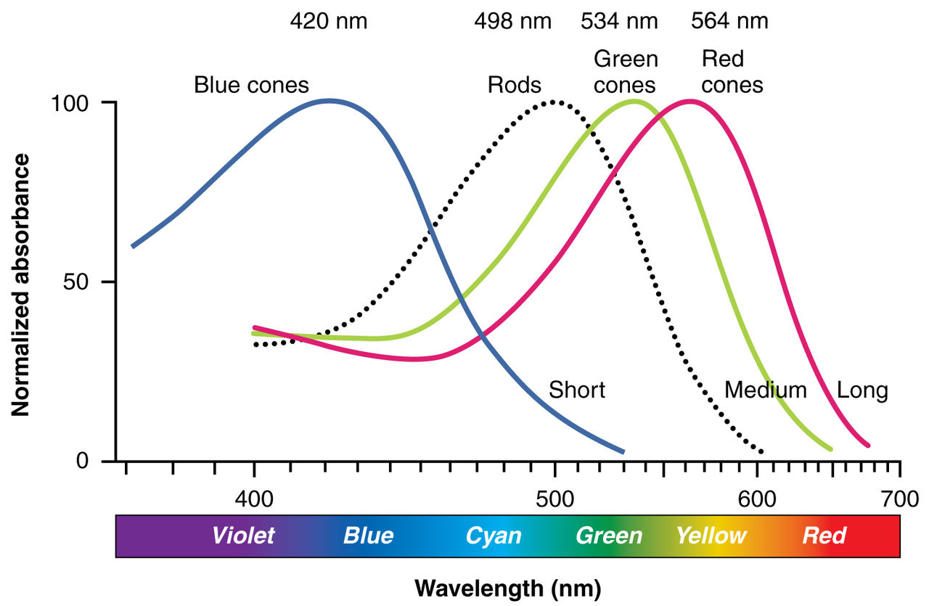
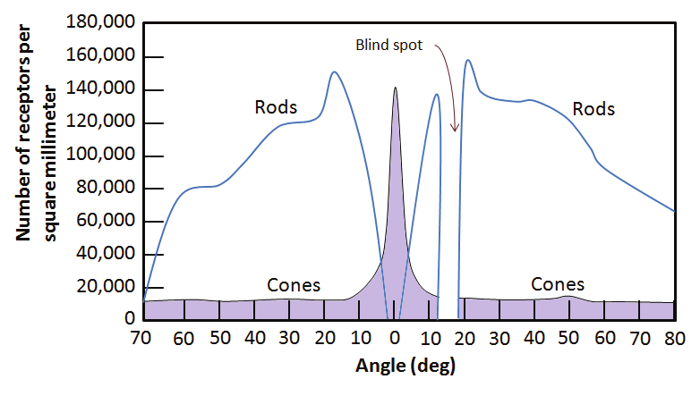
Photoreceptors
Rods and Cones
  Cones: S, M, L
  Rods:
Spatial distribution ~ eccentricity

Slide 25
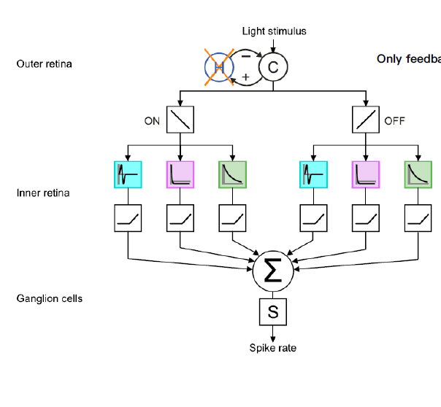
Some complicated retinal circuitry…

Slide 26
Response Properties of RGCs
Spatial filtering: Center surround RF
Temporal filtering: ON or OFF

Slide 27
Major Cell Types of RGC
Parvo-Cells
(aka Midget RGC)
More numerous (70%)
Smaller receptive fields
Higher spatial resolution
Static/slow change, Low temporal frequency
Low contrast sensitivity
Chromatic information
Magno-Cells
(aka Parasol RGC)
Less numerous (10%)
Larger receptive fields (3-fold)
Lower spatial resolution
Rapid change, High temporal frequency
High contrast sensitivity
Achromatic
K-Cells
(8%)
Bistratified
Spatial-, temp properties overlap with M, P
Quote from Marge Livingstone:
“Your color vision system is slow from the start!”
“Your color vision is of lower spatial resolution.”
“Motion system does not know color.”
https://youtu.be/oKCtrVtz_zA
P (ON, OFF)
1-2 pairs at each sampling locus
M (ON, OFF)
1-2 pairs at each sampling locus
From lecture slides of Andreas Burkhalter
Notes:
You don’t have to memorize this but this is useful in explain many things!

Slide 28
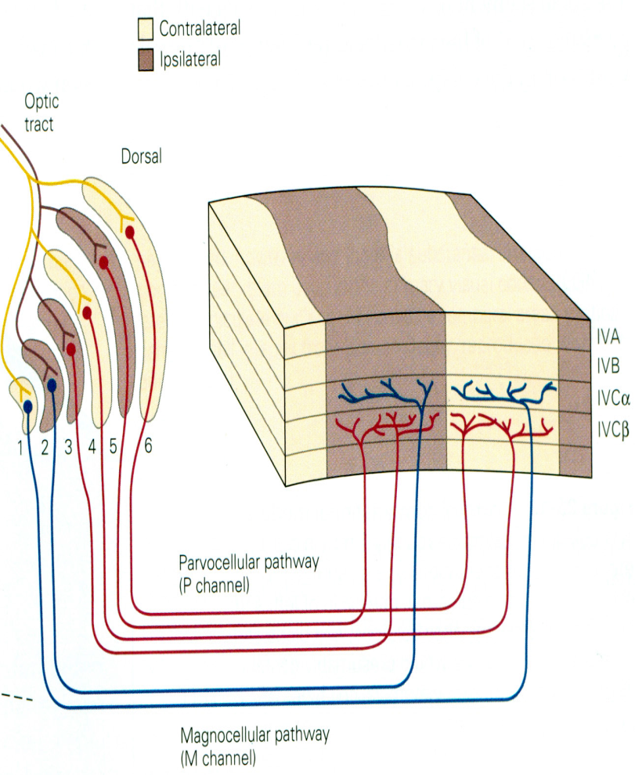
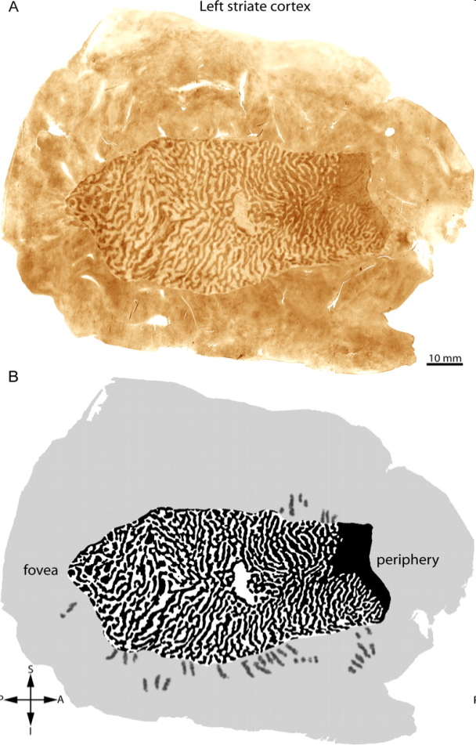
P,M channel are fed forward in parallel.
Eye-specific layers terminate in
ocular dominance columns (bands)
From lecture slides of Andreas Burkhalter

Slide 29
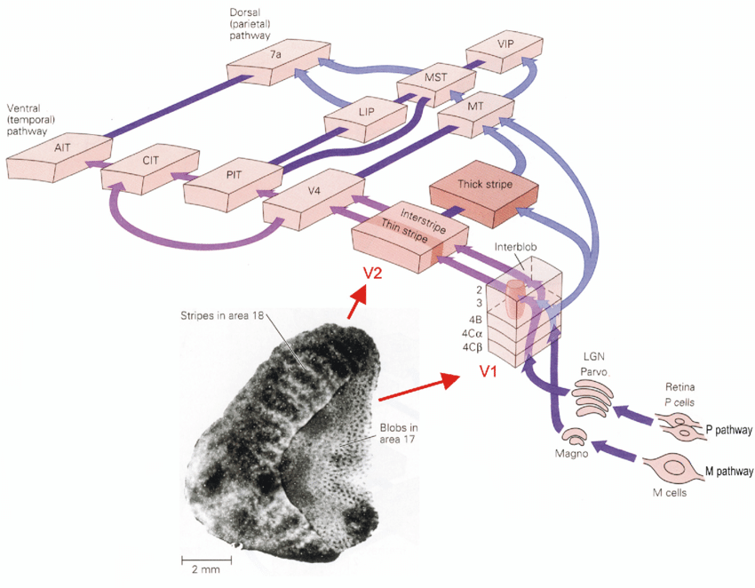
P and M pathway in the whole visual system
Parvo
Color; High acuity; Slow
Low contrast sensitivity
Ventral
Magno
No color; Low acuity; Fast
High contrast sensitivity
Dorsal

Slide 31
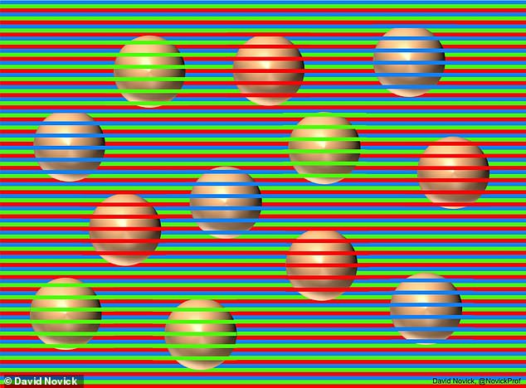
Color vision with lower resolution…

Slide 32
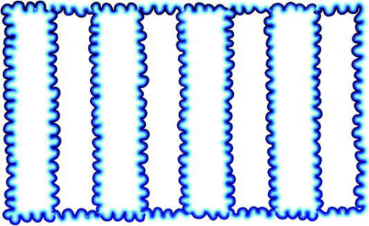
Color vision with lower resolution…
https://www.osapublishing.org/josaa/fulltext.cfm?uri=josaa-22-10-2207&id=85412
Notes:
Water color illusion.

Slide 33
Recreated from Livingstone’s demo

Slide 34
Notes:
Red Green Blue
LightBlue cyan yellow
Better when eye fixates.

Slide 35
Notes:
Orc

Slide 36
Notes:
Red Green Blue
LightBlue cyan yellow
Better when eye fixates.

Slide 38
Notes:
Red Green Blue
LightBlue cyan yellow
Better when eye fixates.

Slide 39
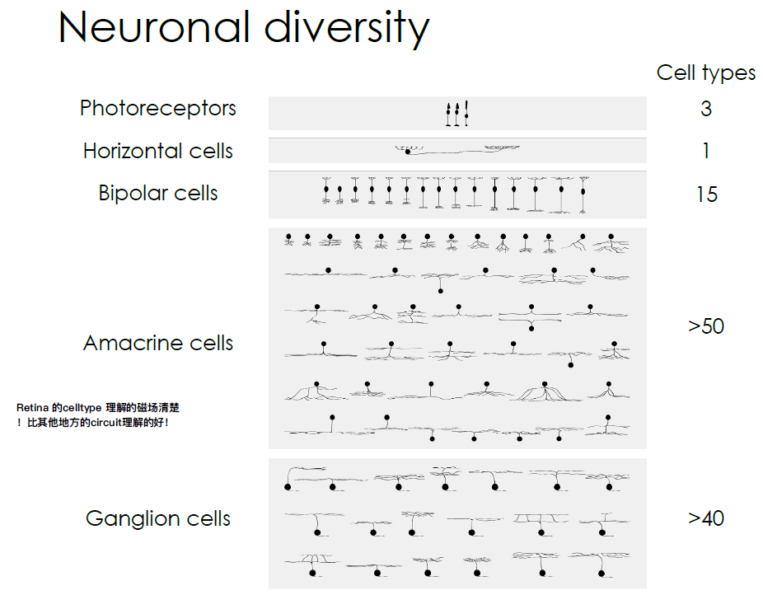
RGCs have a great diversity…
Diversity identified by
Gene expression
Morphology
Response property
Function (computation)

Slide 40
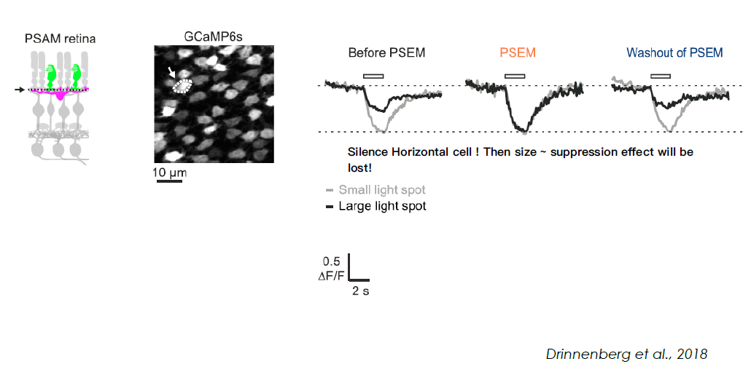
Surround Suppression Implemented by Horizontal Cells

