Slide 1
Section 7 Dynamic System and Hodgkin-Huxley Model
Brief Conceptual Review and HW3
Binxu Wang
Nov. 1st , 2021

Slide 2
Review Contents
Dynamic system analysis and stability
Biophysics of Membrane and H-H model.

Slide 3
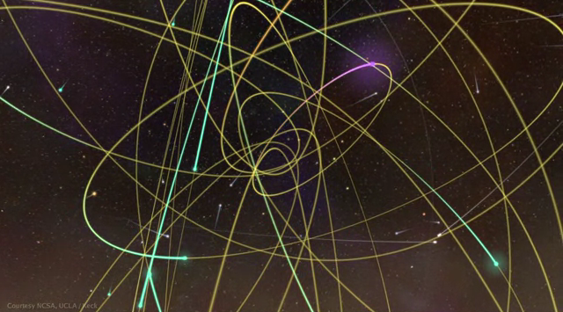
Dynamic System and Stability Analysis
Notes:
So dynamics system is originated in the dynamics in physics but now it’s used everywhere in biology and engineering.
I hope you also have this view of dynamic system after the review section. “neurons or population of neurons move as orbits in a huge phase space”

Slide 4
Dynamic System is Everywhere…
Mechanics, Astrophysics, Fluid dynamics, Solar dynamics …
Robotics, Autonomous car…
Gene interaction network; protein interaction (e.g. molecular clock?)…
Single neurons; neural networks
Epidemics, population dynamics…
Notes:
It’s used on nearly every level of physics and biology, so it’s pretty important toolkit in your pocket.

Slide 5
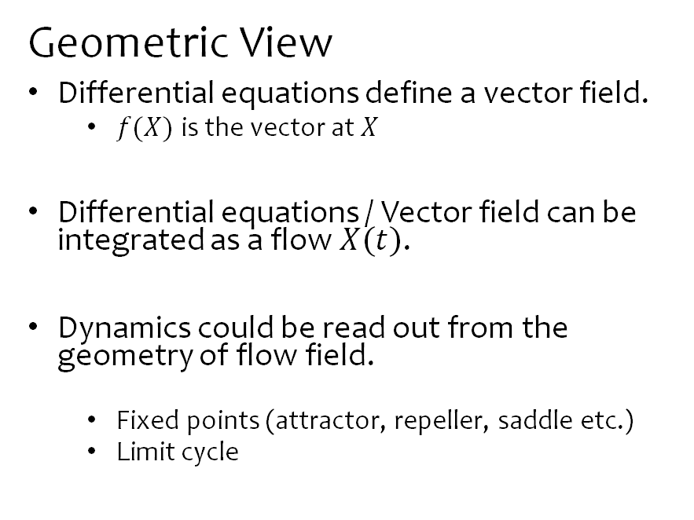
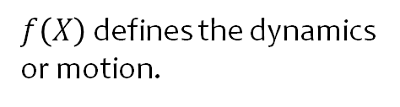
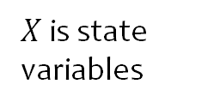
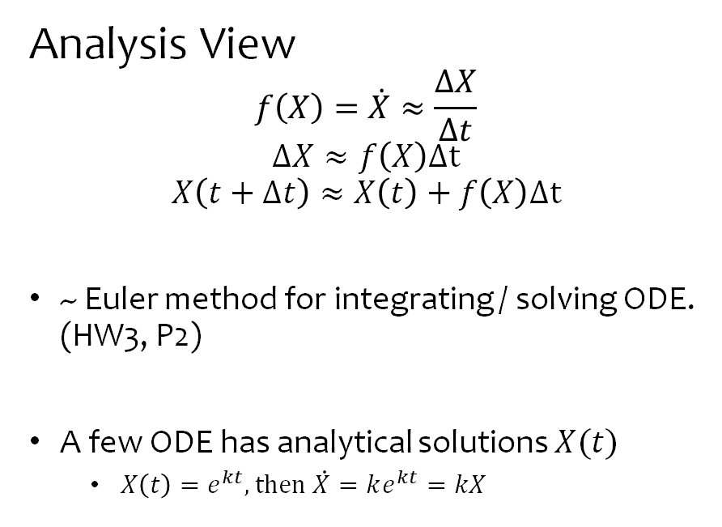
Dynamic System Review
$$\dot{X}=f(X)$$
$X$ is state variables
$f\left(X\right)$ defines the dynamics or motion.
Analysis View
$$f\left(X\right)=\dot{X}≈\frac{ΔX}{Δt}$$
$$ΔX≈f\left(X\right)Δt$$
$$X\left(t+Δt\right)≈X\left(t\right)+f\left(X\right)Δt$$
~ Euler method for integrating / solving ODE. (HW3, P2)
A few ODE has analytical solutions $X(t)$
  $X\left(t\right)=e^{kt}, then \dot{X}=ke^{kt}=kX$
Geometric View
Differential equations define a vector field.
  $f(X)$ is the vector at $X$
Differential equations / Vector field can be integrated as a flow $X(t)$.
Dynamics could be read out from the geometry of flow field.
  Fixed points (attractor, repeller, saddle etc.)
  Limit cycle
Notes:
https://problemsolvingwithpython.com/06-Plotting-with-Matplotlib/06.15-Quiver-and-Stream-Plots/
We will try to connect these two views in the following
Analysis view is used to “solve” the ODE usually numerically.
Geometric view is to provide intuition of why the system behave in this manner. (explain or understand)
Let’s try applying these method to some simple cases
After we have a model, how to understand it.

Slide 6
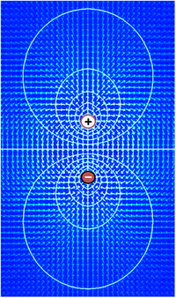
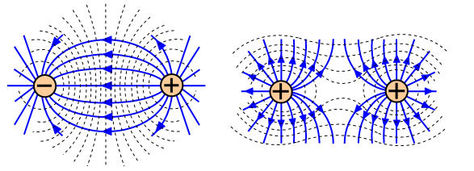

Physics example: Electric field and field “lines”
Field lines are the flow defined by the vector field of $\vec{E}$

Slide 7



1-D Dynamic System
  1-D function on a line
  $$\dot{x}=f\left(x\right), x∈ℝ$$
Let’s try reading the dynamics from the vector field!
$$f\left(x\right)$$
$$x$$
Fix point
  Attractor (stable fix point)
  Repeller (unstable fix point)
Notes:
1-D dynamic system could be Represented by a function on real line.

Slide 8

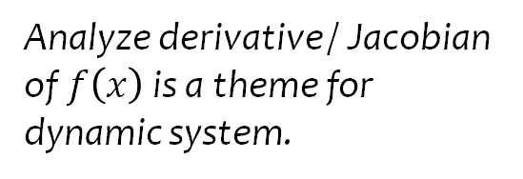
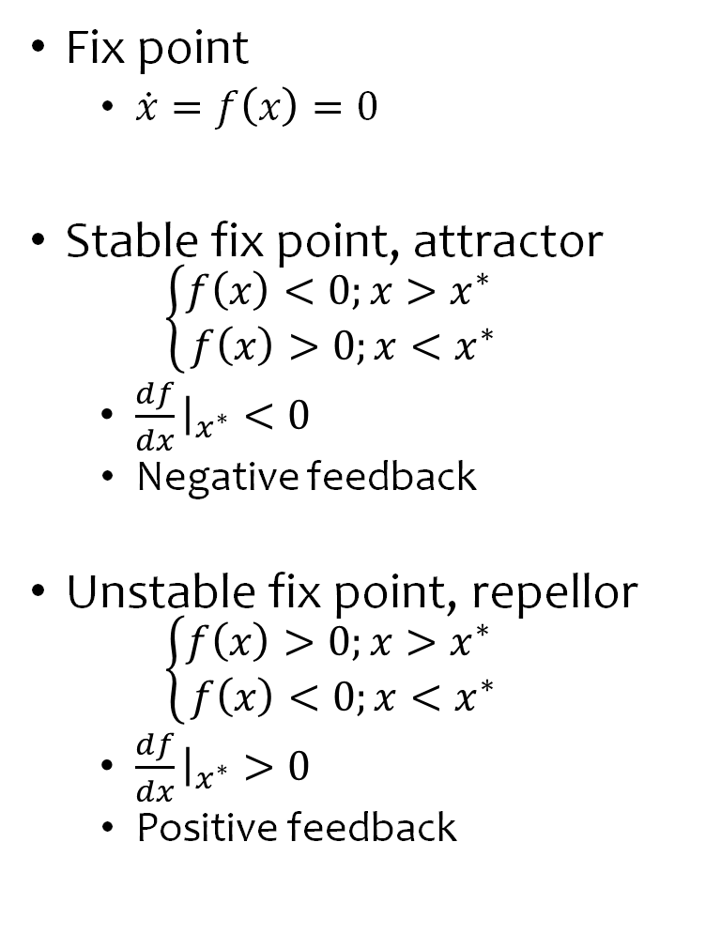



Stability of Fix Point
Fix point
  $\dot{x}=f\left(x\right)=0$
Stable fix point, attractor
  $$\left\{\begin{aligned}f\left(x\right)<0;x>x^{∗} \\ f\left(x\right)>0;x<x^{∗}\end{aligned}\right.$$
  $\frac{df}{dx}{\left.​\right|}_{x^{∗}}<0$
  Negative feedback
Unstable fix point, repellor
  $$\left\{\begin{aligned}f\left(x\right)>0;x>x^{∗} \\ f\left(x\right)<0;x<x^{∗}\end{aligned}\right.$$
  $\frac{df}{dx}{\left.​\right|}_{x^{∗}}>0$
  Positive feedback
Analyze derivative / Jacobian of $f\left(x\right)$ is a theme for dynamic system.
$$f\left(x\right)$$
$$x$$
$$f\left(x\right)$$
$$x$$

Slide 9

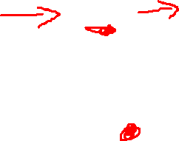
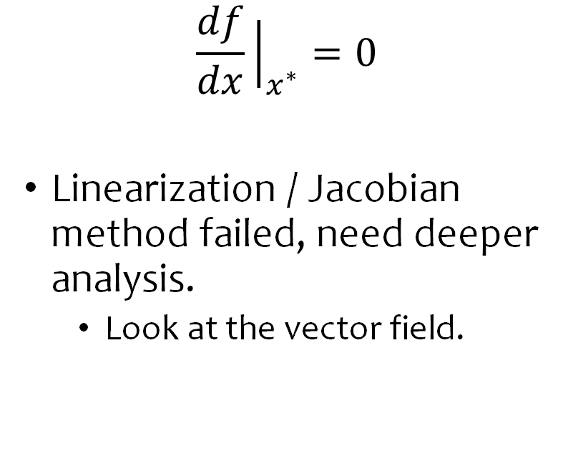

What about the dynamics of these cases?
$$\frac{df}{dx}{\left.​\right|}_{x^{∗}}=0$$
Linearization / Jacobian method failed, need deeper analysis.
  Look at the vector field.
$$f\left(x\right)$$
$$x$$
$$f\left(x\right)$$
$$x$$

Slide 10
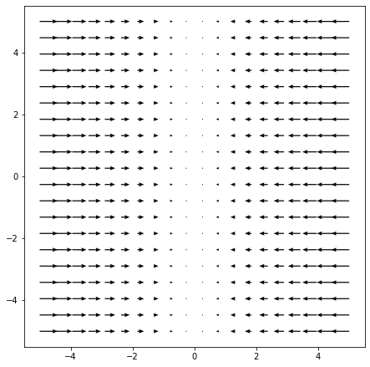
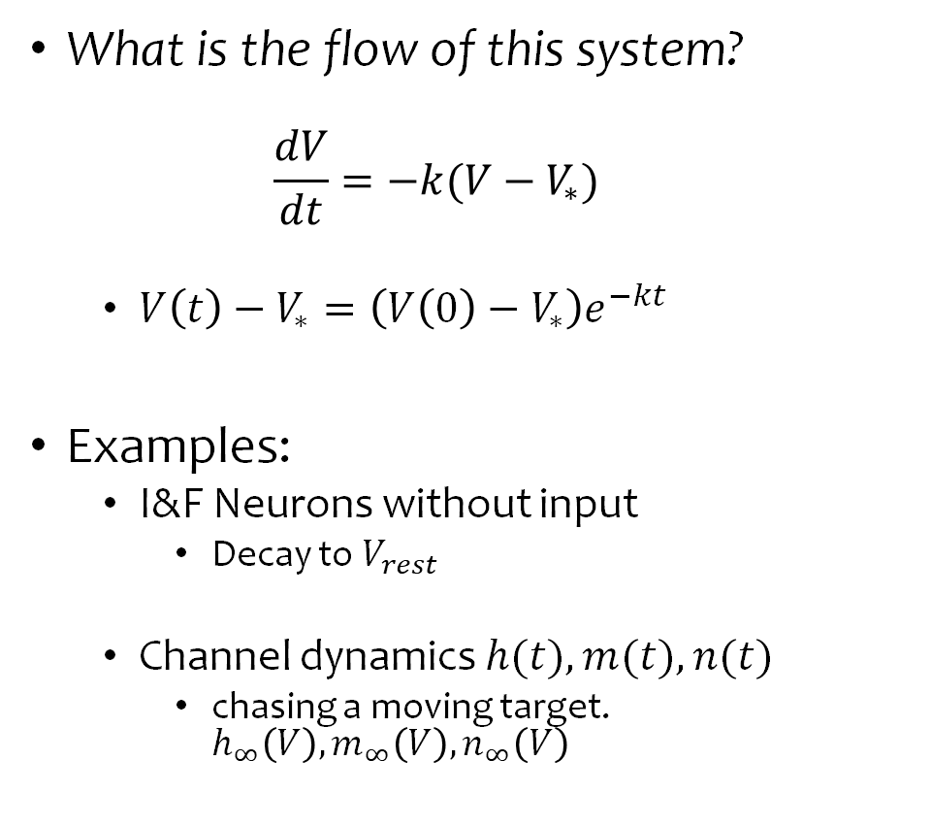


First-order dynamics
What is the flow of this system?
  $$\frac{dV}{dt}=−k(V−V_{∗})$$
  $V\left(t\right)−V_{∗}=\left(V\left(0\right)−V_{∗}\right)e^{−kt}$
Examples:
  I&F Neurons without input
    Decay to $V_{rest}$
  Channel dynamics $h(t),m(t),n(t)$
    chasing a moving target. $h_{∞}\left(V\right),m_{∞}\left(V\right),n_{∞}\left(V\right)$
$$f\left(V\right)$$
$$V$$
Notes:
What’s the effect of $k$ ?
Membraine time constant etc.
What’s the meaning or effect of $V_{∗}$

Slide 11
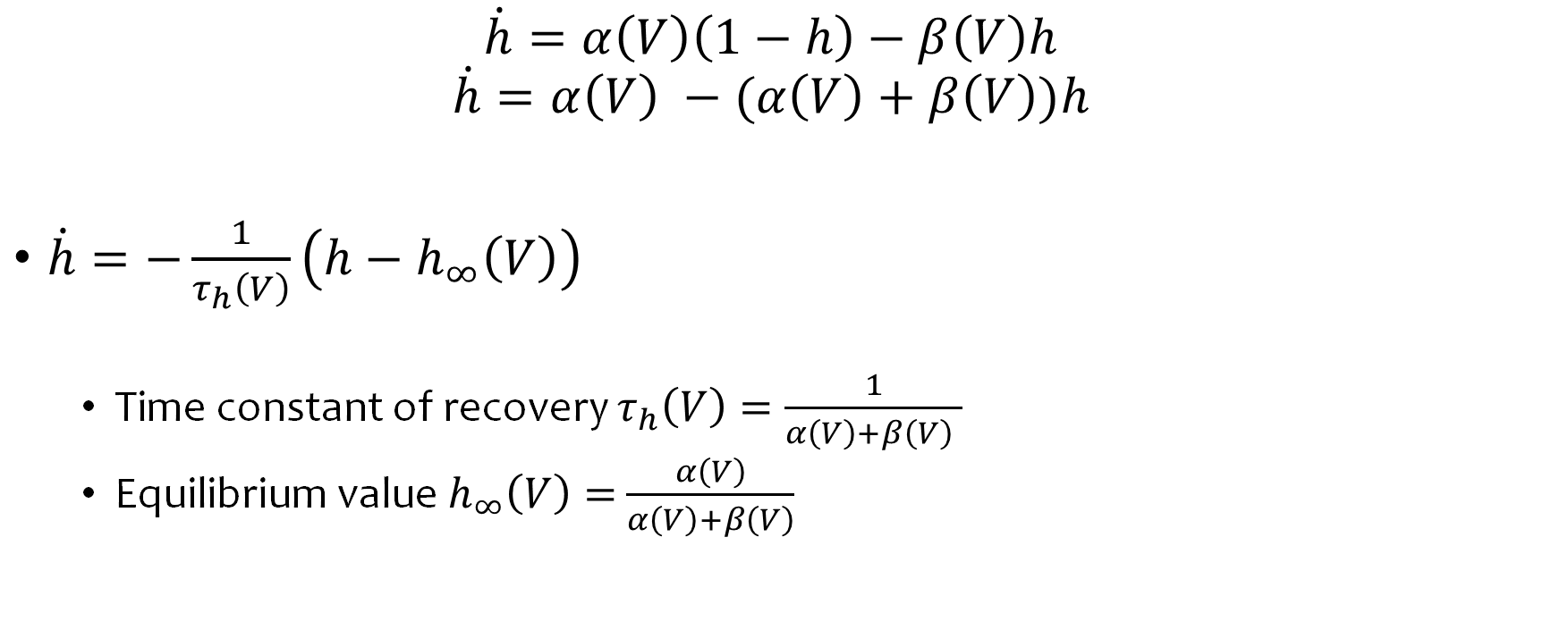
Reformulation of the equations for gating variables.
$$\dot{h}=α\left(V\right)\left(1−h\right)−β\left(V\right)h$$
$$\dot{h}=α\left(V\right) −(α\left(V\right)+β\left(V\right))h$$
$\dot{h}=−\frac{1}{τ_{h}\left(V\right)}\left(h−h_{∞}\left(V\right)\right)$
  Time constant of recovery $τ_{h}\left(V\right)=\frac{1}{α\left(V\right)+β\left(V\right) }$
  Equilibrium value $h_{∞}\left(V\right)=$ $\frac{α\left(V\right)}{α\left(V\right)+β\left(V\right)}$

Slide 12
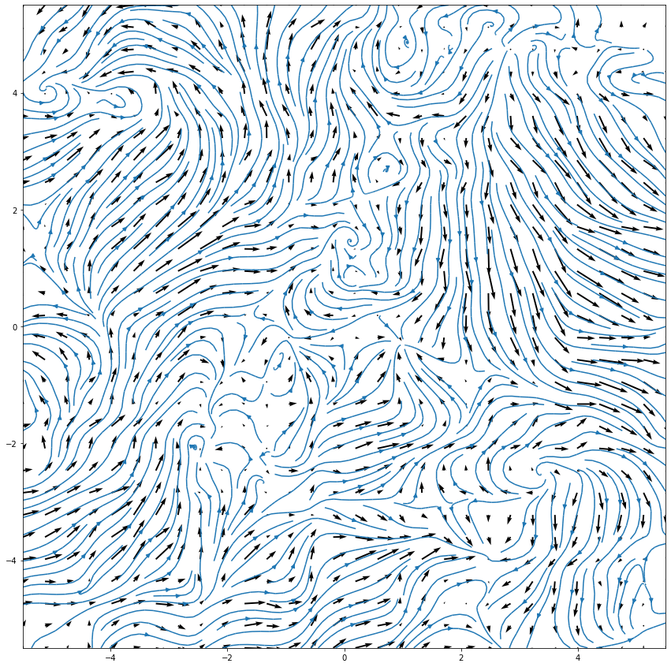
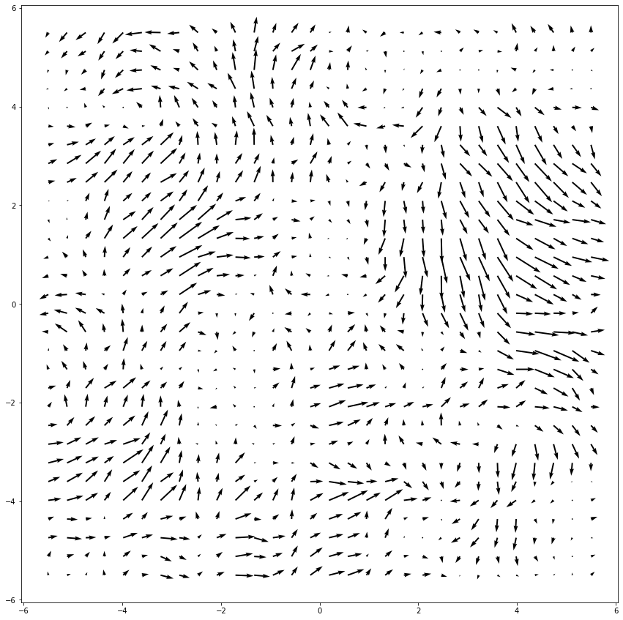
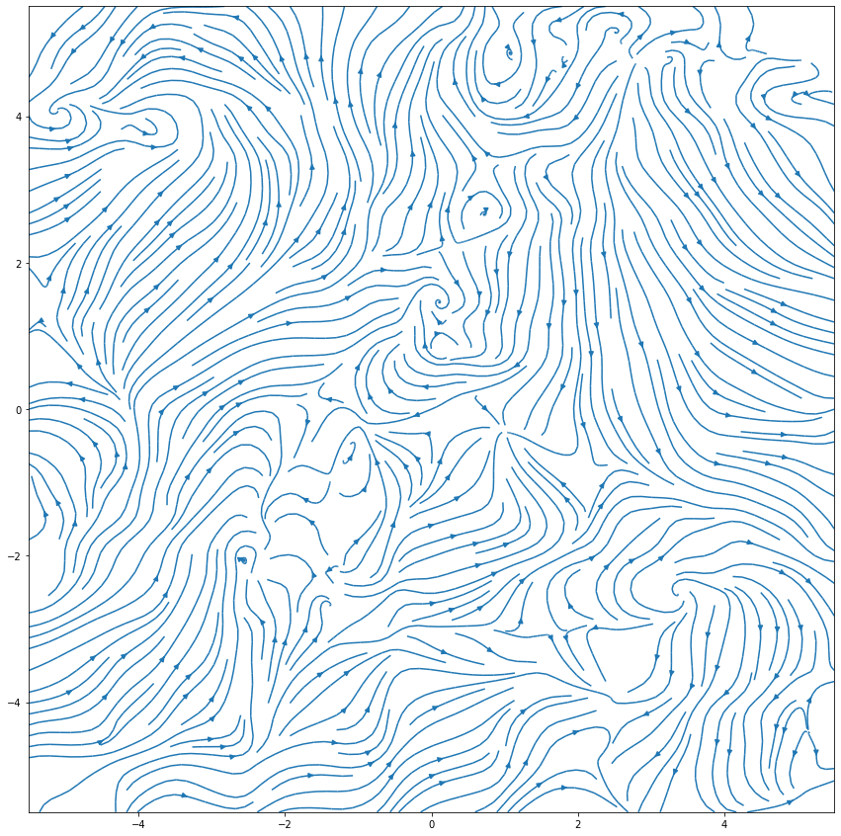
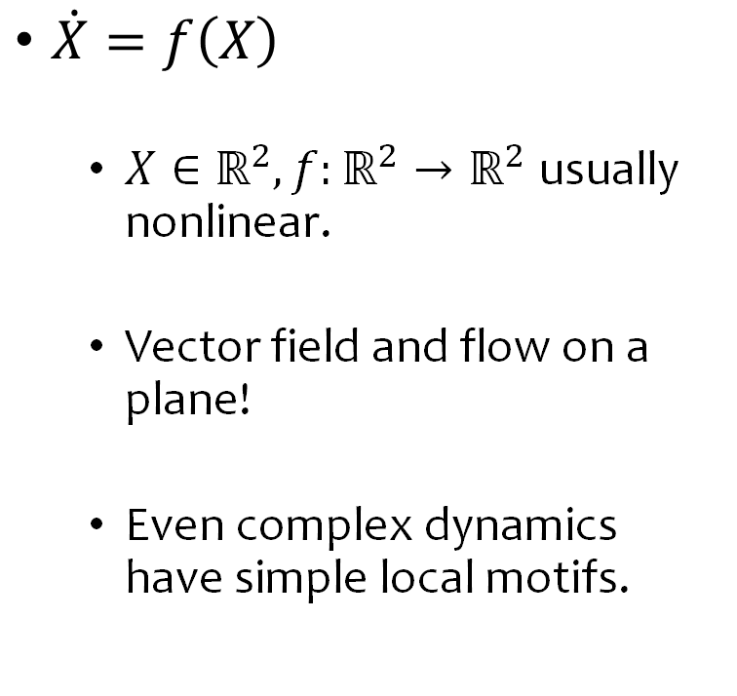
2-D Dynamic Systems
$\dot{X}=f\left(X\right)$
  $X∈ℝ^{2},f:ℝ^{2}→ℝ^{2}$ usually nonlinear.
  Vector field and flow on a plane!
  Even complex dynamics have simple local motifs.

Slide 13
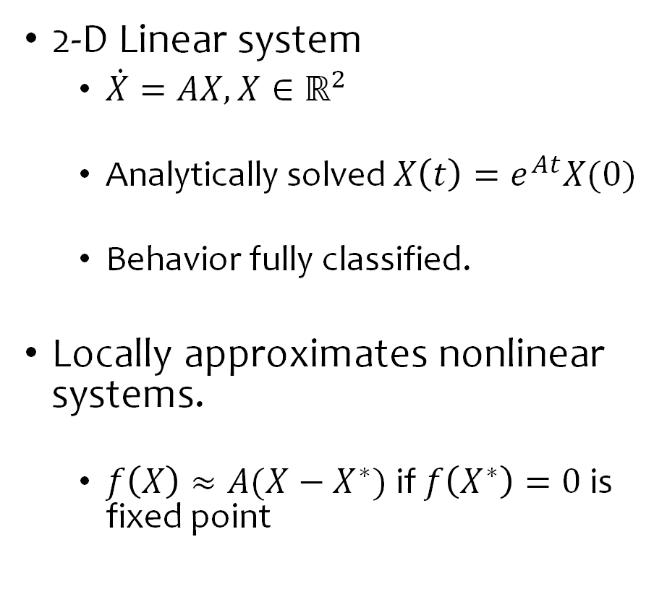
Motifs of complex dynamics: Linear system
2-D Linear system
  $\dot{X}=AX, X∈ℝ^{2}$
  Analytically solved $X\left(t\right)=e^{At}X(0)$
  Behavior fully classified.
Locally approximates nonlinear systems.
  $f\left(X\right)≈A(X−X^{∗})$ if $f\left(X^{∗}\right)=0$ is fixed point
Notes:
Next let’s talk about these motif and the math behind it

Slide 14
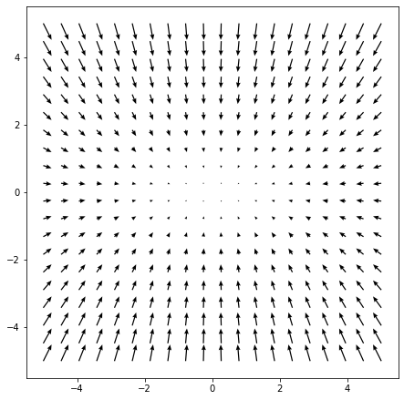
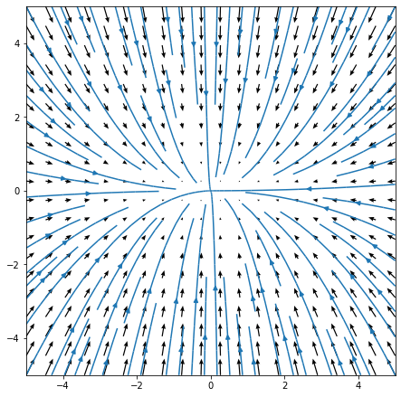

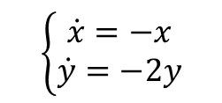
2-D Linear System
$$\dot{X}=\left[\begin{matrix}−1 & 0 \\ 0 & −2\end{matrix}\right]X$$
$$\left\{\begin{aligned}\dot{x}=−x \\ \dot{y}=−2y\end{aligned}\right.$$
Attractor
Notes:
Let’s try some example of 2D systems.
What is the fixed point of this system?
Is it stable? From the vector field?
From which direction x converge faster to the fix point?
What’s the flow looked like?

Slide 15
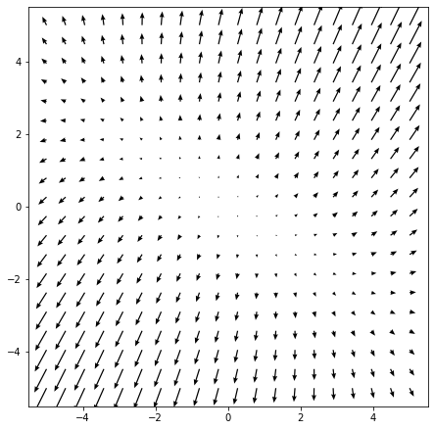
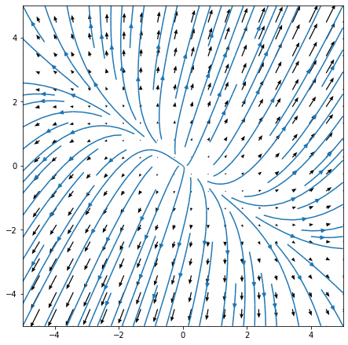

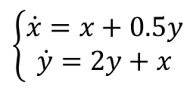
2-D Linear System
$$\dot{X}=\left[\begin{matrix}1 & 0.5 \\ 1 & 2\end{matrix}\right]X$$
$$\left\{\begin{aligned}\dot{x}=x+0.5y \\ \dot{y}=2y+x\end{aligned}\right.$$
Repellor
Notes:
Let’s try some example of 2D systems.
What is the fixed point of this system?
Is it stable? From the vector field?
From which direction x converge faster to the fix point?
What’s the flow looked like?

Slide 16
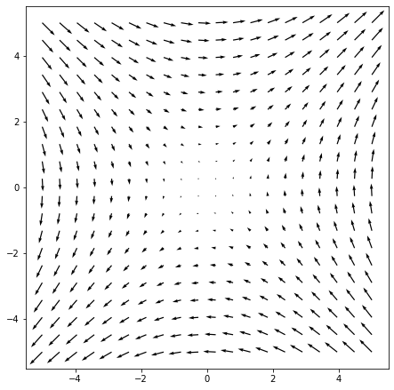
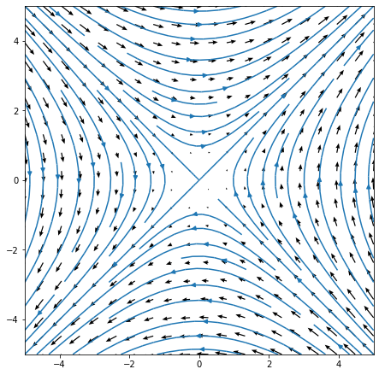
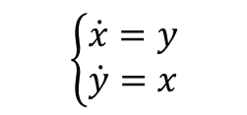

2-D Linear System
$$\dot{X}=\left[\begin{matrix}0 & 1 \\ 1 & 0\end{matrix}\right]X$$
$$\left\{\begin{aligned}\dot{x}=y \\ \dot{y}=x\end{aligned}\right.$$
Saddle
Notes:
What is the fixed point of this system?
Is it stable? From the vector field?
What’s the flow looked like?

Slide 17
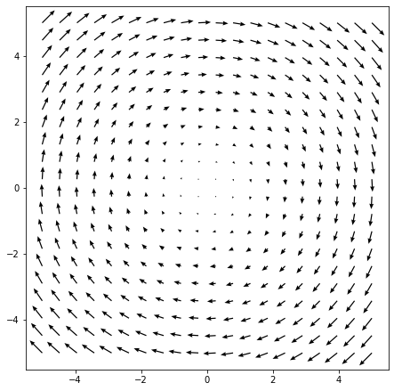
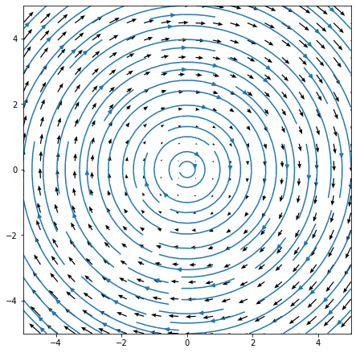
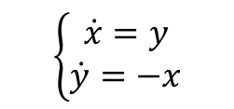

2-D Linear System
$$\dot{X}=\left[\begin{matrix}0 & 1 \\ −1 & 0\end{matrix}\right]X$$
$$\left\{\begin{aligned}\dot{x}=y \\ \dot{y}=−x\end{aligned}\right.$$
Center

Slide 18
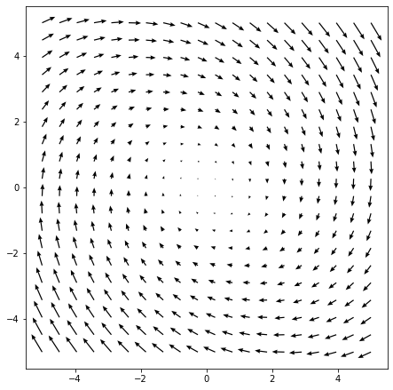
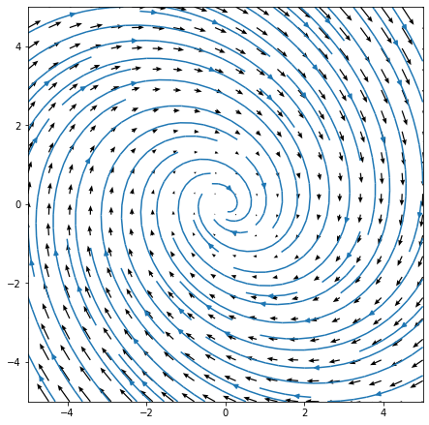
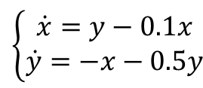

2-D Linear System
$$\dot{X}=\left[\begin{matrix}−0.1 & 1 \\ −1 & −0.5\end{matrix}\right]X$$
$$\left\{\begin{aligned}\dot{x}=y−0.1x \\ \dot{y}=−x−0.5y\end{aligned}\right.$$
Stable Spiral

Slide 19
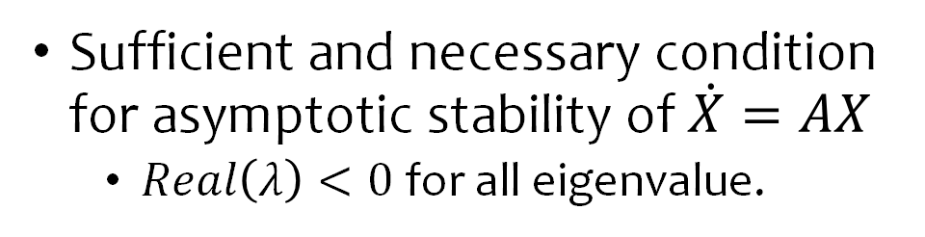
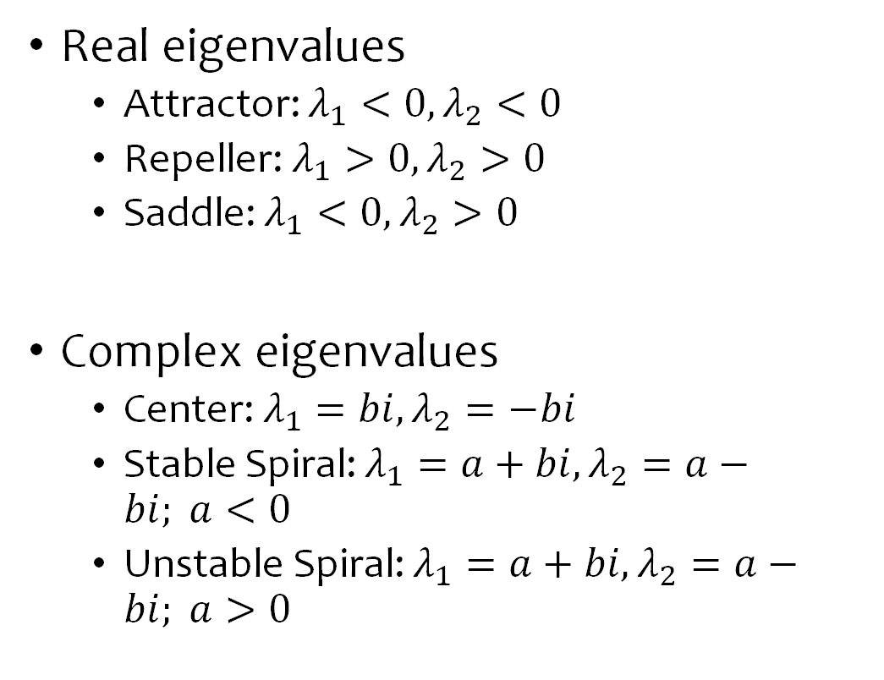
Eigenvalue is the Key
Real eigenvalues
  Attractor: $λ_{1}<0,λ_{2}<0$
  Repeller: $λ_{1}>0,λ_{2}>0$
  Saddle: $λ_{1}<0,λ_{2}>0$
Complex eigenvalues
  Center: $λ_{1}=bi,λ_{2}=−bi$
  Stable Spiral: $λ_{1}=a+bi,λ_{2}=a−bi; a<0$
  Unstable Spiral: $λ_{1}=a+bi,λ_{2}=a−bi; a>0$
Sufficient and necessary condition for asymptotic stability of $\dot{X}=AX$
  $Real\left(λ\right)<0$ for all eigenvalue.

Slide 20
Locally Analysis of 2-D Nonlinear Systems
$\dot{X}=f\left(X\right)$
  $X∈ℝ^{2},f:ℝ^{2}→ℝ^{2}$ usually nonlinear.
  Vector field and flow on a plane!
  Even complex dynamics have simple local motifs.

Slide 21

Example: FitzHugh-Nagumo Model
$$\frac{dV}{dt}=V−V^{3}−W+I$$
$$\frac{dW}{dt}=0.08(V+0.7−0.8W)$$
Note the 0.08
  What that mean for the vector field? Dynamics?
  Great speed / time scale difference in $V$ and $W$
Notes:
What kind of fix point is it?
Depending on the I current?

Slide 22
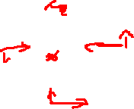
Nullcline for Qualitative Analysis
Notes:
See the board.
Blue line will be moved up and down by the input current.

Slide 23
Mystery of Spiking: How can a constant input generate oscillatory response?!
Limit cycle is the answer! Only exist in nonlinear system > 2D.
No limit cycle in 1-D system, need to manual reset.

Slide 24
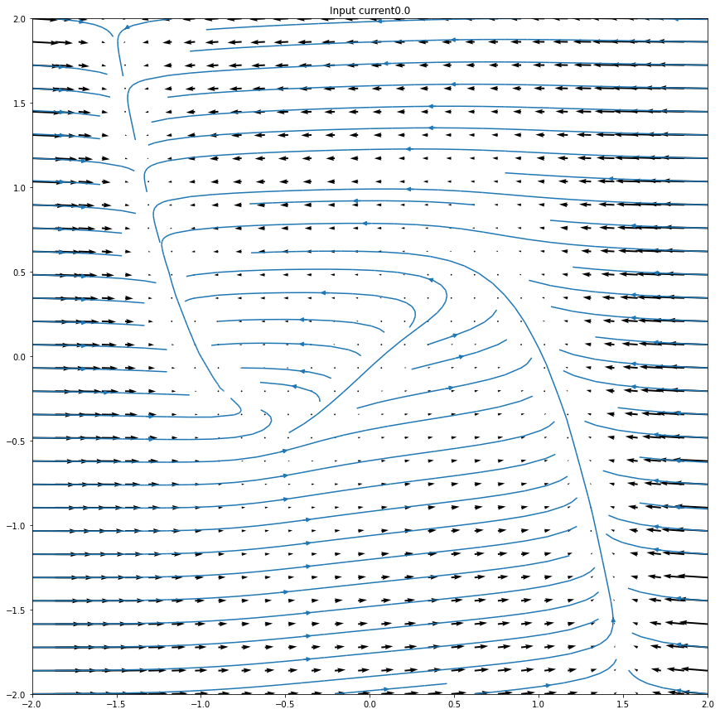
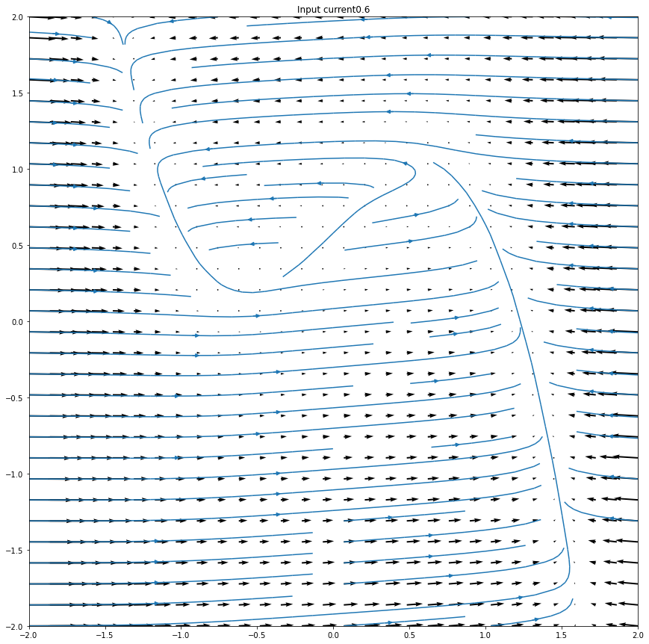
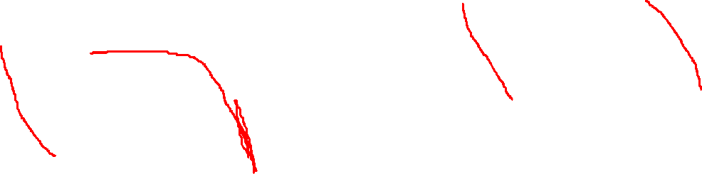
Vector field without Spike / Limit Cycle
Vector field with Spike / Limit Cycle

Slide 25
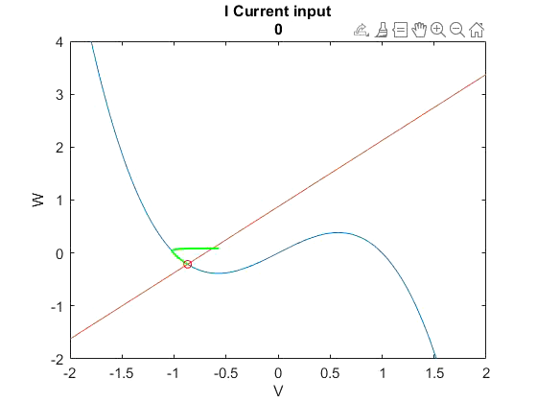

Proof Our Intuition by Simulation

Slide 26
Hodgkin-Huxley Model and Biophysics Review
Notes:
This connects so many fields and it’s brilliant in so many ways.
Biophysics,
Structural biology, protein structure
Dynamic system and math
Neuroscience !

Slide 27
All models are wrong, some are useful.
--George Box
H-H is one of those hyper useful models…

Slide 28
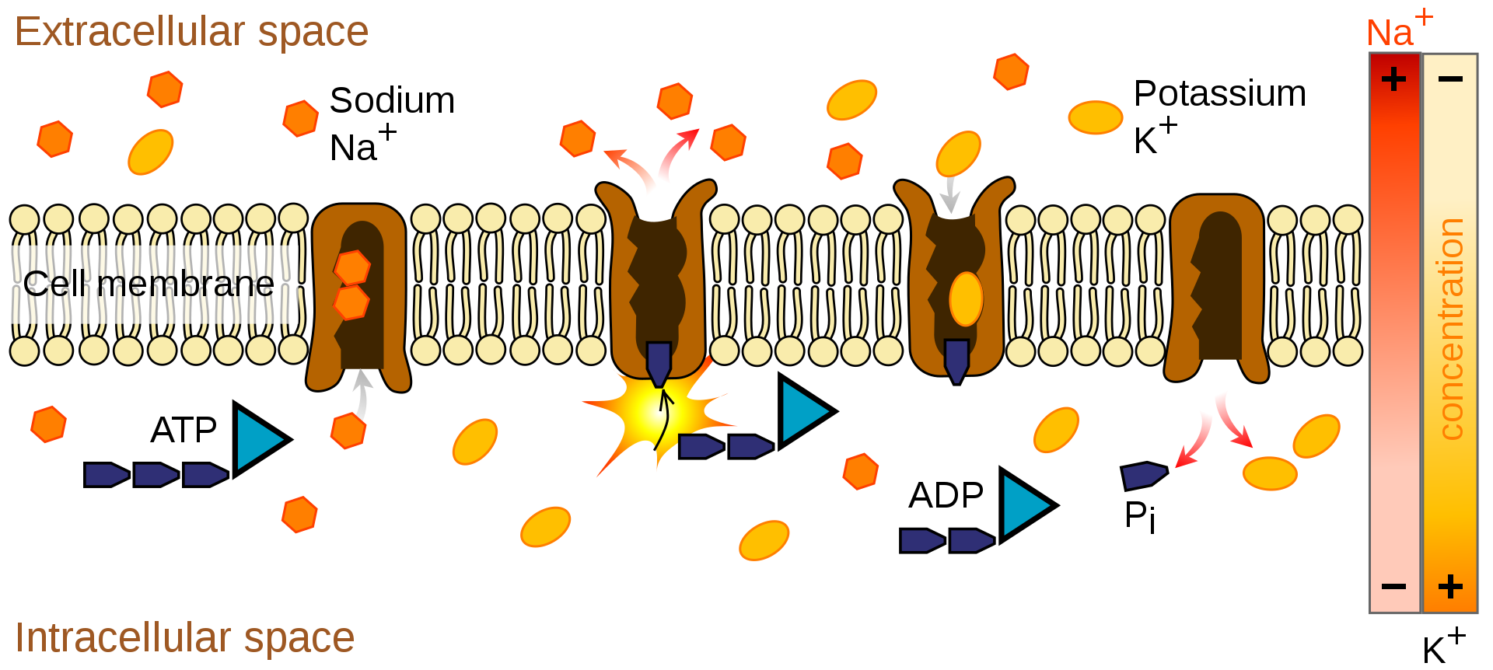
Why there is a difference of electric potential across cellular membrane?
What are some key players?
  Semi-permeability of membrane
  Ion(s)
  Ion pumps
  Concentration gradient
Notes:
sodium–potassium pump, which transports three sodium ions out of the cell and two potassium ions in.
the concentration of potassium ions K⁺ inside the neuron is roughly 20-fold larger than the outside concentration, whereas the sodium concentration outside is roughly ninefold larger than inside.
If the ion pumps are turned off by removing their energy source, or by adding an inhibitor such as ouabain, the axon can still fire hundreds of thousands of action potentials before their amplitudes begin to decay significantly.

Slide 29
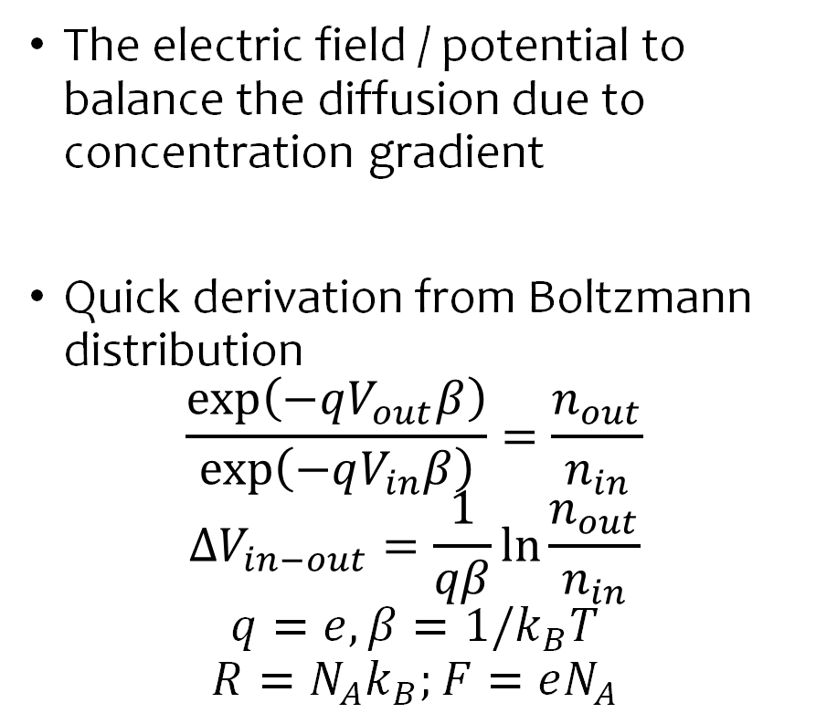

Reversal Potential / Nernst Potential
The electric field / potential to balance the diffusion due to concentration gradient
Quick derivation from Boltzmann distribution
$$\frac{\exp\left(−qV_{out}β\right)}{\exp\left(−qV_{in}β\right)}=\frac{n_{out}}{n_{in}}$$
$$ΔV_{in−out}=\frac{1}{qβ}\ln{\frac{n_{out}}{n_{in}}}$$
$$q=e,β=1/k_{B}T$$
$$R=N_{A}k_{B};F=eN_{A}$$
+
+
+
+
+
+
Outside
$$\vec{E}$$
Inside
+
+
Need a potential / electric field to counterbalance the diffusion.
Notes:
https://www.physiologyweb.com/calculators/ghk_equation_calculator.html

Slide 30

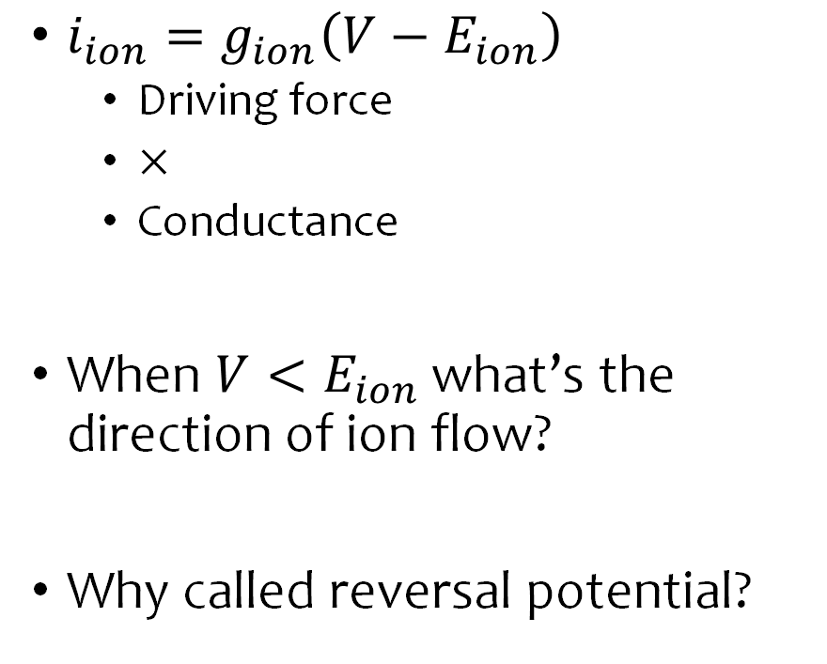

Model for One Channel / Ion
+
+
+
$i_{ion}=g_{ion}\left(V−E_{ion}\right)$
  Driving force
  $×$
  Conductance
When $V<E_{ion}$ what’s the direction of ion flow?
Why called reversal potential?
+
+
+
Outside
Inside
+
+
$$V$$
$$i_{ion}$$
Inside cell
Outside

Slide 31
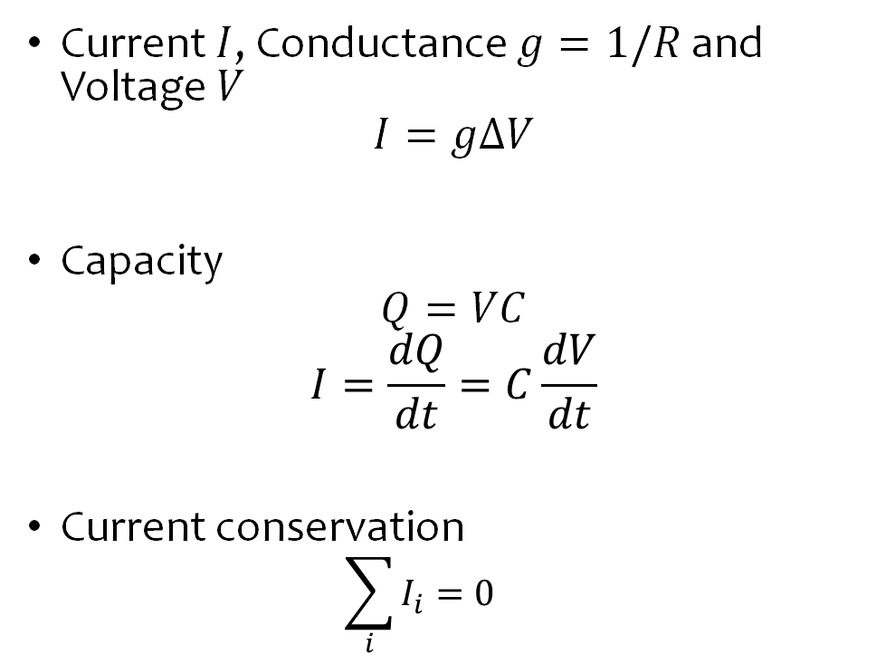
Circuit Physics Review
Current $I$, Conductance $g=1/R$ and Voltage $V$
$$I=gΔV$$
Capacity
$$Q=VC$$
$$I=\frac{dQ}{dt}=C\frac{dV}{dt}$$
Current conservation
  $$\sum_{i}{I_{i}}=0$$

Slide 32
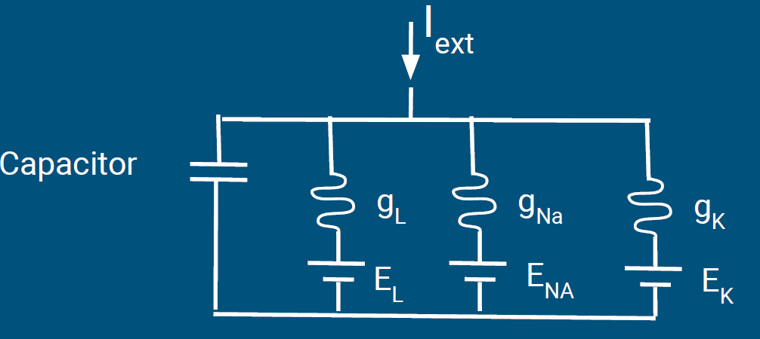
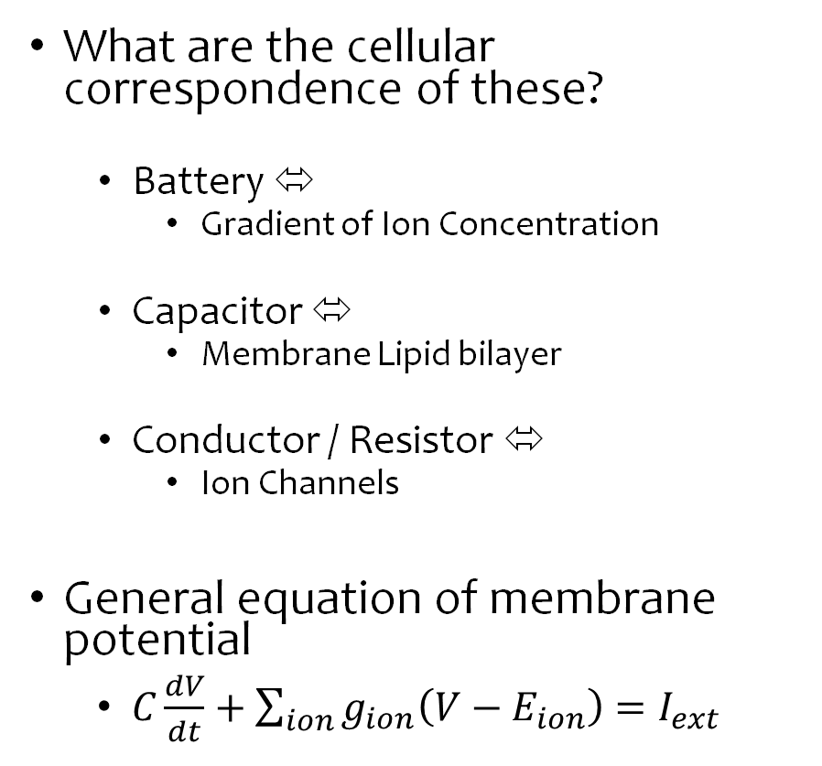

Membrane as Circuit
What are the cellular correspondence of these?
  Battery ⬄
    Gradient of Ion Concentration
  Capacitor ⬄
    Membrane Lipid bilayer
  Conductor / Resistor ⬄
    Ion Channels
General equation of membrane potential
  $C\frac{dV}{dt}+\sum_{ion}{g_{ion}\left(V−E_{ion}\right)}=I_{ext}$
Inside Cell
$$V_{in}$$
Outside Cell

Slide 33
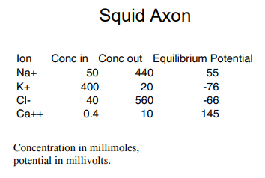


Voltage equation
$$C_{m}\frac{dV}{dt}=−g_{Na}\left(V−E_{Na}\right)−g_{K}\left(V−E_{K}\right)−g_{L}\left(V−E_{L}\right)+I_{ext}$$
  Na+ channel open
    -> pull up the Voltage
  K+ channel open
    -> pull down the Voltage
  Leaky channel
    -> return to resting
  $C_{m}$
    Capacity ~ time constant

Slide 34



Dynamics of Channel
Voltage dependency.
  $$\dot{m}=α\left(V\right)\left(1−m\right)−β\left(V\right)m$$
  $$\dot{m}=−\frac{1}{τ_{m}\left(V\right)}\left(m−m_{∞}\left(V\right)\right)$$
  $$m_{∞}\left(V\right)=\frac{α\left(V\right)}{α\left(V\right)+β(V)}$$
  $$τ_{m}=\frac{1}{α\left(V\right)+β(V)}$$
  Chasing a moving equilibrium
  Extreme case, fast convergence
  $$m\left(t\right)=m_{∞}(V(t))$$
Modified from HW3
Gating dynamics
  $$g_{Na}=\overline{g_{Na}}m^{3}h$$
  $$g_{K}=\overline{g_{K}}n^{4}$$

Slide 35


H-H model in phase space
Blue to Red color correspond to low to high current level (my matlab)
https://www.researchgate.net/figure/a-3D-h-M-V-phase-space-projection-of-the-Purkinje-cell-model-at-I-app-29487_fig6_328254161

Slide 36


Other Views of the H-H Manifold

