Slide 1
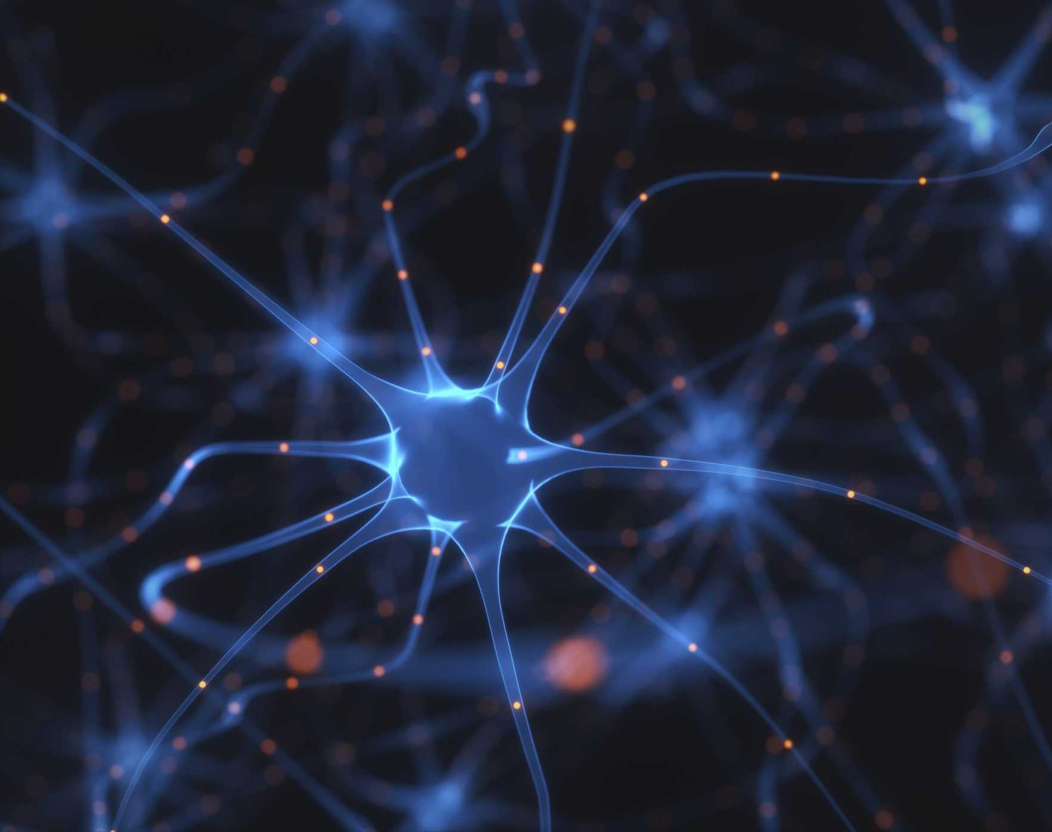
Head Direction Neurons, Hopfield Network, and Learning Rules
Section 9, Conceptual Review and HW 4
Binxu Wang
Nov. 15th, 2021

Slide 2
Model of Head Direction Neurons

Slide 3
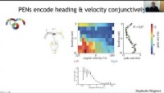
Head Direction Neurons for Real in Fly
Can you see the connection to the continuous attractor network?
https://youtu.be/2fORQ7icGVU?t=325

Slide 4

Head Direction Neuron: What to model?
Desirable property
  Stable when head is not moving (memory)
  Track the change when the animal turn. (integrator)
  Represent a single direction in $\left(0,2π\right)$ (single value)

Slide 5
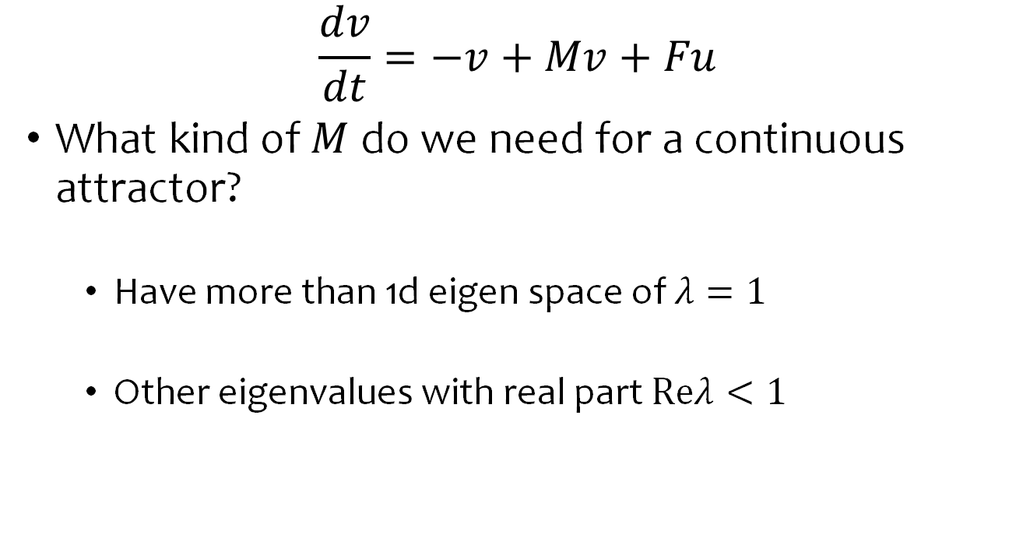
Continuous Attractor Network
$$\frac{dv}{dt}=−v+Mv+Fu$$
What kind of $M$ do we need for a continuous attractor?
  Have more than 1d eigen space of $λ=1$
  Other eigenvalues with real part $Reλ<1$

Slide 6
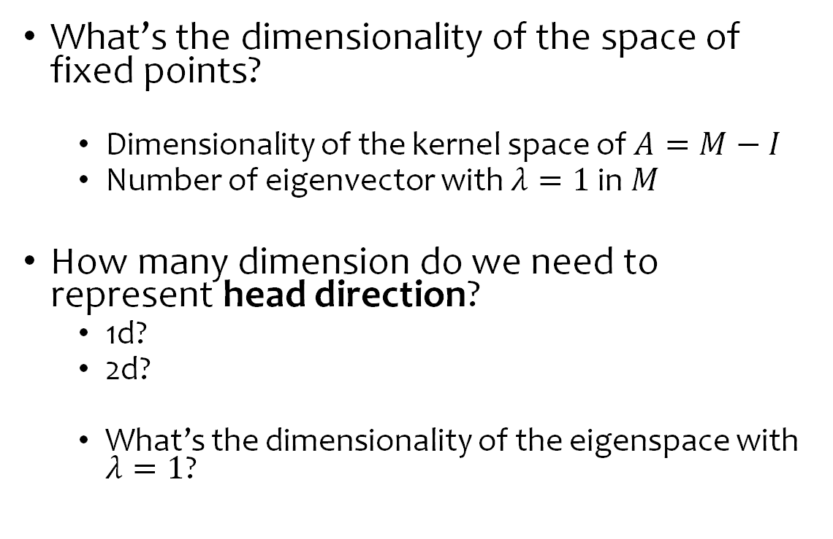
Linear Dynamic System: Fixed point(s)
What’s the dimensionality of the space of fixed points?
  Dimensionality of the kernel space of $A=M−I$
  Number of eigenvector with $λ=1$ in $M$
How many dimension do we need to represent head direction?
  1d?
  2d?
  What’s the dimensionality of the eigenspace with $λ=1$?

Slide 7
Continuous Ring Attractor in Theory

Slide 8
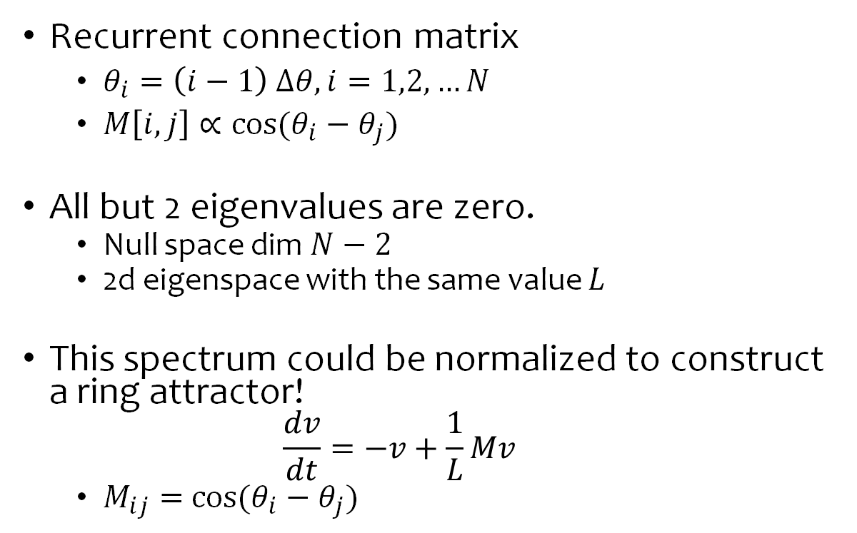
Spectral Analysis of Recurrent Matrix
Recurrent connection matrix
  $θ_{i}=\left(i−1\right) Δθ, i=1,2,…N$
  $M\left[i,j\right]∝cos⁡(θ_{i}−θ_{j})$
All but 2 eigenvalues are zero.
  Null space dim $N−2$
  2d eigenspace with the same value $L$
This spectrum could be normalized to construct a ring attractor!
  $$\frac{dv}{dt}=−v+\frac{1}{L}Mv$$
  $M_{ij}=$ $cos⁡(θ_{i}−θ_{j})$
Notes:
Eigenvectors form a 2d space
$sin$ and $cos$ basis for the circular attractor.

Slide 9
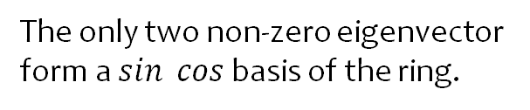
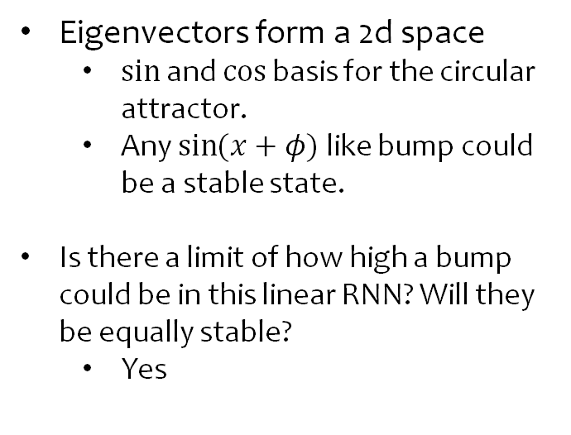
Eigen Structure of a Linear Ring Attractor Model
Eigenvectors form a 2d space
  $sin$ and $cos$ basis for the circular attractor.
  Any $\sin{(x+φ)}$ like bump could be a stable state.
Is there a limit of how high a bump could be in this linear RNN? Will they be equally stable?
  Yes
%Matlab simulation code
prefang = 0:pi/50:pi-0.0001;
angdiff = prefang - prefang';
wmat = cos(angdiff);
[evc,eva] = eig(wmat);
Neuro120_tutorials/RingAttractorEigs.m at master · Animadversio/Neuro120_tutorials
The only two non-zero eigenvector form a $\sin{cos}$ basis of the ring.

Slide 10
How Ring Attractor Track the Change in Head Direction?
How Ring Attractor Memorize the State of Head Direction?
How to design a circuit that takes in turning information and move the bump

Slide 11
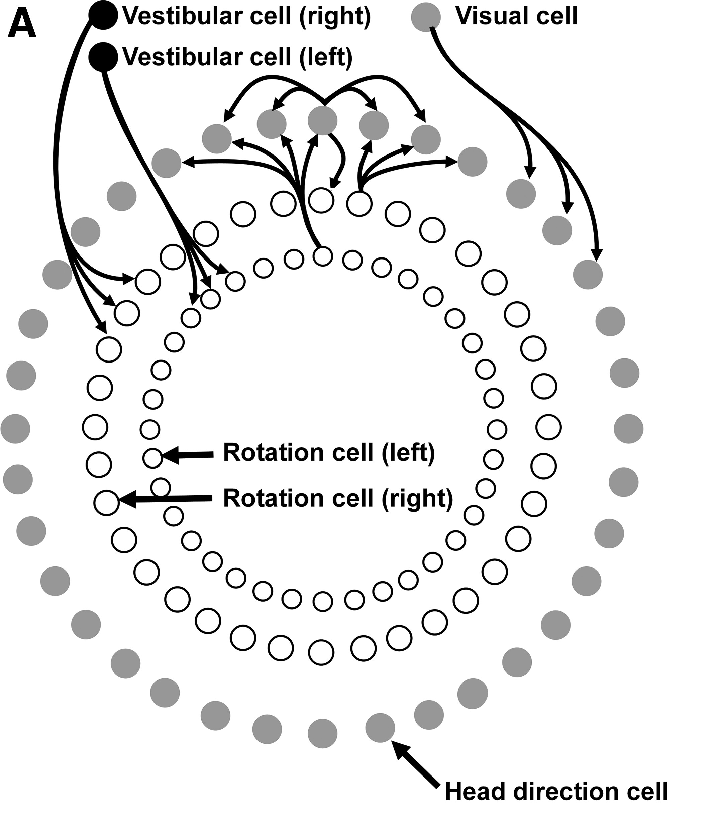
How the bump move when the animal turn:
Model for Mouse
Vestibular system sense acceleration
  Push / pull the bump of activity along the attractor.
Visual system find anchors for head direction.
  Pin down certain directions.
Skaggs, W. E., Knierim, J. J., Kudrimoti, H. S. & McNaughton, B. L. A model of the neural basis of the rat’s sense of direction. Adv. Neural Inf. Process. Syst. 7, 173–180 (1995)
https://doi.org/10.1152/jn.00501.2017

Slide 12
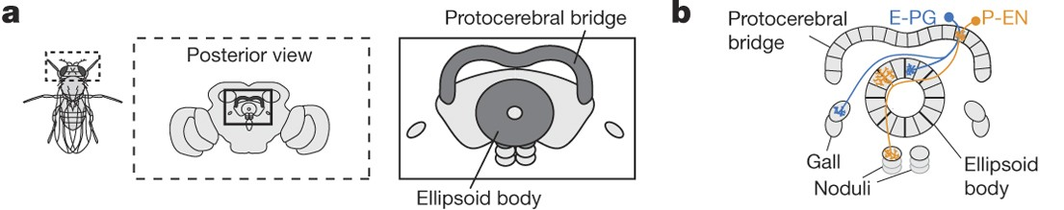
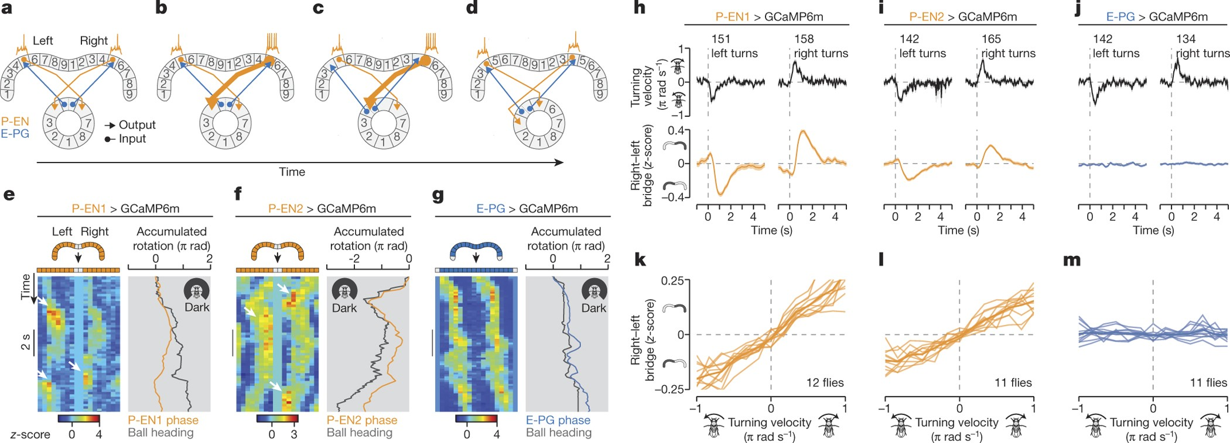
How the bump move when the animal turn:
Circuit Anatomy for Fly
Anatomy of projections
Notes:
E-PG and P-EN neurons.
E-PGs (ellipsoid body-protocerebral bridge-gall neurons,)
P-ENs (protocerebral bridge-ellipsoid body-noduli neurons
left- and right-bridge P-ENs project clockwise and anticlockwise, respectively, to the ellipsoid body
E-PGs, on the other hand, project without shifting from the ellipsoid body to the bridge

Slide 13
How the bump move when the animal turn:
Model and Data for Fly
A neural circuit architecture for angular integration in Drosophila | Nature 2017
Notes:
In linking this anatomical work to our physiological observations, we noticed that left- and right-bridge P-ENs project clockwise and anticlockwise, respectively, to the ellipsoid body.
E-PGs, on the other hand, project without shifting from the ellipsoid body to the bridge
For example, assuming that there are reciprocally excitatory interactions between E-PGs and P-ENs, E-PG activity in tile 5 of the ellipsoid body would activate P-EN cells in glomerulus 5 in both the left and right bridge

Slide 14
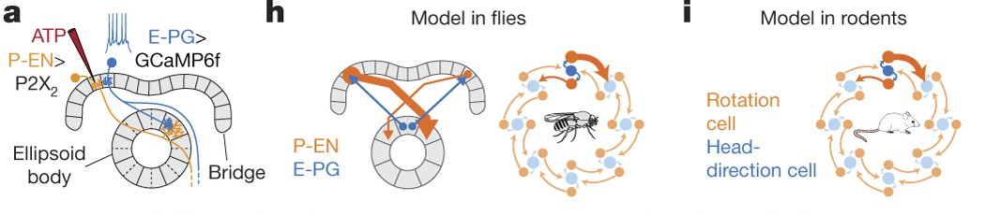
Striking Consistence between Model and Reality

Slide 15
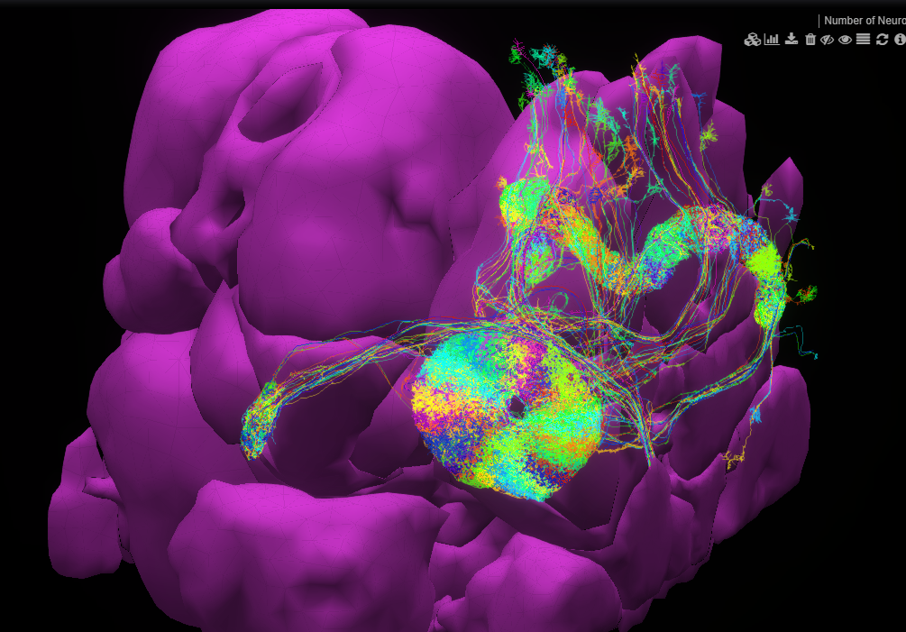
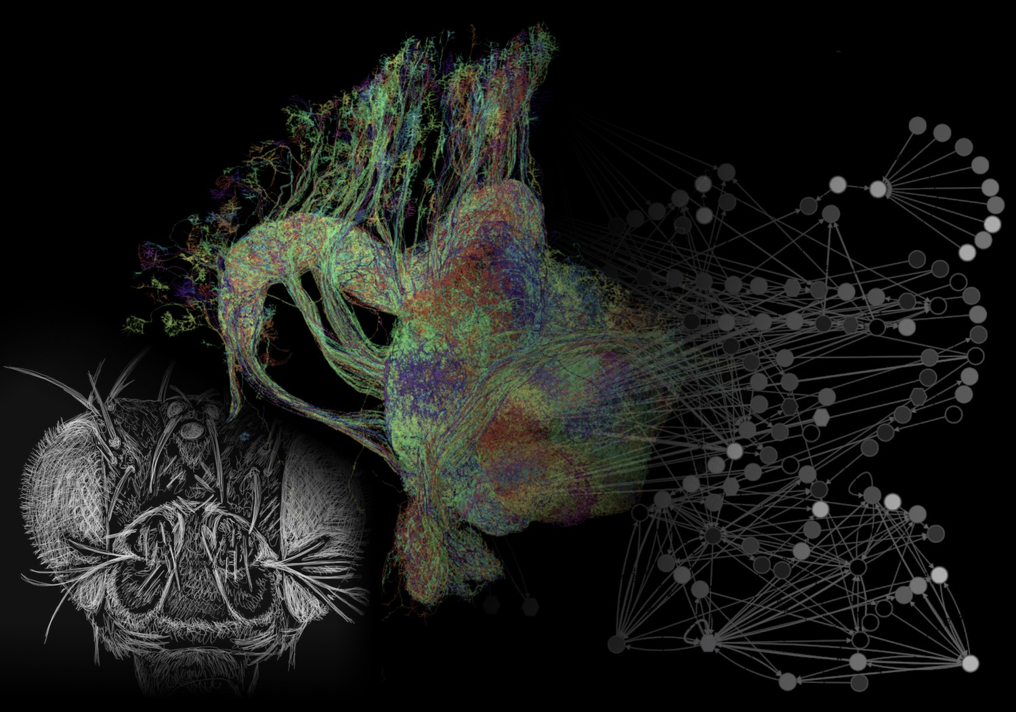
This Circuit is Breathtakingly Beautiful.
NeuroNLP.Hemibrain (fruitflybrain.org)
Notes:
NeuroNLP.Hemibrain (fruitflybrain.org) NeuroNLP.Hemibrain (fruitflybrain.org)

Slide 16
Hopfield Network

Slide 17
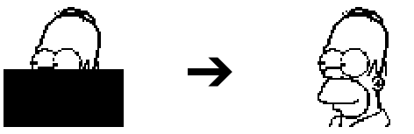
Desirable Properties of Long-Term Memory Model
Content addressable
  Part of pattern -> Whole pattern
  Could recover from corruption, noise resistant.
  Auto-associative

Slide 18
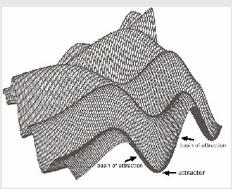
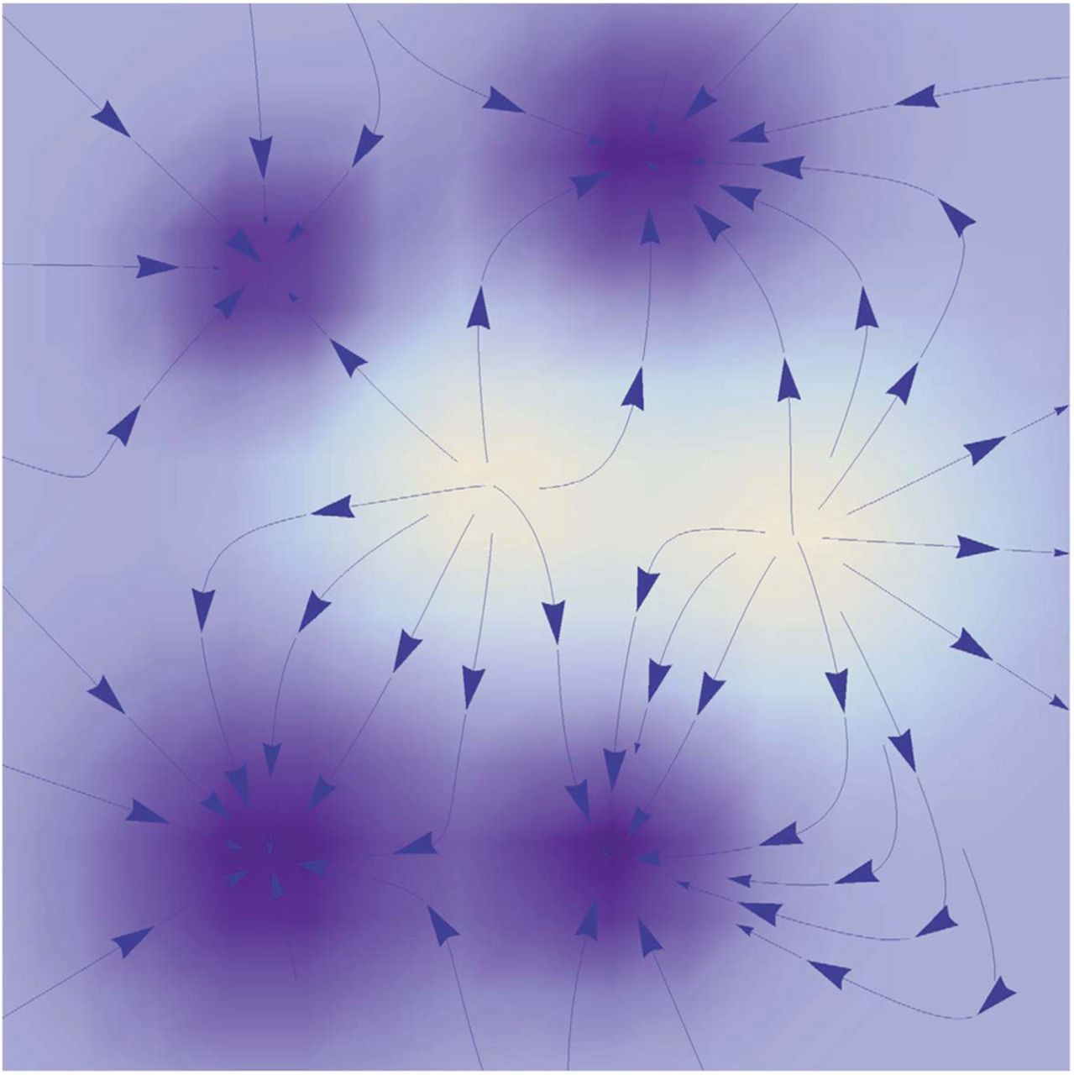
Insights of Hopfield Network
Memorized patterns as attractors states.
Memory retrieval as converging to attractor.
  The dynamics / update rule follows an energy landscape.
  Memory stores at the maximum / minimum

Slide 19

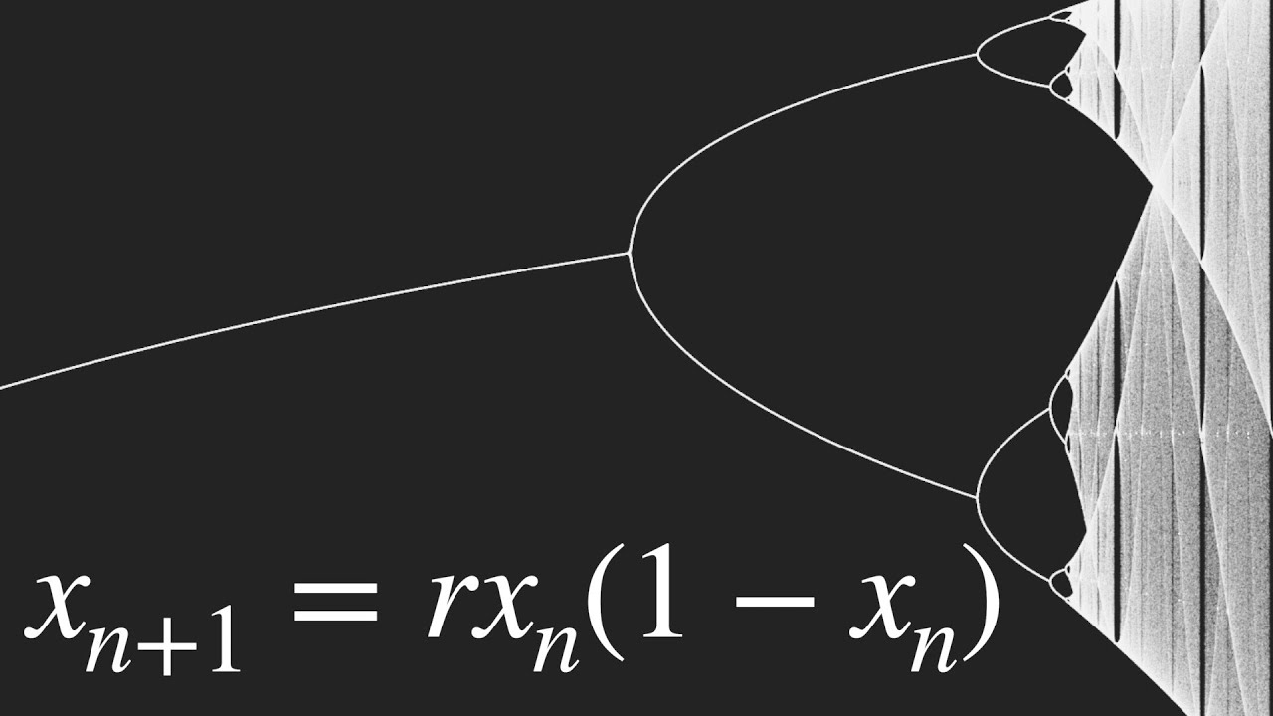
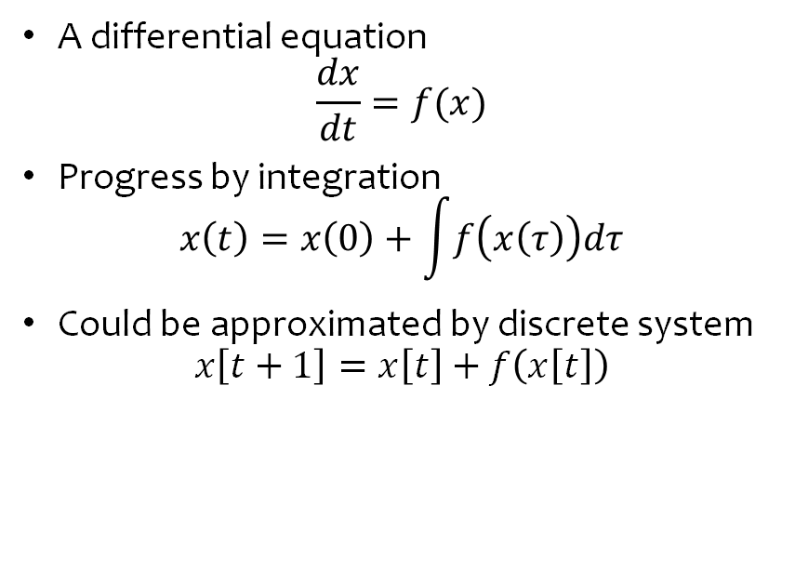

Discrete vs Continuous Dynamic System
Continuous System
Discrete System
A differential equation
$$\frac{dx}{dt}=f(x)$$
Progress by integration
$$x\left(t\right)=x\left(0\right)+\int{f\left(x\left(τ\right)\right)dτ}$$
Could be approximated by discrete system
$$x\left[t+1\right]=x\left[t\right]+f\left(x\left[t\right]\right)$$
A mapping
$$X\left[t+1\right]=F\left(X\left[t\right]\right)$$
Progress by iteratively applying the map
$$X\left[t+1\right]=F(F(F(…F(X\left[0\right]))))$$
Notes:
If you take a course in ds, first distinction.
But the results in the two types of systems could be translated.

Slide 20
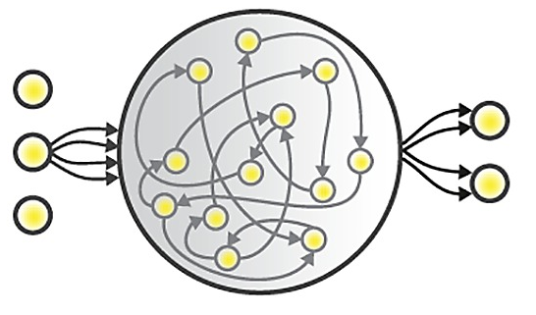
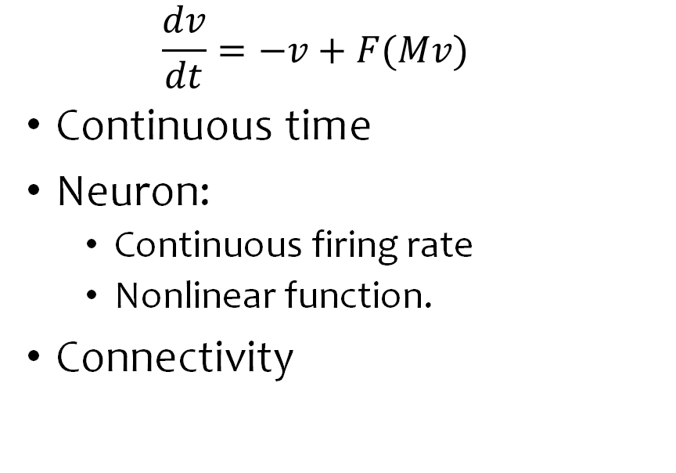
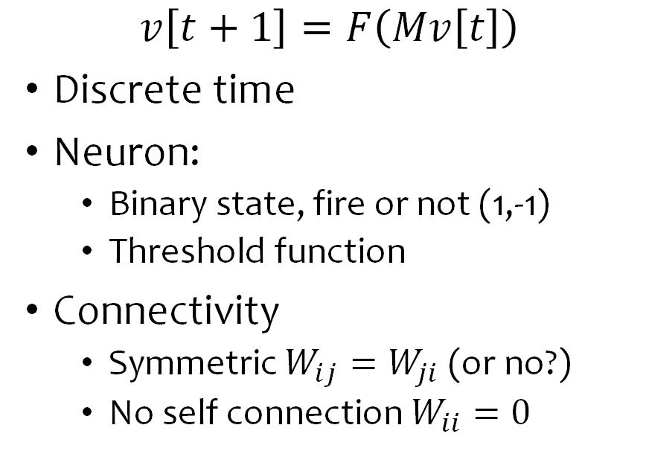
Hopfield Network vs RNN
Recurrent neural network
Hopfield network
  $$\frac{dv}{dt}=−v+F(Mv)$$
Continuous time
Neuron:
  Continuous firing rate
  Nonlinear function.
Connectivity
$$v\left[t+1\right]=F\left(Mv\left[t\right]\right)$$
Discrete time
Neuron:
  Binary state, fire or not (1,-1)
  Threshold function
Connectivity
  Symmetric $W_{ij}=W_{ji}$ (or no?)
  No self connection $W_{ii}=0$
Notes:
To our concrete

Slide 21
Could we model Long-Term Memory by Linear RNN?
Or can Linear RNN store patterns in its attractors?
  No, recall that linear RNN has 1 or infinite stable state.
  All the stable fix points are linearly connected.
  You don’t want a memory to interpolate two.

Slide 22
Neuron View of Hopfield Network: RNN

Slide 23
Pattern View of Hopfield Network: Pattern Space

Slide 24

How to Learn / Build a Hopfield Network
How to set a state as attractor / stable fixed point?

Slide 25
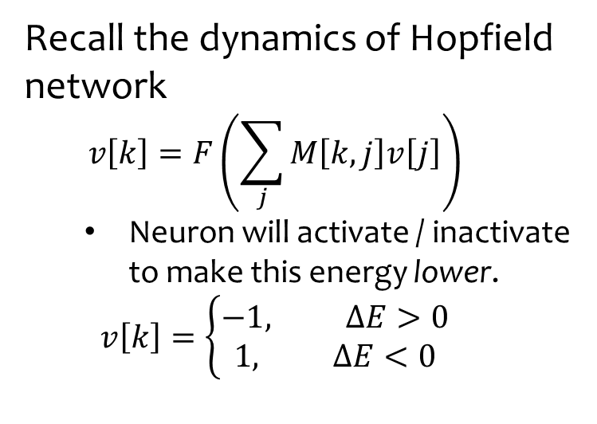
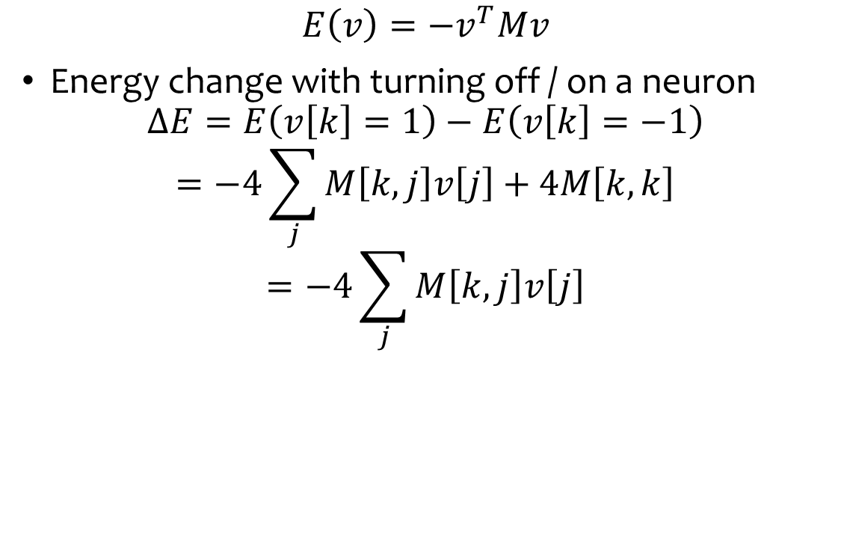
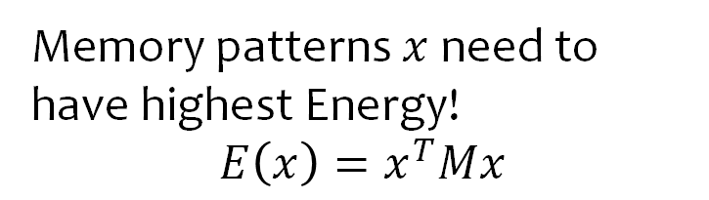
Energy Function of a Hopfield Network
$$E\left(v\right)=−v^{T}Mv$$
Energy change with turning off / on a neuron
$$ΔE=E\left(v\left[k\right]=1\right)−E\left(v\left[k\right]=−1\right)$$
$$=−4\sum_{j}{M\left[k,j\right]v\left[j\right]}+4M\left[k,k\right]$$
$$=−4\sum_{j}{M\left[k,j\right]v\left[j\right]}$$
Recall the dynamics of Hopfield network
  $$v\left[k\right]=F\left(\sum_{j}{M\left[k,j\right]v\left[j\right]}\right)$$
  Neuron will activate / inactivate to make this energy lower.
  $$v\left[k\right]=\left\{\begin{aligned}−1, ΔE>0 \\ &1, ΔE<0\end{aligned}\right.$$
Memory patterns $x$ need to have highest Energy!
$$E\left(x\right)=x^{T}Mx$$

Slide 26
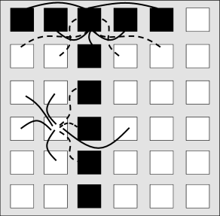
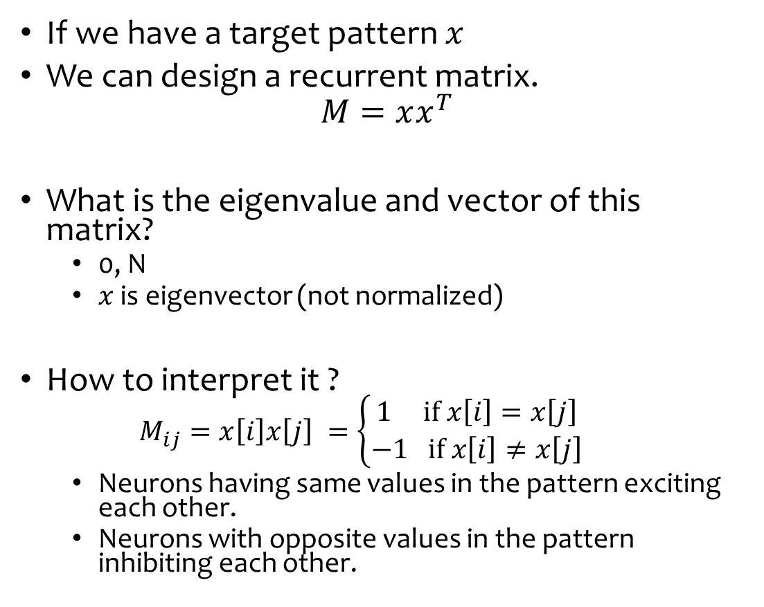
Demo: Manual Encoding a Single Memory
If we have a target pattern $x$
We can design a recurrent matrix.
$$M=xx^{T}$$
What is the eigenvalue and vector of this matrix?
  0, N
  $x$ is eigenvector (not normalized)
How to interpret it ?
  $$M_{ij}=x\left[i\right]x\left[j\right] =\left\{\begin{aligned}1 if x\left[i\right]=x\left[j\right] \\ −1 if x\left[i\right]≠x\left[j\right]\end{aligned}\right.$$
  Neurons having same values in the pattern exciting each other.
  Neurons with opposite values in the pattern inhibiting each other.

Slide 27
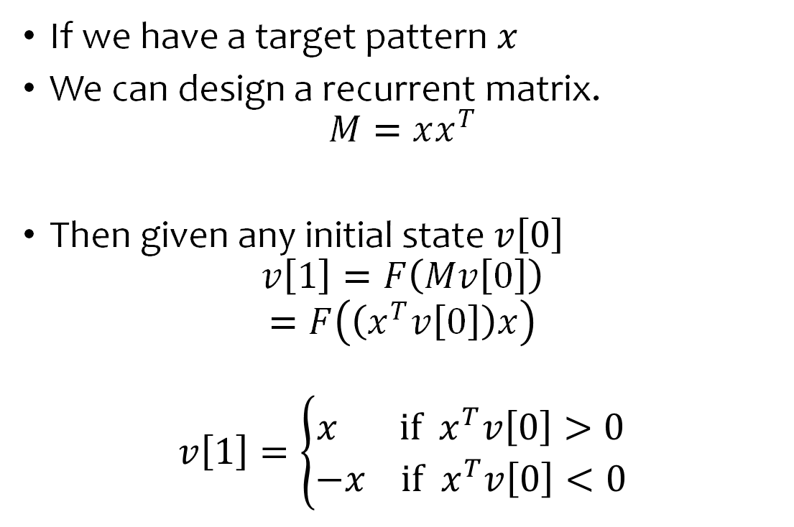
Demo: Manual Encoding a Single Memory
If we have a target pattern $x$
We can design a recurrent matrix.
$$M=xx^{T}$$
Then given any initial state $v\left[0\right]$
$$v\left[1\right]=F\left(Mv\left[0\right]\right)$$
$$=F\left(\left(x^{T}v\left[0\right]\right)x\right)$$
$$v\left[1\right]=\left\{\begin{aligned}x if x^{T}v\left[0\right]>0 \\ −x if x^{T}v\left[0\right]<0\end{aligned}\right.$$
Given a single memory, any initial state will converge to that memory or it’s antipodes memory !
A good start

Slide 28
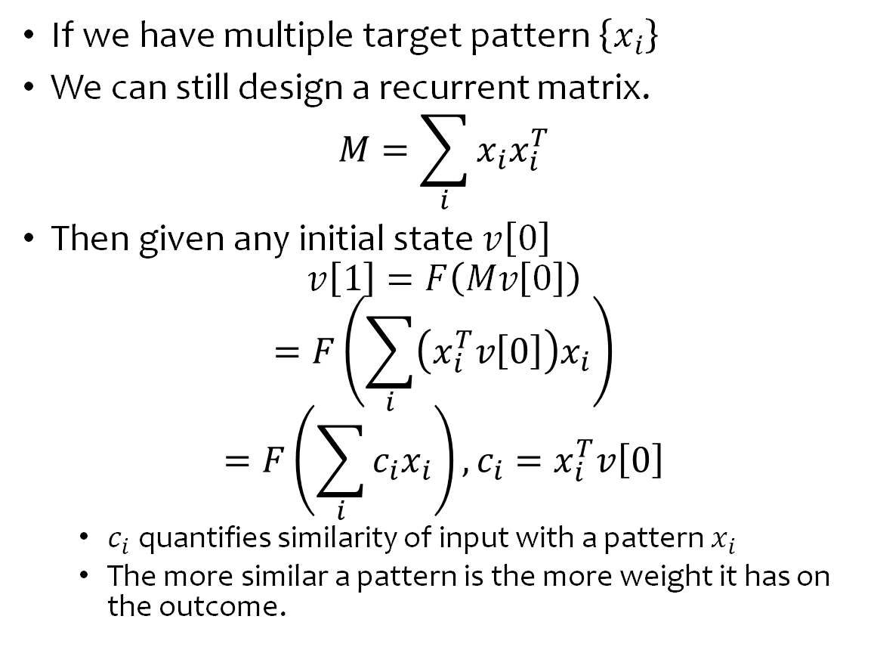
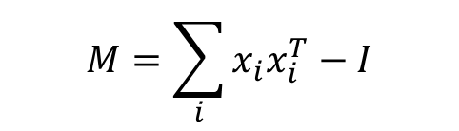
Demo: Encoding Multiple Memories
If we have multiple target pattern $\left\{x_{i}\right\}$
We can still design a recurrent matrix.
$$M=\sum_{i}{x_{i}x_{i}^{T}}$$
Then given any initial state $v\left[0\right]$
$$v\left[1\right]=F\left(Mv\left[0\right]\right)$$
$$=F\left(\sum_{i}{\left(x_{i}^{T}v\left[0\right]\right)x_{i}}\right)$$
$$=F\left(\sum_{i}{c_{i}x_{i}}\right), c_{i}=x_{i}^{T}v\left[0\right]$$
  $c_{i}$ quantifies similarity of input with a pattern $x_{i}$
  The more similar a pattern is the more weight it has on the outcome.
$$M=\sum_{i}{x_{i}x_{i}^{T}−I}$$
General lesson
Non-correlated memory patterns are easier to store, less likely to interfere.
Similar / correlated memory pattern can interfere and create amalgamates.
Not necessarily converge to the good memory.
Notes:
Original design in Hopfield paper.

Slide 29
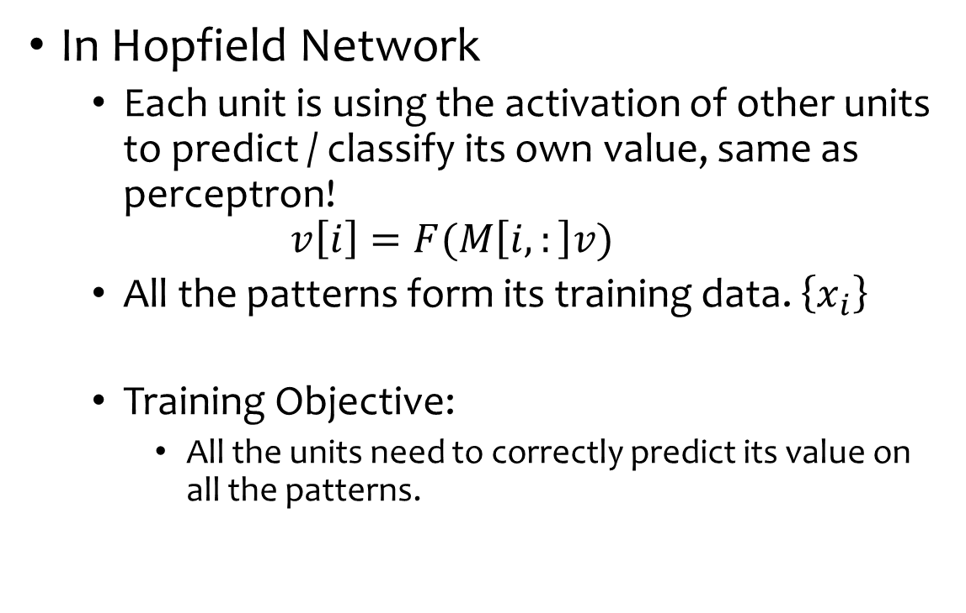
Hopfield network as an Array of Perceptrons
In Hopfield Network
  Each unit is using the activation of other units to predict / classify its own value, same as perceptron!
  $$v\left[i\right]=F(M\left[i,:\right]v)$$
  All the patterns form its training data. $\left\{x_{i}\right\}$
  Training Objective:
    All the units need to correctly predict its value on all the patterns.
This philosophy is similar to the modern transformer architecture. Deeply related.

Slide 30
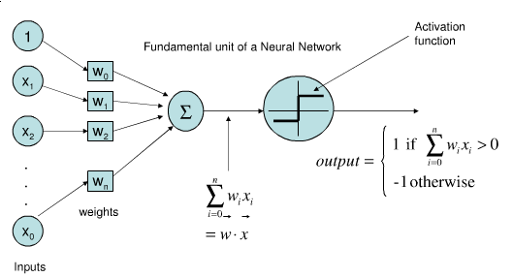
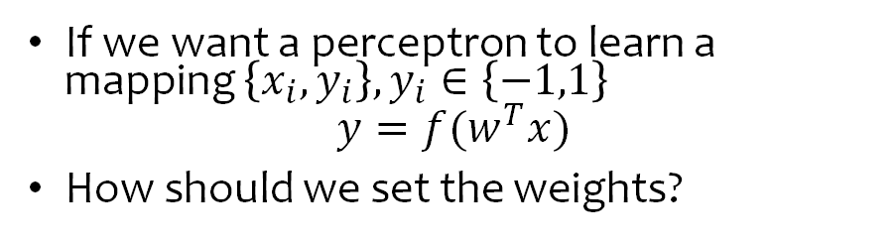
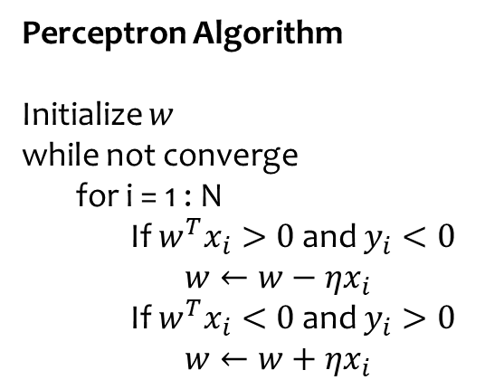
Digression: How perceptron learn?
Perceptron
If we want a perceptron to learn a mapping $\left\{x_{i},y_{i}\right\}, y_{i}∈\left\{−1,1\right\}$
$$y=f(w^{T}x)$$
How should we set the weights?
Perceptron Algorithm
Initialize $w$
while not converge
for i = 1 : N
If $w^{T}x_{i}>0$ and $y_{i}<0$
$w←w−ηx_{i}$
If $w^{T}x_{i}<0$ and $y_{i}>0$
$w←w+ηx_{i}$

Slide 31
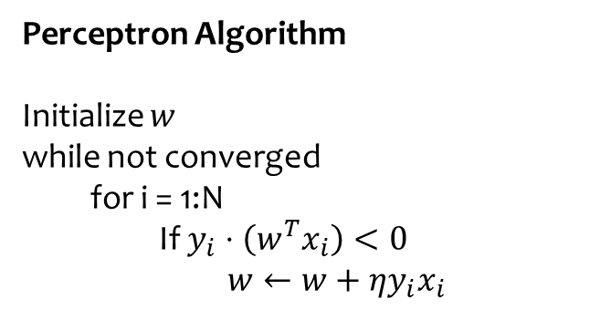
Digression: How perceptron learn?
Perceptron
This algorithm can be written more concisely
Perceptron Algorithm
Initialize $w$
while not converged
  for i = 1:N
    If $y_{i}⋅\left(w^{T}x_{i}\right)<0$
      $$w←w+ηy_{i}x_{i}$$

Slide 32
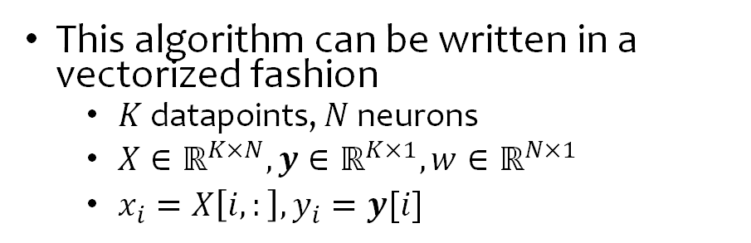
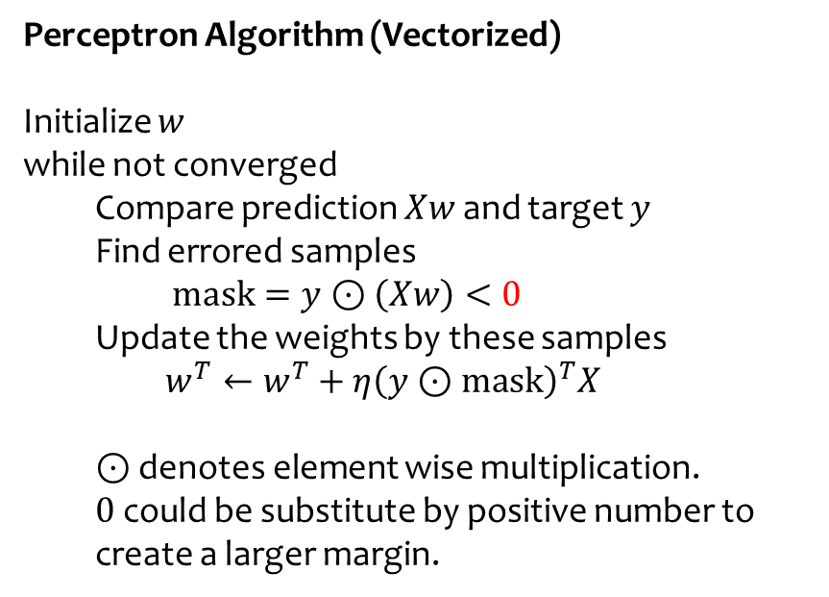
Digression: How perceptron learn?
This algorithm can be written in a vectorized fashion
  $K$ datapoints, $N$ neurons
  $X∈ℝ^{K×N},y∈ℝ^{K×1},w∈ℝ^{N×1}$
  $x_{i}=X\left[i,:\right], y_{i}=y[i]$
Perceptron
Perceptron Algorithm (Vectorized)
Initialize $w$
while not converged
  Compare prediction $Xw$ and target $y$
  Find errored samples
    $$mask=y⊙\left(Xw\right)<0$$
  Update the weights by these samples
  $$w^{T}←w^{T}+η{\left(y⊙mask\right)}^{T}X$$
  $⊙$ denotes element wise multiplication.
  $0$ could be substitute by positive number to create a larger margin.

Slide 33
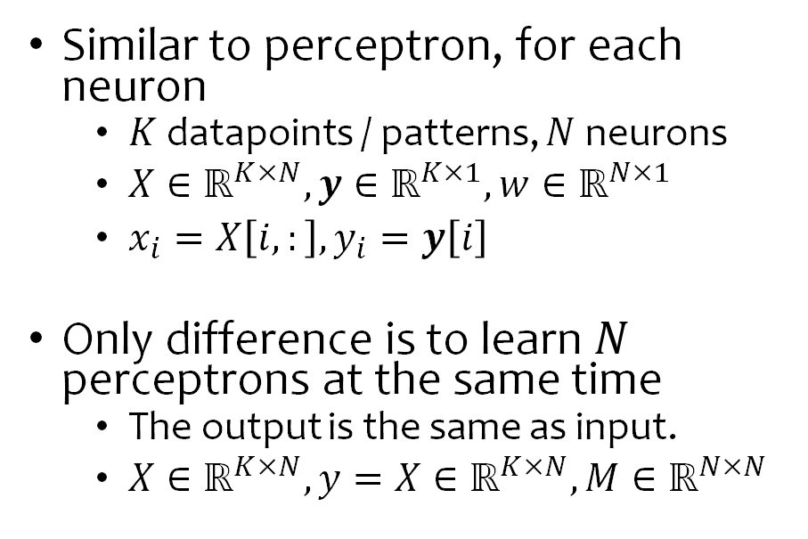
Hopfield network as an Array of Perceptrons
Similar to perceptron, for each neuron
  $K$ datapoints / patterns, $N$ neurons
  $X∈ℝ^{K×N},y∈ℝ^{K×1},w∈ℝ^{N×1}$
  $x_{i}=X\left[i,:\right], y_{i}=y\left[i\right]$
Only difference is to learn $N$ perceptrons at the same time
  The output is the same as input.
  $X∈ℝ^{K×N},y=X∈ℝ^{K×N},M∈ℝ^{N×N}$

Slide 34
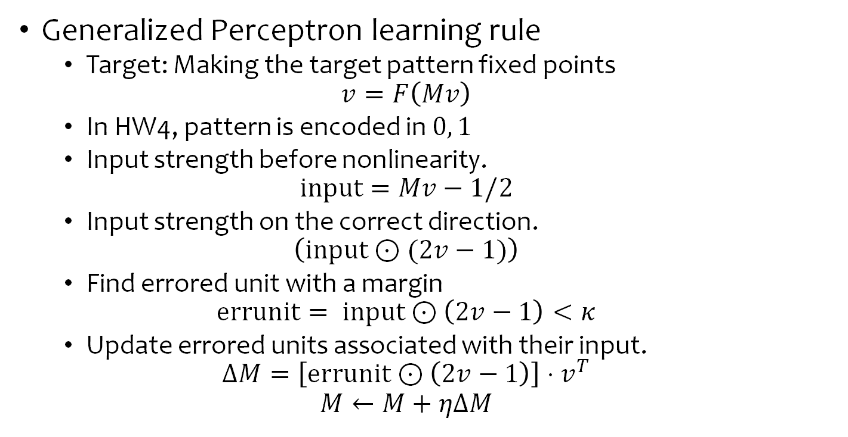
Perceptron Learning Algorithm for Hopfield Network
Generalized Perceptron learning rule
  Target: Making the target pattern fixed points
  $$v=F\left(Mv\right)$$
  In HW4, pattern is encoded in $0, 1$
  Input strength before nonlinearity.
  $$input=Mv−1/2$$
  Input strength on the correct direction.
  $$\left(input⊙(2v−1)\right)$$
  Find errored unit with a margin
  $$errunit= input⊙\left(2v−1\right)<κ$$
  Update errored units associated with their input.
  $$ΔM=\left[errunit⊙\left(2v−1\right)\right]⋅v^{T}$$
  $$M←M+ηΔM$$
Notes:
Previous rules to get weight matrices are one shot and not guanranteed to be optimal.
So people come up with error driven way to get the weight matrix iteratively, little by little.

Slide 35
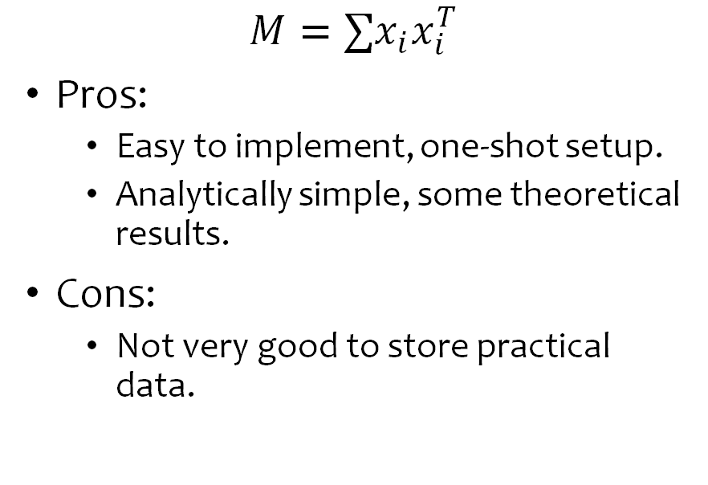
Ways to Design Hopfield Network Weights
Error Driven Learning
Prescription / Hand-Design
Methods
  Generalized Perceptron Learning
  Backpropagation
Cons:
  Takes longer time to train. Harder to implement. More tuning.
  No analytical solution.
Pros
  Better in storage and retrieval.
$$M=∑x_{i}x_{i}^{T}$$
Pros:
  Easy to implement, one-shot setup.
  Analytically simple, some theoretical results.
Cons:
  Not very good to store practical data.

Slide 36

Memory as Stable Fixed point
For memory $μ_{i}$
$$μ_{i}=F(Mμ_{i})$$
$M=\sum_{i}{μ_{i}μ_{i}^{T}}$

Slide 37
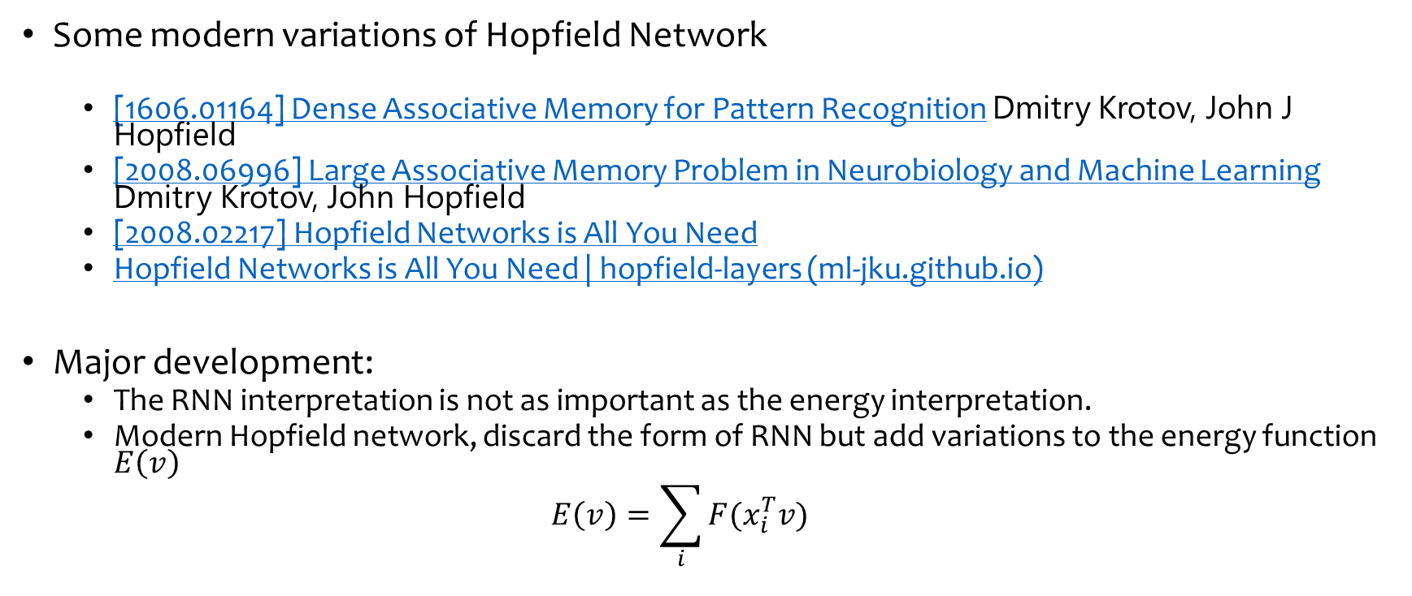
Hopfield Network is classic and not dead…
Some modern variations of Hopfield Network
  [1606.01164] Dense Associative Memory for Pattern Recognition Dmitry Krotov, John J Hopfield
  [2008.06996] Large Associative Memory Problem in Neurobiology and Machine Learning Dmitry Krotov, John Hopfield
  [2008.02217] Hopfield Networks is All You Need
  Hopfield Networks is All You Need | hopfield-layers (ml-jku.github.io)
Major development:
  The RNN interpretation is not as important as the energy interpretation.
  Modern Hopfield network, discard the form of RNN but add variations to the energy function $E\left(v\right)$
  $$E\left(v\right)=\sum_{i}{F(x_{i}^{T}v)}$$

Slide 38
Modern Hopfield Network

Slide 39
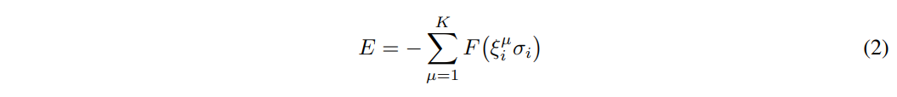
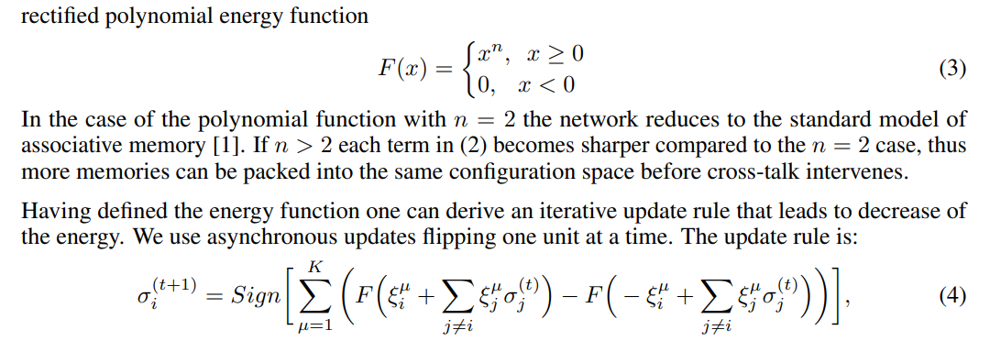
Additive Energy model

Slide 40
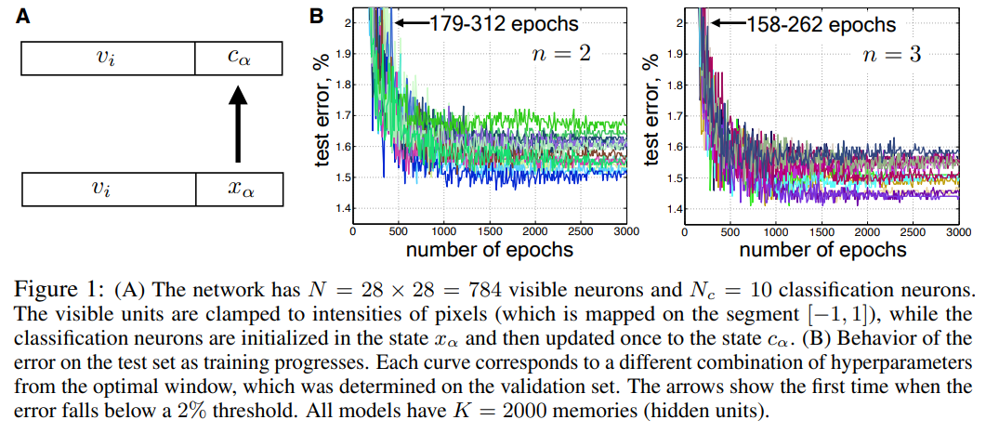
Associative Memory Model can also do pattern classification
Notes:
This objective function is then minimized using a backpropagation algorithm. The learning starts with random memories drawn from a Gaussian distribution. The backpropagation algorithm then finds a collection of K memories ξ µ i,α,

Slide 41
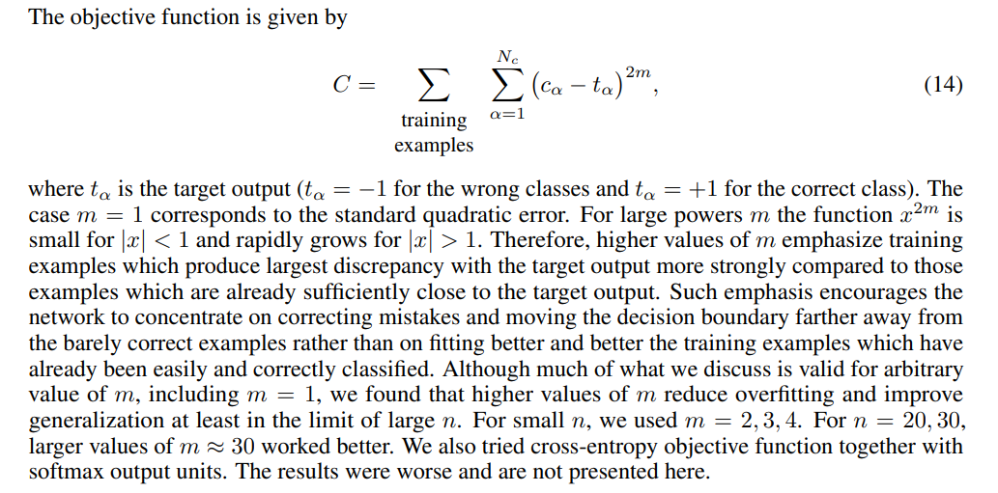

Slide 42
Results of Different Learning Algorithm

Slide 43
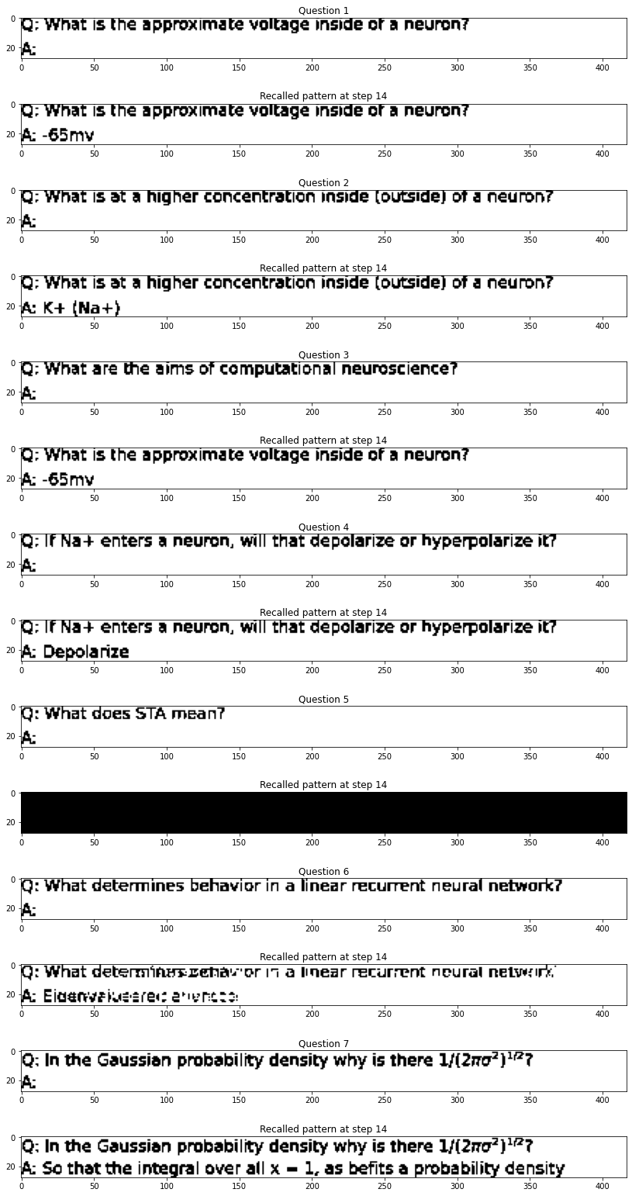
Perceptron learning rule (kappa=0.5)

Slide 44
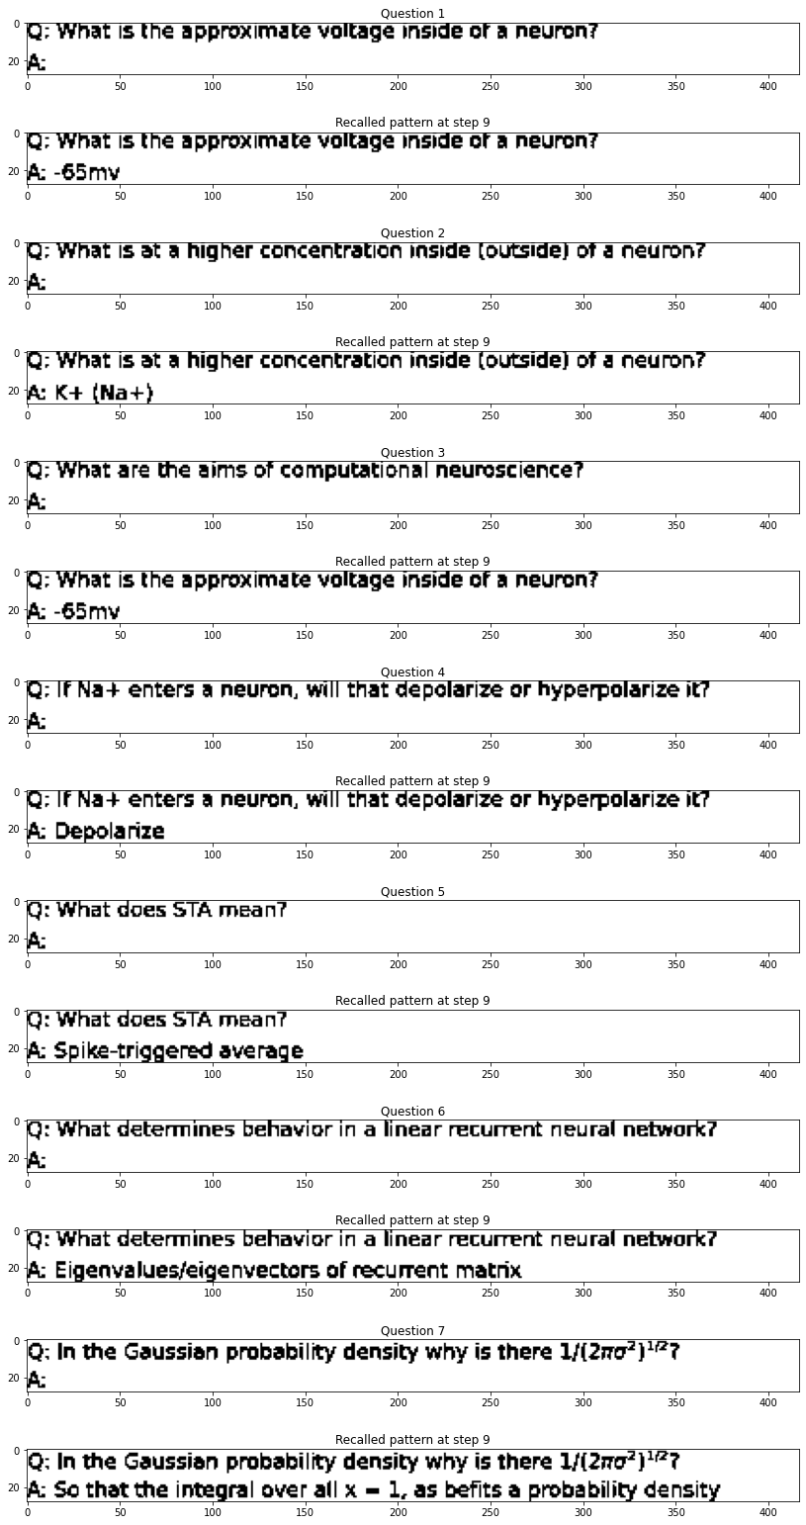
Perceptron Learning Rule with a larger (kappa =1)
Notes:
81732
40637
28475
20930
20986
18868
18762
19569
17136
13520
12326
11531
9584
7641
6279
5068
3701
3045
3145
1970
1309
483
572
322
224
34
0

Slide 45
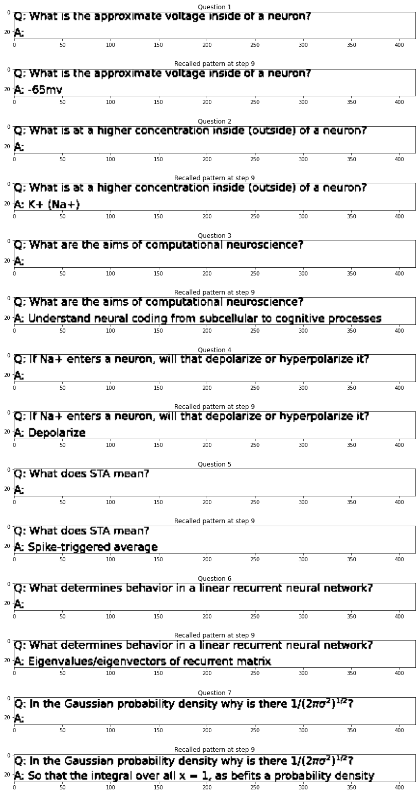
Larger Margin and Larger Learning Rate (eta = 1e-2; kappa = 10)

Slide 46
Perceptron learning rule with whitening
Notes:
12831
16516
10254
4495
2459
780
0

